Slide 1
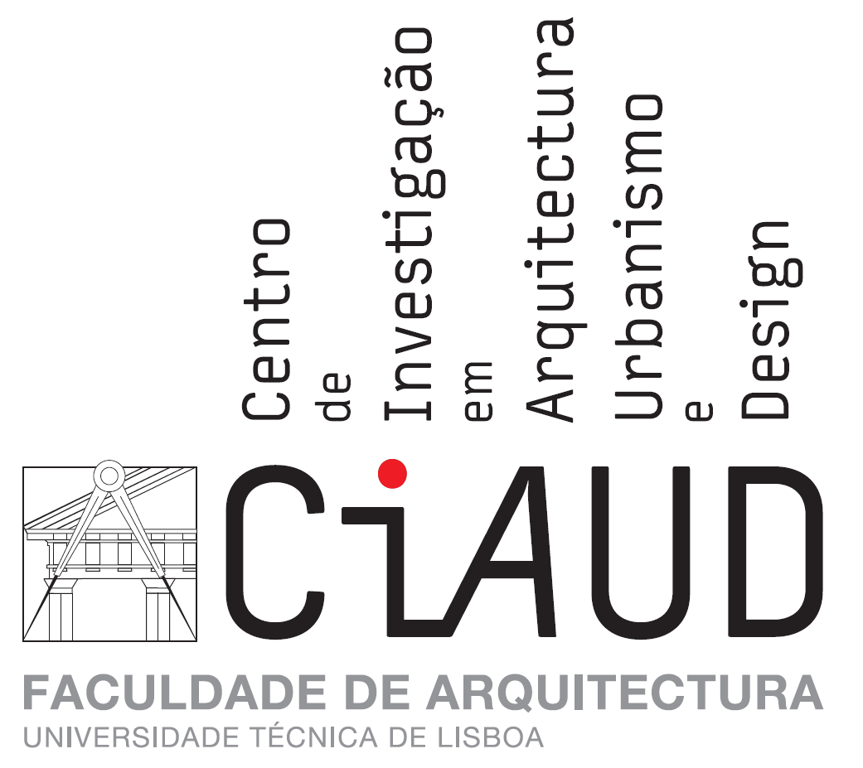
A COMMON RESEARCH AGENDA IN REAL ESTATE AT THE EUROPEAN FACULTIES OF ARCHITECTURE?
João Manuel Carvalho jmc@fa.ulisboa.pt
ERES Education Seminar, TU Delft, 27-28^{h} of November 2015
Rua Sá Nogueira | Pólo Universitário | Alto da Ajuda | 1349-055 Lisboa | +351 21 361 5000 | www.fa.ulisboa.pt

Slide 2
CONTEXT SPECIFICITY
The design of Real Estate products mostly falls on Architects, either for interior space organization under rehabilitation works, or for new buildings and the typological units within them, or for urban development.
Architects must be aware that for the most part of their interventions they are dealing with Real Estate. Looking for an explicit methodology for them to have this systematically into account seems important.
Business schools lead on Real Estate, but, as might be expected, under a financial point of view which either assumes a property in its present condition or quite indirectly provides gross guidelines for future improvements.
The only Real Estate School (1) in Portugal doesn’t have Architecure or Engineering design chairs. Its core relies on Real Estate valuation and facility / building management.

Slide 3
THE EUROPEAN FACULTIES OF ARCHITECTURE AS A MICROCOSMOS FOR REAL ESTATE EDUCATION
Real Estate as a specific knowledge domain is mostly Real Estate Development, i.e., the provision of new spaces to meet market demand and / or social needs. “New spaces” does of course include rehabilitation of pre-existing spaces.
The design of new spaces within Real Estate Development is a task for Architects. They can strongly contribute to reduce (or at least to control) the intrinsic risk of the developer’s business. Architects should get aware of this through their academic curriculum.
European Faculties of Architecture work within historically stable market economies with long-settled regulation on environment, either natural or built. This provides a specific framework for their relationship with Real Estate Development.
The uneasy academic status of Real Estate – which is contested either on ideological or on epistemological grounds – makes sensible the search for the integration of Real Estate within the acknowledged fields of science. Architecture and Real Estate Development may be a good clue for the purpose.

Slide 4
THE ROLE OF RESEARCH IN THE INTEGRATION ARCHITECTURE-REAL ESTATE
A recent survey of the “preferred” research (Architecture and Urbanism) at the Faculty of Architecture of the Lisbon University evidences no relation with Real Estate.
An effort to create categories that might shelter the “preferred” research gave the following outcome:
Architecture & Beaux Arts, Design Theory & Methodology, History of Architecture, Building Systems, Architecture & Sociology, Urban Design , Urban Planning, Architecture & Value (1 case)
Some years ago a published article by Franz Fuerst and Claudia Murray on the value of signature Architecture launched a path of research that did not gather much followers further on. It did however provide for a lot of questions concerning the relationship between Architecture and value.
On the Real Estate side those questions also need deepening – e.g., work on the value of real estate at golf resorts (Paloma once presented a paper on the subject at an ERES meeting) evidences the role of the urban layout, but no detailed design principles have been imported from the golf resorts analysis to value-searching urban design.

Slide 5
THE ROLE OF RESEARCH IN THE INTEGRATION ARCHITECTURE-REAL ESTATE (cont.)
Attracting Architects to Real Estate studies goes through the paths of design optimization and design value added. These paths question innovation as a means of achieving optimal and higher value architectural solutions.
Those research paths are compatible with the abovementioned categories, e.g.:
Architecture & Beaux Arts – how enhancing for the building value are the artistic works embedded?
Design Theory & Methodology – how to review sistematically prior design according to score or value assigned?
History of Architecture – how did landmarks behave vis à vis the real estate evolution?
Building Systems – how much “sustainability” may be suported by the market value of the building?
Architecture & Sociology – how to score or value different plan alternatives for the same space?
Urban Design – how flexible must the morfological matrix be to allow for value maximization in the long-term?
Urban Planning – how to incorporate into plan design the trade-offs derived from financially balanced plans?

Slide 6
THE COMMON REAL ESTATE RESEARCH AGENDA FOR THE EUROPEAN FACULTIES OF ARCHITECTURE
The seminal questions – What does Real Estate Development need to mitigate its product risk and how to achieve this through Architecture? What architectural design features should be present in real estate products in order to maximize their value added?
Too few experiments have taken place on finding the demand-sought features of space. This has to be done with large samples and based on designed elements (e.g., apartment plans). A common methodology could be adopted for the European space, as well as, partially, the logistics. Assigning scores or market values to architectural features seems to be a relevant research domain, though a wide one and requesting further monitoring through time.
This research would provide the background for a deeper integration between Architecture and Real Estate.
How far could European Faculties of Architecture cooperate on this? They would be serving a better use of natural and built resources, the efficiency of Real Estate Development and the employability of Architecture students.

Slide 7
SOME REFERENCES
Bentley, Ian (1999), Urban Transformations. Power, people and urban design, London, Routledge
de La Paz, Paloma Taltavul (2010), “The impact of golf courses on housing demand”, European Real Estate Society Annual Conference (17th), Milan
Fuerst, Franz et al. (2011), “Designer buildings; an evaluation of the economic value of signature architecture”, Environment and Planning A, 43 (1), pp.166-184
Remoy, Hilde; Wilkinson, Sara (2011), “Sustainability and office building conversions: a comparison of Dutch and Australian practices”, European Real Estate Society Annual Conference (18th), Eindhoven

Slide 8
APPENDIX – CATEGORIES AND THEIR RESEARCH THEMES
Architecture & Beaux Arts – Arts in Architecture, originality, authenticity
Design Theory & Methodology – Composition principles, theory of Architecture, innovation
History of Architecture – history, comparative studies, monographies
Building Systems – sustainability, structure rehabilitation
Architecture & Sociology – Architecture and participation, profession, education
Urban Design – morphology, urban patterns, urban design and mobility
Urban Planning – plan making, urban politics, mobility issues
Architecture and Value – housing plan optimization

