Slide 1
THE EFFECTS OF DEMOLITION
CONTROL PRECINCTS ON RESIDENTIAL
PROPERTY
VALUES
Jason Staines, The University of Queensland
Peter Elliott, The University of Queensland
Clive Warren, The University of Queensland

Slide 2
OVERVIEW
Research Problem and Question
Background and Literature Review
Development of Theoretical Framework and Hypotheses
Research Method and Data
Regression Analysis and Results
Research Implications

Slide 3
Research problem and question
The housing market is heavily regulated by multiple layers of external control.
The debate as to the ideal level and composition of regulations such as Demolition Control Precincts (DCPs) is ever present amongst governments, developers, environmentalists and property owners.
This paper proceeds on the basis that the existence of DCPs is not debated. This research interest lies with the effects of DCPs.
Previous research conducted has not provided a definitive explanation of the effects of DCPs on property values and the housing market in general (Heintzelman and Altieri 2013).
The impacts of historical preservation designation have not been empirically examined in Australia. Exploring and empirically testing the impacts are crucial.
The question, therefore, arises: What effects do municipal government urban planning regulations, and specifically historical preservation regulations have on the value of properties.
.

Slide 4
Background and literature review
Urban Planning, Regulation and Effects
Housing Markets and Segmentation
Demolition Control Precincts and Brisbane Housing
DCPs have been designated throughout Brisbane’s pre-war suburbs. Small patches of pre-war houses have been designated in some areas and almost entire suburbs designated in others. Figures1 and 2 next slide illustrate Brisbane DCPs.
Pre-war houses located in a DCP are subject to the City Plan Demolition Code (Code). The Code aims to maintain the character of traditional pre-war streetscapes by controlling demolition, relocation and removal of buildings that contribute to the character of Brisbane.
In addition to the Code, the Residential Design Character Code is a further measure that has the intention of retaining the traditional building character of Brisbane. This code ensures new building work including new houses and extensions are compatible in appearance with existing character buildings and the traditional character streetscape. The purpose of this code is to ensure new building work reflects or strengthens pre-war housing character through compatible form, scale, materials and detailing.
The DCP can benefit property owners by improving their predictions of future neighbourhood characteristics, protecting them from negative spatial externalities and maintaining a positive aesthetic.
Such benefits are juxtaposed against the restriction owners confront regarding alteration, demolition or development possibilities.
.

Slide 5
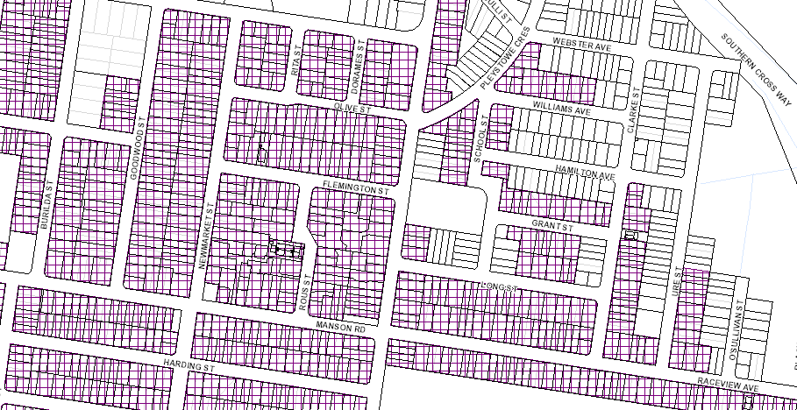
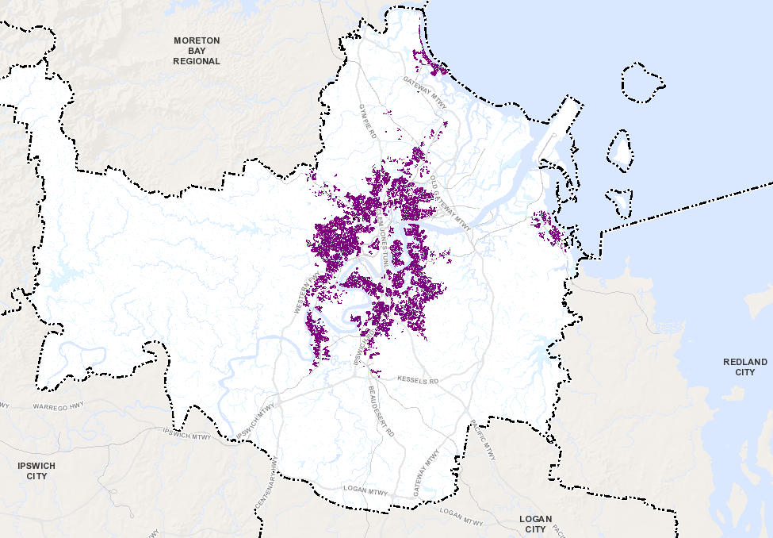
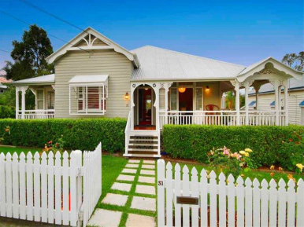
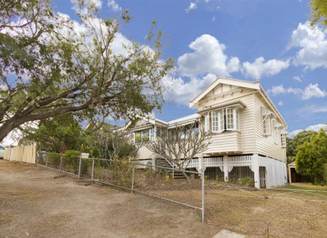
Demolition Control Precincts and Brisbane Housing

Slide 6
Development of Theoretical Framework and Hypotheses
The theoretical framework integrates the theories of urban planning regulation and urban housing market economics, and presents the hypotheses.
To determine the effects that DCPs have on properties designated, it is essential to make a comparison with properties that are not designated. Properties that are not designated in a DCP are not affected by the Code. Therefore, regardless of what improvements are on the property, it can be transformed into a vacant parcel at any time by removing or demolishing the existing improvements. These properties are not affected by restriction effects or scarcity effects.
Pre-war houses located in DCPs are affected by restriction effects and scarcity effects. Restriction effects occur as a potential higher and better use of the site is unachievable. This is a due to the Code which stipulates pre-war houses cannot be removed or demolished. As a result, these properties are unable to be transformed into vacant sites, reducing the supply of vacant land.
This situation is represented graphically using supply and demand curves. A decrease in supply, from S1 to S2, causes the equilibrium price to rise. Demand D1 is inelastic, it remains unchanged, due to two factors. First, positive amenity effects created by the DCP enhance the liveability and desirability. Second, vacant land outside of DCPs may not be considered an acceptable substitute. The difference between P1 and P2, represents the price premium buyers pay for vacant sites located in a DCP.
Notes:
To determine the effects that DCPs have on properties designated, it is essential to make a comparison with properties that are not designated. Properties that are not designated in a DCP are not affected by the Code. Therefore, regardless of what improvements are on the property, it can be transformed into a vacant parcel at any time by removing or demolishing the existing improvements. These properties are not affected by restriction effects or scarcity effects.
Pre-war houses located in DCPs are affected by restriction effects and scarcity effects. Restriction effects occur as a potential higher and better use of the site is unachievable. This is a due to the Code which stipulates pre-war houses cannot be removed or demolished. As a result, these properties are unable to be transformed into vacant sites, reducing the supply of vacant land.
This situation is represented graphically using supply and demand curves. A decrease in supply, from S1 to S2, causes the equilibrium price to rise. Demand D1 is inelastic, it remains unchanged, due to two factors. First, positive amenity effects created by the DCP enhance the liveability and desirability. Second, vacant land outside of DCPs may not be considered an acceptable substitute. The difference between P1 and P2, represents the price premium buyers pay for vacant sites located in a DCP.

Slide 7
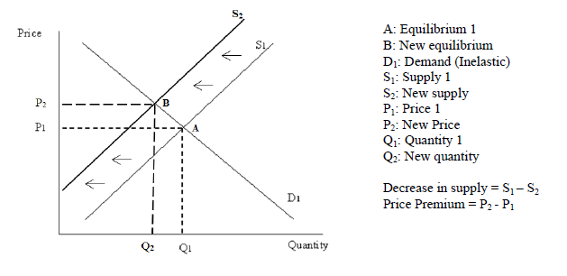
Development of Theoretical Framework and Hypotheses CONT’D.

Slide 8
Development of Theoretical Framework and Hypotheses CONT’D.
It is hypothesised that:
H1: DCPs reduce the number of residential sites capable of becoming vacant land. DCPs decrease the supply of residential vacant land.
H2: Vacant land that is not located in a DCP is not an acceptable substitute for vacant land located in a DCP.
H3: Demand for vacant land in a DCP is inelastic.
H4: The Brisbane vacant land market is segmented into two submarkets; vacant land in DCPs and vacant land not located in DCPs.
H5: Residential vacant land located in DCPs, will sell for a higher price, than a comparable site not located in a DCP.

Slide 9
Research Method and Data
Brisbane was selected as the geographical region to understand and research the effects of DCPs. In practical terms, Brisbane housing sales transaction data was available and accessible. Statutory site valuation data was also available from 2009 to 2013. As this study sought to investigate urban planning regulation in an Australian context, Brisbane was an acceptable location to examine. Brisbane is suitable as it generally follows neoclassical location theory. Brisbane has similar characteristics with other Australian cities including Sydney and Melbourne. These cities have comparable housing markets and urban planning frameworks. The findings of this thesis can be applied to other Australian housing markets, and prudently to international housing markets.

Slide 10
Research Method and Data CONT’D.
In order to successfully examine the effect of DCP designation on housing, a data set was required that contains sales of properties both inside and outside of DCPs. Vacant land is an acceptable form of housing to use to quantify the DCP designation effect, as the sale prices capture the embedded neighbourhood and regulatory site attributes. Vacant land sales data is considered ideal in answering the research question, as there are no improvements on the land. Therefore, there is no contention as to the value of any improvements, which is an issue commonly encountered in housing market research and property valuation.

Slide 11
Research Method and Data CONT’D.
Rosen’s (1974) hedonic price regression model was the method of analysis for the data. The hedonic model reveals the marginal implicit prices of heterogeneous attributes associated with property, including land-use restrictions and zoning.
The functional form chosen was the linear type, was found to provide the best fit for the data (Box and Tidwell 1962). An additional model functional form, log-log, was employed to illustrate the proportional effect of the DCP variable. The linear hedonic equation may be expressed as follows:-

Slide 12
Research Method and Data CONT’D.
The log-log hedonic equation (Used for DCPs in Outer suburbs: Manly, Wynnum, Sandgate, Shorncliffe) may be expressed as follows:
Where:

Slide 13
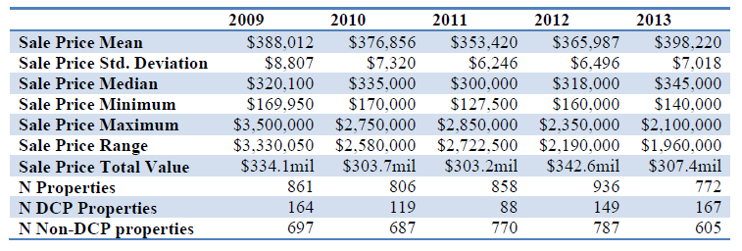
REGRESSION ANALYSIS AND RESULTS
Brisbane Residential Vacant Land Sales Descriptive Statistics 2009 - 2013

Slide 14
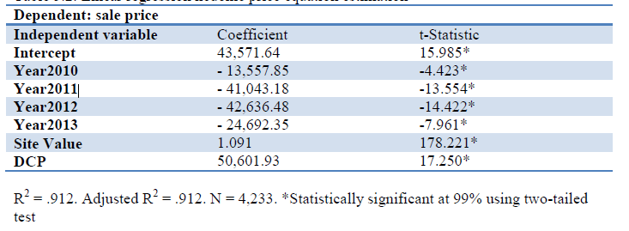
REGRESSION ANALYSIS AND RESULTS CONT’D.
Linear Regression Hedonic Price Equation Estimation

Slide 15
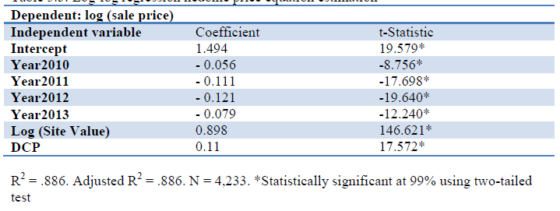
REGRESSION ANALYSIS AND RESULTS CONT’D.
Log-log Regression Hedonic Price Equation Estimation

Slide 16
REGRESSION ANALYSIS AND RESULTS CONT’D.
Hedonic Price Equation Estimation (Used for DCPs in Outer suburbs: Manly, Wynnum, Sandgate, Shorncliffe)

Slide 17
REGRESSION ANALYSIS AND RESULTS CONT’D.
Overview of Findings

Slide 18
Research FINDINGS
Past research has found that historic preservation designation has mixed effects on property values. The results of the three hedonic price regression models utilising Brisbane sale transactions are conclusive as to the effect of the DCPs. DCP designation has a significant positive effect on sale price. These results are consistent with THE THEORETICAL FRAMEWORK AND Hypotheses. The regression models provide a good fit to the data, with the independent variables explaining a high proportion of the variation in the sales prices. The models and independent variables are statistically significant at 99 percent level of confidence, and the coefficient signs conform to directional expectations
The linear regression found for a vacant site located in a DCP, the DCP designation increased the sales price by $50,600. Therefore it can be concluded that a vacant site located in a DCP is worth approximately $50,600 more in value than a comparable vacant site not located in a DCP. Similar findings are achieved for the other regression results.
DCP.

Slide 19
Research Implications
There are a number of important implications to the results. Preservationists and supporters of historical preservation measures understand the positive amenity effects generated. The findings deduce that in Brisbane considerable positive amenity effects are created in DCPs which appeal to a wide range of buyers. Critics of historic preservation measures, posit that such urban planning regulation negatively impact property values. The findings establish that such an affect may occur at an individual property level, potentially pre-war houses. The DCP regulations affect each submarket of the housing market differently. Overall, the positive amenity effects and scarcity effects outweigh any negatives; as designation enhances value.

Slide 20
Research Implications
The findings of this research that the Brisbane housing market is segmented and vacant land in DCPs attract a substantial price premium is significant to The Land Court of Queensland, property owners, Valuer General, financiers, buyers, real estate agents, developers and valuers.

