Slide 1
Dynamic Credit Partners
Dutch Mortgage Market

Slide 2
Disclaimer
The data and information used in the accompanying Analysis contained herein have been obtained from sources that Dynamic Credit Partners Europe BV (“Dynamic”) and/or its affiliates (collectively, the “Dynamic Group”) believe to be reliable, subject to change without notice, its accuracy is not guaranteed, and it may not contain all material information concerning the securities which may be the subject of the analysis. Neither Dynamic nor its affiliates make any representation regarding, or assume responsibility or liability for, the accuracy or completeness of, or any errors or omissions in, any information that is part of the analysis.
Dynamic may have relied upon certain quantitative and qualitative assumptions when preparing the analysis which may not be articulated as part of the analysis. The realization of the assumptions on which the analysis was based are subject to significant uncertainties, variabilities and contingencies and may change materially in response to small changes in the elements that comprise the assumptions, including the interaction of such elements. Furthermore, the assumptions on which the analysis was based may be necessarily arbitrary, may made as of the date of the analysis, do not necessarily reflect historical experience with respect to securities similar to those that may be the contained in the analysis, and does not constitute a precise prediction as to future events. Because of the uncertainties and subjective judgments inherent in selecting the assumptions and on which the analysis was based and because future events and circumstances cannot be predicted, the actual results realized may differ materially from those projected in the Analysis.
The Analysis is based in part on Dynamic’s interpretation of some of the applicable legal documentation for the transaction. The legal documentation for any structured product is complicated, may not cover all possible situations and may be subject to varying interpretations. Although Dynamic believes it has made a reasonable interpretation of the language in the applicable documents in conducting the Analysis, there can be no assurance that these interpretations are correct, are consistent with all other provisions within the documents, or that the documents would not be interpreted in materially different ways by a court or legal authority.
Nothing included in the analysis constitutes any representations or warranty by Dynamic as to future performance. No representation or warranty is made by Dynamic as to the reasonableness, accuracy or sufficiency of the assumptions upon which the analysis was based or as to any other financial information that is contained in the analysis, including the assumptions on which they were based.
Members of the Dynamic Group shall not be liable for (i) the accuracy or completeness of, or any errors or omissions in, any information contained in the analysis, (ii) any indirect, incidental consequential or special damages, or (iii) any other type of damages which may arise from your or any other party’s use of the data or analysis contained herein except to the extent such damages are found by a final judgment of a court to be solely caused by the willful misconduct, bad faith or gross negligence of Dynamic. Dynamic may own, or manage entities that may own, the securities that are subject to this analysis.
The information that contained in the analysis should not be construed as financial, legal, investment, tax, or other advice. You ultimately must rely upon your own examination and professional advisors, including legal counsel and accountants as to the legal, economic, tax, regulatory, or accounting treatment, suitability, and other aspects of the analysis. Dynamic does not assume any responsibility for investment decisions. Any of Dynamic’s analysis may be forwarded to your clients but must contain appropriate disclaimers per the paragraphs above.
This document is for informational purposes and does not constitute an offer to sell or buy any securities, and may not be relied upon in connection with any offer to sell or buy any securities.

Slide 3
Overview
Dutch mortgage market overview
Drivers of mortgage default

Slide 4
Main figures and indicators of the Netherlands
# Period
Population 16,778,025 December 2012
Households 7,512,824 2012
Housing 7,140,800 (100%) 2012
Rental 2,905,000 (40.7%) 2012
Social 2,114,900 (29.6%) 2012
Private 790,100 (11.1%) 2012
Owner-occupied 4,235,800 (59.3%) 2012
Mortgages 4,167,000 2009
Single product 2,907,000 (~50% I/O) 2009
Multiple product 1,259,000 (~75% I/O) 2009
Average House Price €210,384 February 2013
Average Mortgage €248,416 February 2013
Economic growth (y-o-y) -0.9% 4th Quarter 2012
Unemployment, seasonally adjusted 7.7% February 2013
Consumer confidence -44 February 2013
Inflation 3.0% February 2013
Sources: Central Bureau of Statistics (2013), Kadaster (2013),
WoON 2012 (2013), Bureau for Economic Policy Analysis (2013)
Notes:
Notes:
Mortgages outstanding – new numbers come out in April in WoON 2012
Around 300-400k houses are unoccupied (reasons: for sale/rent, renovation, ready for demolishment; 1 januari 2011 375K unoccipied)
Sources:
Inflation: http://statline.cbs.nl/StatWeb/publication/?DM=SLNL&PA=71311ned&D1=0,4&D2=0&D3=129,142,155,168,181,194,219,232&HDR=G1,T&STB=G2&VW=T

Slide 5
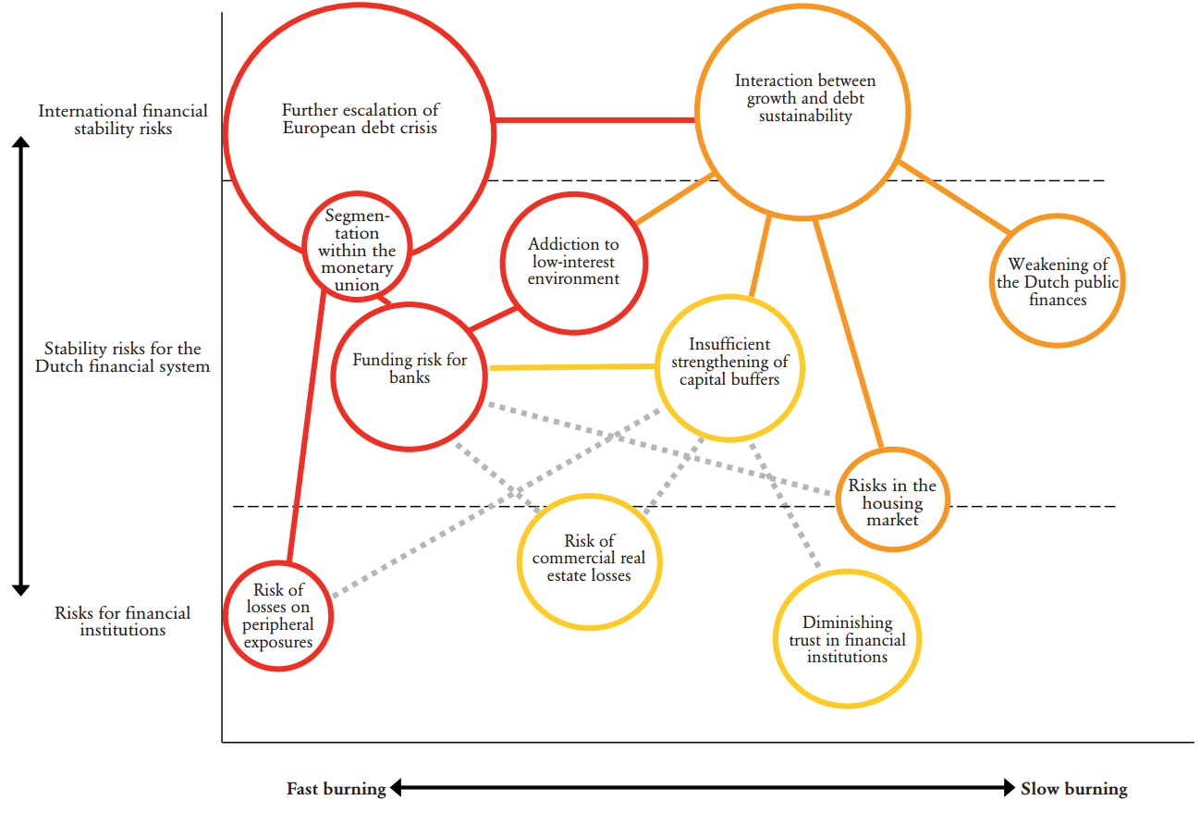
Dutch Mortgage Market Within the Broader Economic Landscape
Risks in the housing market
Source: DNB, Oct 2012
Notes:
In October 2012 the financial stability report showed the following graph

Slide 6
Dutch Household Suffer from Heavy Debt Burdens
Household Debt vs. Sovereign Debt
Source: Eurostat, 2011

Slide 7
Housing prices will continue to fall from the pre-crisis peak
House price bubble has yet to fully disappear
in the 12 years before the house price peak: Consumer price inflation: +33% Income growth: +55% House price increase: +160%
US house prices increased by only 135% in the 12 years before their housing peak…
Notes:
Voorjaar 2012 grafieken DNB ipv rechtergrafiek

Slide 8
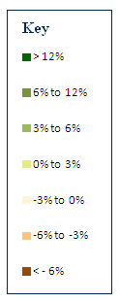
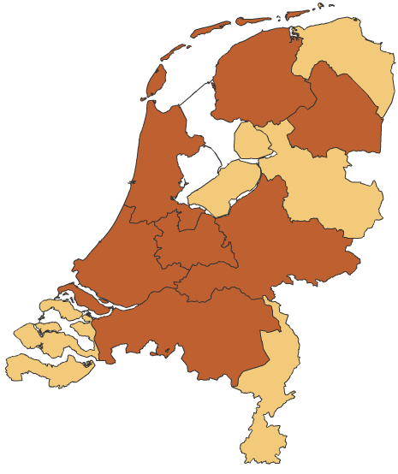
Housing Price Change Y-o-Y by Region
November 2006 November 2011 November 2012
Source: CBS, 2013
Notes:
http://www.cbs.nl/nl-NL/menu/themas/bouwen-wonen/cijfers/extra/huizenprijzen-visualisatie.htm

Slide 9
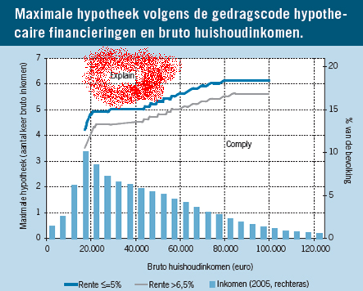
We all now understand the risk of mortgage innovation…
Underestimated effect of many years of mortgage innovation on mortgage risk:
According to the AFM (Dutch financial markets regulator) analysis, 25% of the mortgages of pre-2011 vintages did not comply with the mortgage-code-of-conduct. Of those ‘explanations’, 80-90% is considered ‘not prudent’ by the AFM.
Risky mortgage innovation is more likely to grow in a weak regulatory environment
According to the ‘’code-of-conduct’: low income households are allowed to borrow up to 5 times their income (when rates are <5%), with NO further explanation
Notes:
9

Slide 10
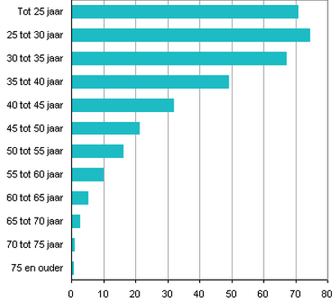
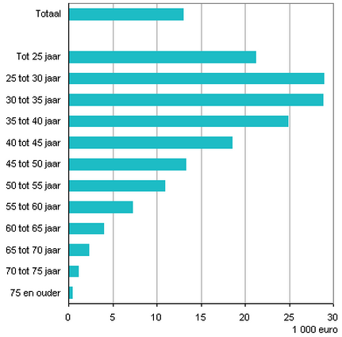
In 2010 already 1 million + households with residual mortgage debt
Percentage of households with residual mortgage debt in 2010 grouped by age of main borrower
Average amount of residual mortgage debt in 2010 grouped by age of main borrower
Source: CBS, 2013

Slide 11
Dutch Mortgage Arrears Data – Jan 2013
Issuer | Total # Mtges | Arrears | 30+ | 60+ | 90+
1 | 9,291 | 0.17% | 0.09% | 0.06% | 0.05%
2 | 11,131 | 0.82% | 0.06% | 0.06% | 0.05%
3 | 16,988 | 2.47% | 1.81% | 1.04% | 0.69%
4 | 185,367 | 3.03% | 1.46% | 0.85% | 0.53%
5 | 38,360 | 1.92% | 1.26% | 0.65% | 0.33%
6 | 415,052 | 0.84% | 0.48% | 0.34% | 0.25%
7 | 57,347 | 3.52% | 2.46% | 1.78% | 1.27%
8 | 15,234 | 3.54% | 3.04% | 2.15% | 1.42%
9 | 2,966 | 0.00% | 0.00% | 0.00% | 0.00%
WA | 751,736 | 1.72% | 0.98% | 0.64% | 0.42%
Notes:
of 750K+ borrowers (1.4 million+ loan parts)

Slide 12
Drivers of mortgage default
Ability-to-pay, due to
Income decline
Expenses increase
Willingness-to-pay
Strategic default option (when the Current LTV > ~135?)

Slide 13
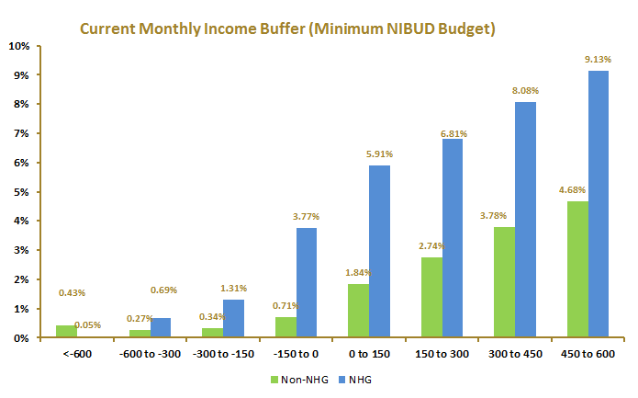
Monthly Net Income Buffers
1
NHG loans usually have lower monthly net income buffers (even when using a minimum “NIBUD-budget”)
¹Not shown: Remaining loans that fall in the 600+ income buffer bucket

Slide 14
Residual Debt
Residual debt is larger for NHG loans

Slide 15
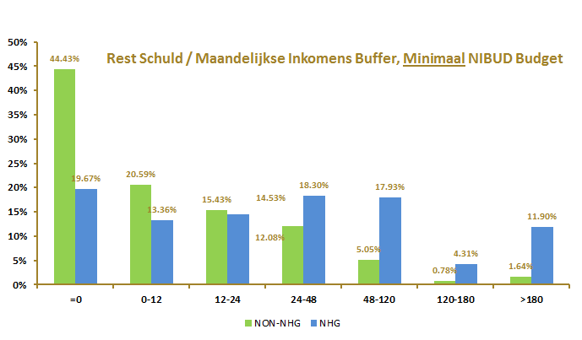
Risk: ‘willingness-to-pay’
Residual debt / Monthly Income Buffer (Minimum NIBUD budget)
At current levels of residual debt estimates, 15% of borrowers needs more than 10 years to repay debt

Slide 16
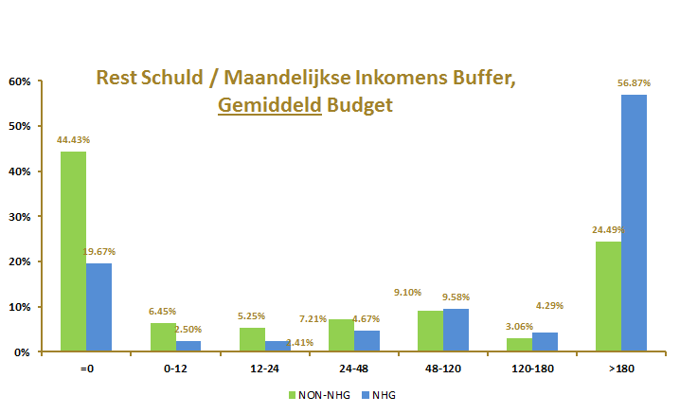
Residual Debt vs Monthly Income Buffer
Remaining debt / Monthly Income Buffer (Average NIBUD Budget)
At current levels of residual debt estimates, 50% of borrowers needs more than 15 years to repay debt.

Slide 17
Dynamic’s Mortgage Analytics
Pan-European Mortgage Data Analysis Tools

Slide 18
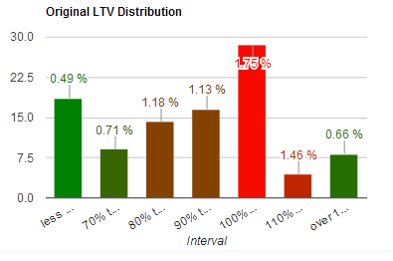
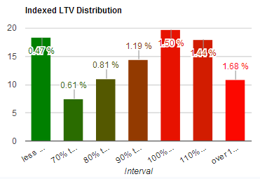
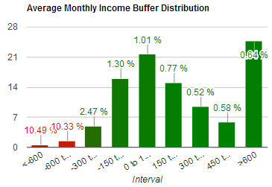
Screenshot

Slide 19
Solutions ???
Assess and thoroughly understand the risk and the developments in the changing mortgage markets
But given all the complexity in the mortgage markets a “tool” is needed to:
Allow for Transparency
Make very large Loan Tape Data (millions of records) easily accessible and understandable
Allow loan-level screening and modeling
Allow for smart analytics and understanding of risk layering
Allow for loan-level micro level modeling (income, household budget, swifts in tax regimes, etc)
Allow for loan-level macro level modeling (house prices, unemployment, rates, inflation, etc)
Run loan-level prepayment, default, rate reset simulations
Link database data with real facts – “actual collateral view”
Loan Pool Analytics

Slide 20
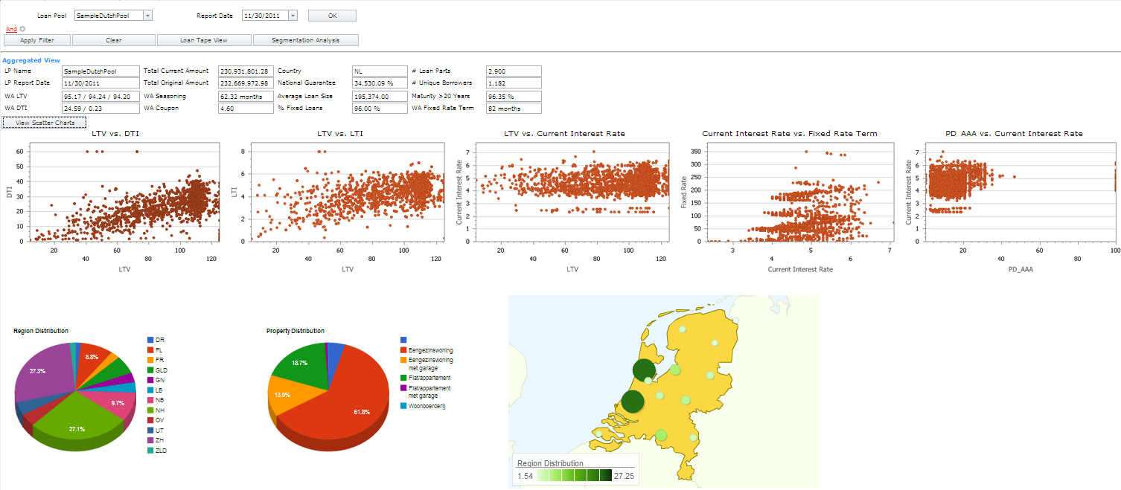
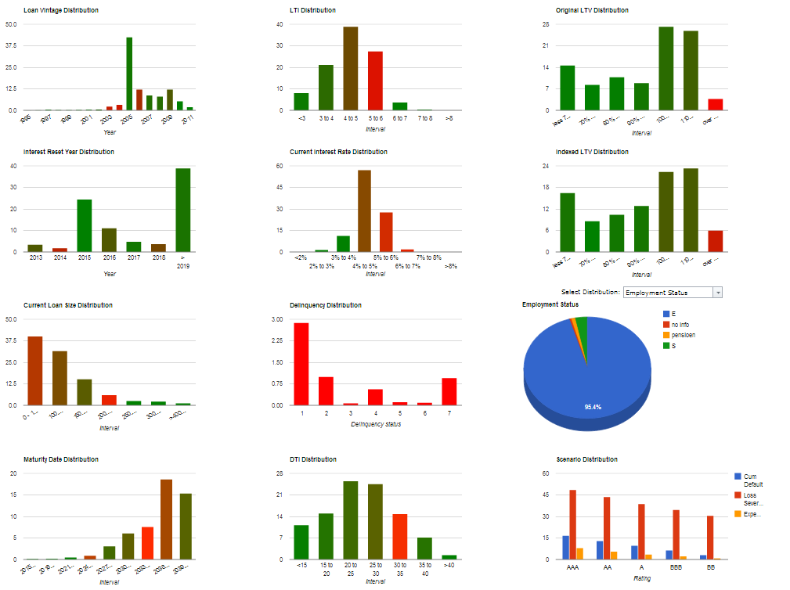
Transparency Tool – Mortgage Pool Analytics
Loan Pool Aggregated Statistics
Loan Pool View
Loan Pool Characteristics Distribution

Slide 21
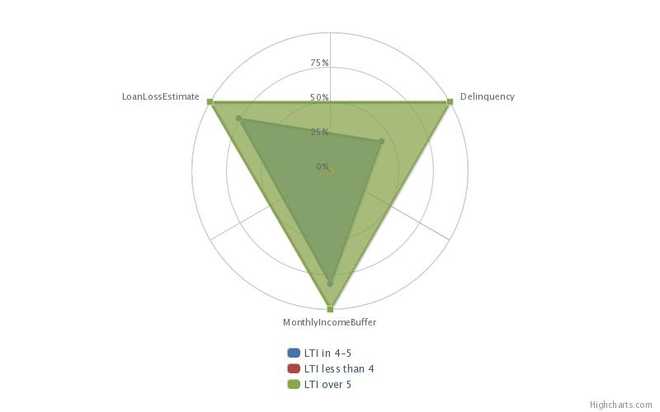
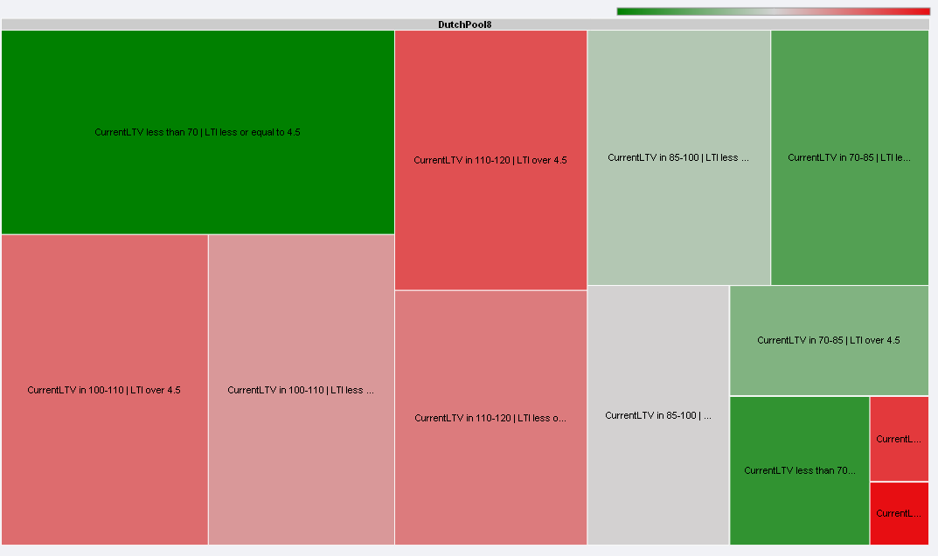
Transparency Tool – Mortgage Pool Analytics
Characteristics Tree Map
Risk Bucketing
Loan Pool
Smart Analytics
to analyze hundreds of thousands of loans
Loan Level Screening
Collateral View
Borrower Affordability
Loan Refinanceability

Slide 22
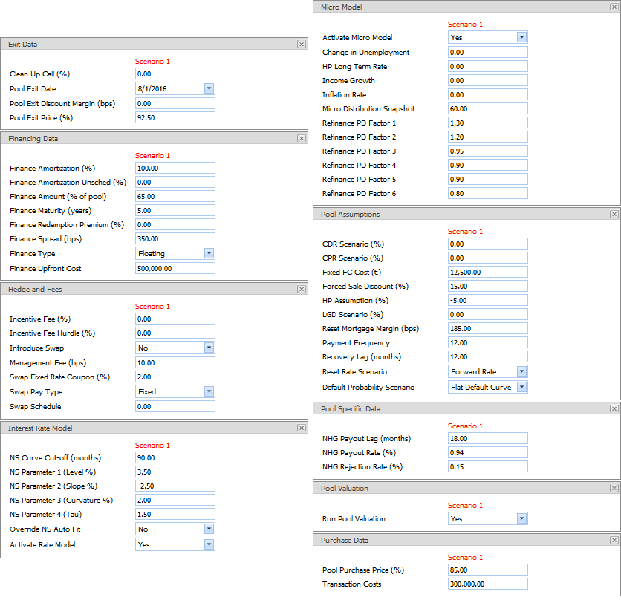
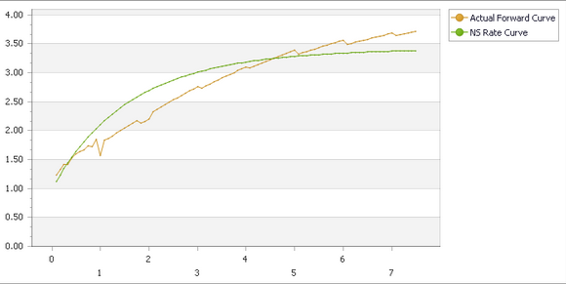
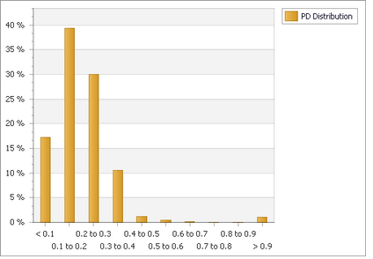
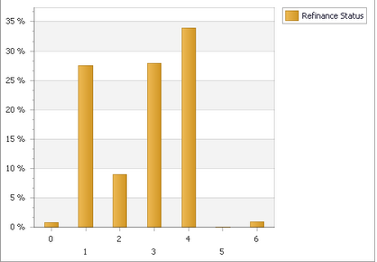
Transparency Tool – Loan Pool Analytics
Micro/Macro Modeling Inputs
Loan Pool
Micro / Macro
Modeling
Rate, Unemployment, Inflation, Wage, House Price Scenarios
Loan Level Default Probabilities and Rating Scenarios
At the Loan Level: Debt Service Capacity and Refinancing Ability

Slide 23
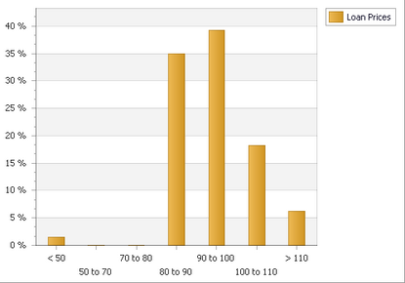
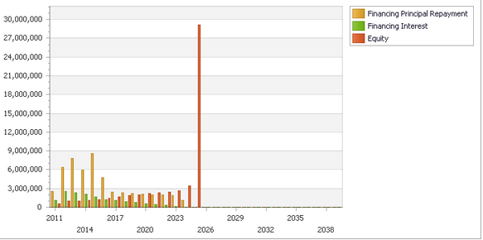
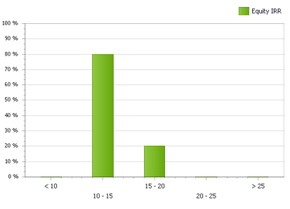
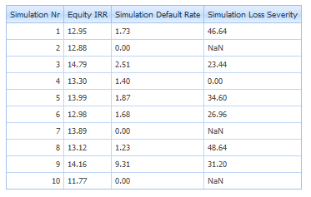
Transparency Tool – Loan Pool Analytics
Loan Level Valuation
Loan Pool
Cash Flows and
Valuation
Pool Cash Flows
Structuring Cash Flows
Default, Prepayments Scenario Simulations

Slide 24
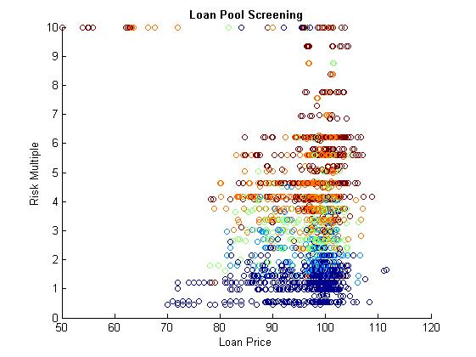
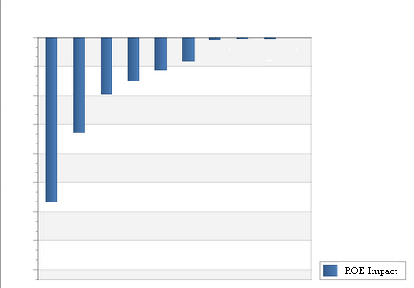
Transparency Tool – Mortgage Pool Analytics
RESTRUCTURE ?
Loan Pool
Screening and
Solutions for High-Risk
Mortgages
ACTIVELY
MONITOR
Color represents the Loss Given Default : Color Code: Red - High / Blue - Low
Loan Level Impact on Return-on-Equity
Solutions to optimize Return-on-Equity

Slide 25
Transparency Tool in a Nutshell
TTool Mortgage Pool Model
Scenario Based Analysis
Micro and Macro Modeling
Risk Based Ranking of Loans
Large Database Capacity (mm loans)
Transparency
User Friendly Web Access
Transparency

