Slide 1
ERES 2012 Infrastructure and development
Colin Elliot
School of the Built Environment
Heriot-Watt University
c.j.elliot@hw.ac.uk www.sbe.hw.ac.uk

Slide 2
Agenda
Infrastructure definitions and parameters
relationship with development
Key UK delivery models with examples
What are Attributes matrix: time/risk/cost/phasing/fundability
Matrix of funding and risk
Future challenges

Slide 3
Infrastructure defined
…………………. the technical structures that support a society, such as roads, water supply, sewers, electrical grids, telecommunications, and so forth, and can be defined as "the physical components of interrelated systems providing commodities and services essential to enable, sustain, or enhance societal living conditions.
Fulmer, Jeffrey (2009). "What in the world is infrastructure?”

Slide 4
Infrastructure types and relevance to development
financial
medium
physical
Strong
other
Social
weak

Slide 5
Infrastructure dependence?
physical
institutional
development

Slide 6
Infrastructure in relation to development
lead
Lag/‘drag’
Synchronised?

Slide 7
Going Dutch….. but with boats, buses, bikes, trams, trains, underground
Notes:
Although at the forefront of initial planning for Amsterdam’s metro system dating from the 1960s, the eight-year north-south construction project only began in 2002 and is costing €1.7bn (excluding rolling stock), double the figure projected in 1996. Lines constituting the current Metro date from 1977, being a mix of

Slide 8
Infrastructure spatial contexts
Spatial
Point e.g. building
Area e.g. town
band e.g. motorway

Slide 9
Development and infrastructure the Parallels
Construction cost focussed
Deficit financing character
Long term
Form capital asset class

Slide 10
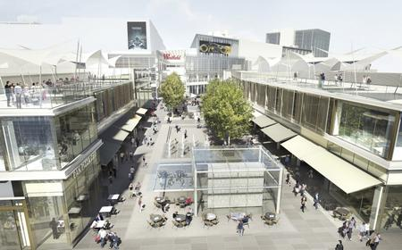
Section 106 agreement (planning)
Example: Westfield Stratford
Scale: £150 M
Funding: developer
Risk: developer

Slide 11
Tax Increment Finance
Example: Buchanan Quarter, Glasgow.
Scale: £80 million
local authority finance
Recoupment through uplift in property tax.
Risk likely to be with local auth.

Slide 12
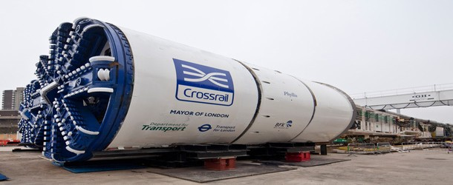
Community infrastructure levy
Example: Crossrail*, London
Funding: Government, private sector, local authority
Payback and justification: business (BRS) and econ/social benefits
Risk: limited/sunk cost
*multiple funding structure

Slide 13
Planning (Section106) agreement
Example: King’s Cross, London
Scale: significant
Funding: developer
Risk: developer

Slide 14
Private Finance Initiative
Example: Edinburgh Royal Infirmary
Scale: £190 M
Funding: private sector
Risk: private sector

Slide 15
Single Estate Strategy
Example: Canary Wharf
Scale: significant
Funding: developer
Risk: developer
Developer benefits fully from value enhancement

Slide 16
Funding and risk matrix

Slide 17
Other UK techniques
Business improvement districts
Local asset backed vehicles

Slide 18
“Prime” Property

Slide 19
Kinnaird Park
Existing
Infrastructure opportunities
Parking | Shops
 | solar
 | housing
Green space | shops
parking

Slide 20
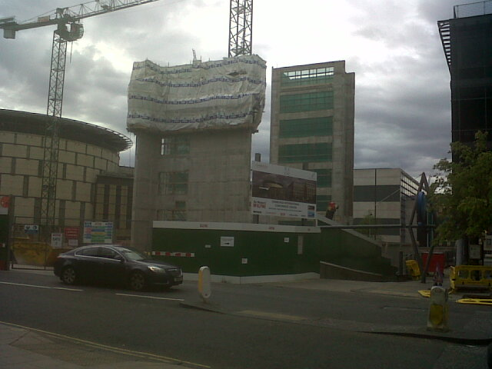
Edinburgh Conference Centre The final piece……….
….but 25 years in the making.

Slide 21
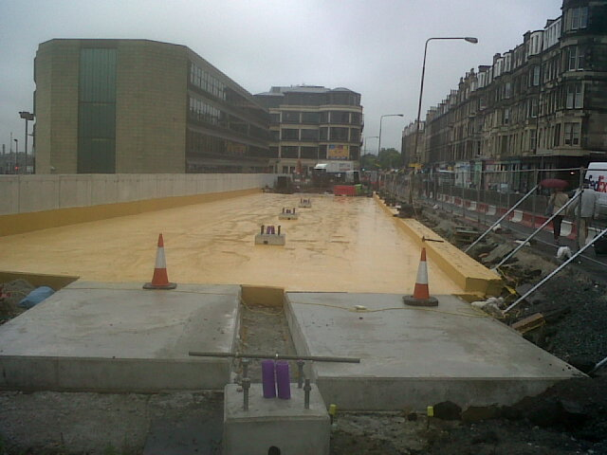
Come back in 2014 and catch the tram!

