Slide 1

Mutual recognition of valuers’ qualification. Vol 2
Kaarel Sahk, lecturer Estonian University of Life Sciences
European Real Estate Society 19th Annual Conference
13th-16th June 2012

Slide 2
Abstract
Real estate appraisal, basically its results are strongly linked with qualification of appraisers involved in of the valuation procedure. Trough a description of the valuers qualification foundation based on the academically curriculum, on the professional experience and ongoing educational development - LLL, we arrive to the professional approval. Solving the question asked a decade ago by Barry Gilbertson: Is a real estate appraisal an art or a science? , we are returning to the other founding question: What are the items, in modern approach a staff that helps to valuers to pass the recognition. In this case are existing two firstly different ways of recognition procedure, the national and international one. The nature of valuer’s qualification and its more sophisticated and detailed analyze bring us to conclusion that over the border as a recognition will move only a science, while qualification and its applications are country based arts. Finally it is evidential that the changes of qualification processes must take into account the both directions, the art and the science, and follow in this case the both mainstreams national and international that are linked with EU development, which turn the different dynamic into one, overall mutual process.
Keywords: recognition, of valuers’ qualification, LLL; certification

Slide 3
Qualification of valuers – do we need unification
Local and international requirements – common interests
Local v.s. international requirements - opposition
Legal effects of unification
Academically institutions role in qualification
Different applications
International certification - are the rules similar

Slide 4
Local and international requirements
Some terms for management problems
  Unification
  Standardization
  Aggregation
  Complementing
  Satisfactory
ERES 2012 # Kaarel Sahk # Mutual recognition of valuers’ qualification
14-16.06.2012
4

Slide 5
Metadisciplinarity & multidisciplinarity
Professor Torop explained (professor Lotman’s approach) - new or renewed viewpoint for problem’s solution
It is the connection between “the language of mathematics” and “the language of art” in the single cultural structure, on the one hand, and the principal difference between their immanent organization, on the other hand, that allows the reciprocal act of translation of texts in these languages, that is, allows them to mutually be the basis for creating a metalanguage of description.

Slide 6
Metadisciplinarity & multidisciplinarity
As a connection of art and science is born so called third viewpoint - contemporary meaning of transdiciplinarity.
Transdiciplinarity as a key word of contemporary approach of interdiciplinarity.
  The fundamental terms are knowledge management and knowledge integration.
  Terms had led to co-operation of differentt disciplines and rising dialog between curricula

Slide 7
One idea more
Paraphrasing Parek who’s writing about globalism we may overload his idea in following:
In the contest of development of studies, curricula as a foundation of real estate science is important to involve the multidimensional development of local curricula and studies

Slide 8
One more term – different viewpoints
Unification is an algorithmic process by which one attempts to solve the satisfactoriness problem. The goal of unification is to find a substitution which demonstrates that two seemingly different terms are in fact either identical or just equal.

Slide 9
Legal effects of unification
What do the new homeland (EU) require?
  Gross border influences were existing
  Gross border influences are existing
  Gross border influences will exist
EU; EC and OECD influences
Why not do operate under the local law auspices?

Slide 10
Local v.s. international requirements
KTI; ministris, Land department, etc
Finland
Former SU
Germany
England
Sweden
KTH; ministris, etc
Baltic’s valuers qualification
Histrorically thinking, education
Common law, education, etc
Regulations, civil law

Slide 11
Valuation standards (01)
base
IVSC
IVS 2007 (2012)
EU
TEGoVA
EVS 2009
local
EVS 875 and collateral EVS
Estonia
RICS
Red Book
2009
USPAP
2009
Appraisal
Found.
  Germany
    BVS & DVP regulations
US influenced countries
RICS influenced countries

Slide 12
Academically institutions role
Cyclical overview of appraisal procedure fundamentals
Obligatory – permanent application of market needs
Participation in professional certification procedure

Slide 13
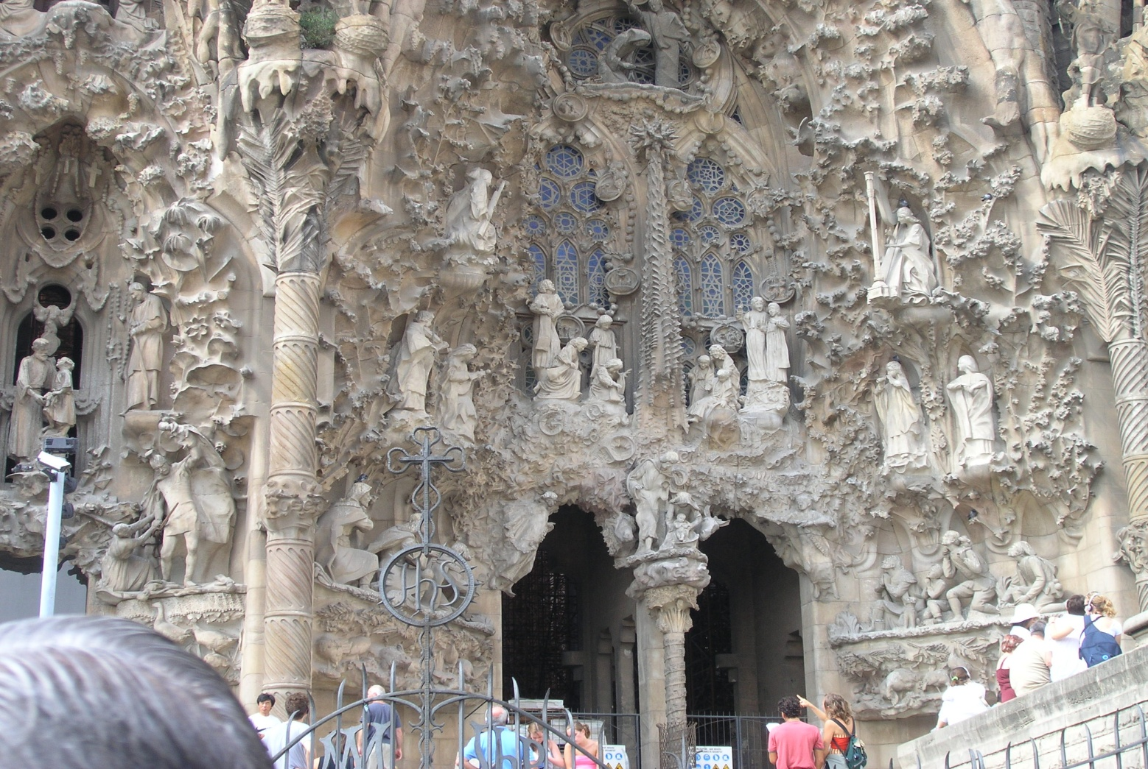
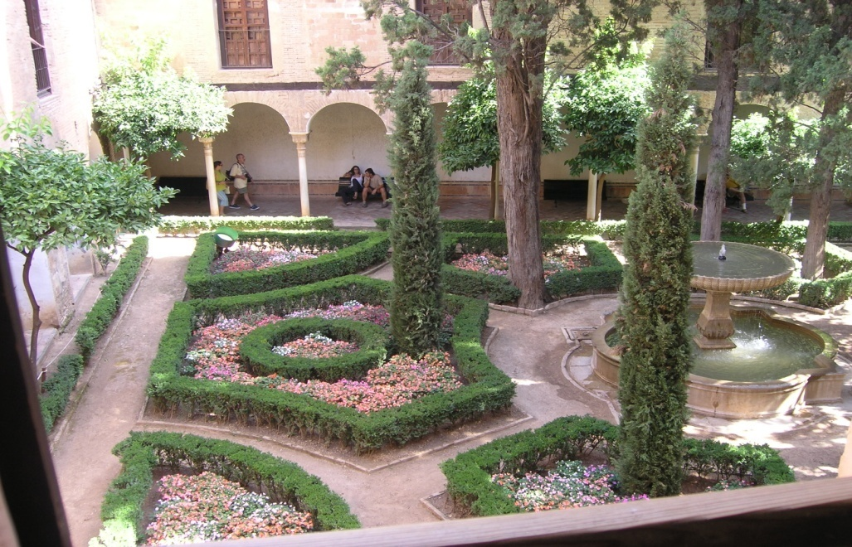

Core relationship of academically real estate education
Capacity of Academically Studies
3 years
Bachelor Studies
2 years
Master Studies
Time
3-4 years
Doctoral and Post
ˇDoctoral Studies

Slide 14
Core relationship of real estate education
Capacity of Studies
Professional Studies
Higher Education
Time
Long Life Learning

Slide 15
Core relationship of three levels of real estate profession quality
Time
Capacity of Studies
Production Qualities
EVS, TEGoVA, professional standards
Personal Quality
IVS, Red Book, IAS
Services Qualities
ISO

Slide 16
Quality – is this the thing what do we need?
Appraisers quality
Procedure quality
Production quality
Proffesional satandards
APPRAISAL
Service satandards
Valuation satandards

Slide 17
Different applications
Who will influence the nature of recognition?
Procedure and the market diversification
  Inside v.s. external valuation
  Inside valuation - result based, qualification is second rate
External valuation – market & profession based, not oriented to the result
Gross border valuation – we go, or they come – how to manage?

Slide 18
Triangula of hopes for appraisal
Appraisers approach
Appraisal environment
appraiser
user
appraisal
owner
Users approach
Owners approach

Slide 19
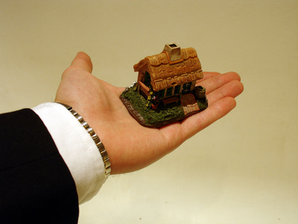
Who are interested in?
Government & banks
Influence is expanding
Multiplicity is falling
Press
Estonina experience
first time buyer ≠ prime market
second time buyer ≠ secondary market
RE developers
Real estate brokers
Speculators & agents
Second time buyers
First time buyers

Slide 20
Copmentence – the tool for recognition
Cognitive compentence
Knowledge compentence
Business compentence
Ethical- behavioural competence
Frances Plimmer, (2002) "Mutual recognition of professional qualifications", Property Management, Vol. 20 Iss: 2, pp.114 - 136

Slide 21
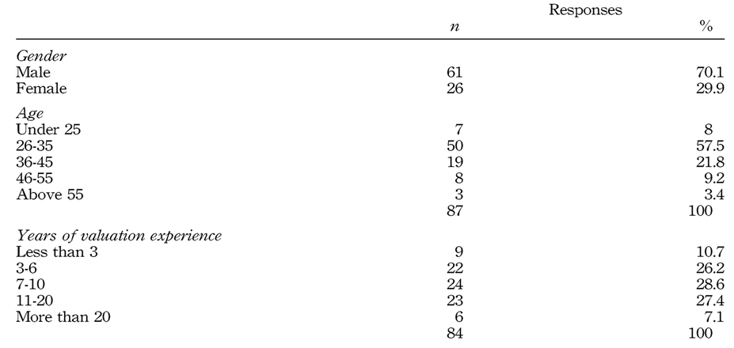
Lay Cheng Lim, Alastair Adair, Stanley McGreal, James Webb, (2006) "Strategic management and operations of real estate valuation service providers in Hong Kong", Journal of Property Investment & Finance, Vol. 24 Iss: 4, pp.343 - 362
Lim, Adair, McGreal & Webb founded in their research

Slide 22
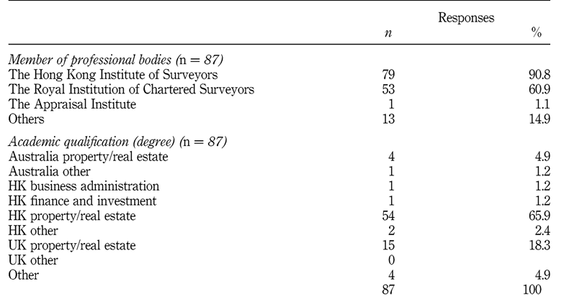
… research according the professional memebership and academic qualification

Slide 23
One other current tendency
LOCAL APPRAISER
A
valuation
Foregin appraiser
B
Local assistant
A1
A2
B1
B2

Slide 24
International certification
The price for certification must guarantee
  Recognition- on both levels
  Insurance- appraisers and firms insurance
  Target orientation
  Be in correlation with the service charges
Overall system is possible but not effective yet
Or do we need it in the first place?

Slide 25
Certification drivers
appraisal
vision
education
practice
MARKET
‘
BEAUTY OF VALUATION

Slide 26
… in particular
  Subsequent checking of previous actions and contemporary lay out
    Internal quality control
    Standardization of procedure
    Production quality – different valuation standards
    Producer quality – professional standards and requirements
    Service quality:
      Based on existing standards
      Based on service standards, e.g. ISO 9001
All these are objects of future recogntion

Slide 27

Science v.s.art Is appraisal (valuation) an art or a science?
Valuation v.s. Appraisal
Art: thing in which skill may be exercised.
Science: systematic and formulated knowledge.
Source: The Concise Oxford Dictionary

Slide 28
Finally …
The changes of the valuation environment are connected with economic situation dynamics, but:
  Before crisis - factors that cause and produce the economic changes
  After crisis - factors that reflect the economic changes
  The both, before and after must be accounted and in the use - if we want to be (back) in business

Slide 29
… finally …
The market participants understandings (market triangular) should to do
  To equalize - commonly and contemporary therefore exists a huge different between the approaches – as final goal is one, this must be eliminated
  To develop – the all participants need a contemporary or collateral advices, the similar conditions are important
  To use LLL – it is a variant, but do not work without enough generalization

Slide 30
Object of satisfication – a new paradidm
client
user
Real estate appraisal
users satisfication
sustainability
Real estate appraisal
energy efficiency
Movement form the outside linkage to the inside connection
valuer

Slide 31
Some referneces
Frances Plimmer, (2002) "Mutual recognition of professional qualifications", Property Management, Vol. 20 Iss: 2, pp.114 – 136
Lay Cheng Lim, Alastair Adair, Stanley McGreal, James Webb, (2006) "Strategic management and operations of real estate valuation service providers in Hong Kong", Journal of Property Investment & Finance, Vol. 24 Iss: 4, pp.343 – 362
Encyclopaedia of real estate terms : based on American and English practice, with terms from the Commonwealth as well as the civil law, Scots, and French law / Damien Abbott London ; Washington, DC : Delta Alpha, c2000 Семиотика и искусствометрия. Москва, Мир, 1972
Torop, P (2011) Kultuurinõukogu ja teaduskultuur
Parekh, B Promoting a Global Culture of Science. – European Review 2009, kd 17, nr 3-4, lk 477–486
Семиотика и искусствометрия. Москва, Мир, 1972
Leauanae L. J; Rasmussen G. D. The Science and Art of Business Valuation. http://www.sagefa.com/articles/The%20Science%20and%20Art%20of%20Business%20Valuation.pdf 05.06.2012
Grover, R; Soloviev, M (2004) Valuation: western influences on the development of Eastern European Valuation Standards. RICS. The Cutting Edge. ISBN 1-84219-031-8
Certification Brochure Delta Examination as HypZert Real Estate Valuer for Mortgage Lending Valuation. CIS HypZert (MLV). Valid as at: December 12, 2011
Smalley P. S. Appraisal: Science or Art? Appraisal Journal, April 1995
Gilbertson, B. Valuation or Appraisal: Art or Science. Global Real Estate Now, Spring 2001, pp 6-8
Ethics in real estate, edited by Stephen E. Roulac Boston, Mass: Kluwer Academic Publishers, 1999

Slide 32
Author’s additional information:
https://www.etis.ee/Portaal/isikuCV.aspx?LastNameFirstLetter=S&PersonVID=43875&lang=en&FromUrl0=isikud.aspx
E-mail address
kaarel.sahk@emu.ee
Mail address
Kreutzwaldi 5, 51014
Tartu
Estonia

Slide 33


Slide 34


