Slide 1
Determinants of innovation diffusion in the real estate sector – case of monitoring based building commissioning for existing buildings
Ari Laitala & Kauko Viitanen
Aalto University, Finland
School of Engineering
Department of Real Estate, Planning and Geoinformatics

Slide 2
Content
What is building commissioning?
What is diffusion of innovation?
Research set
Empirical results
Characteristics of an Innovation
Communication
Social system
Timing
Conclusions

Slide 3
What is Building Commissioning (Cx)?
A process/project where the qualities of energy efficiency and indoor climate are verified and corrected
Energy efficiency is seen only as an input
Output is indoor climate
Quality refers to the requirements of a customer
Owner of a building (investor)
User of a building (tenant)
Different types of Cx
New Construction commissioning, Retro-commissioning, Re-Commissioning
Continuous Commissioning => Monitor-based commissioning (MBCx) => Cloud based commissioning

Slide 4
Why Building Commissioning (Cx)?
There are typically several faults in the functioning of the buildings
Even in the new construction
There are mistakes in
Planning, construction, use
Equipment (HVAC) are technical devices
They get older, they get dirty, they get broke
They must be maintained, repaired and renewed
Optimal situation (in many cases) would be that equipment would go totally broken
But in most (worst) cases, there can be years of imperfect functioning before anything is noticed

Slide 5
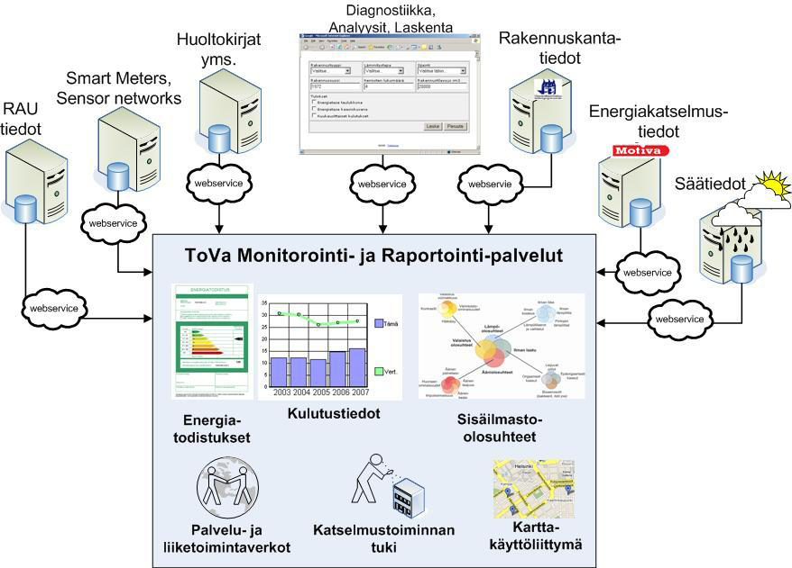
Diagnostics, analyses, calculation
Maintenance manuals etc.
Building stock information
Building automation information
Energy inspection information
Weather prognoses
Monitoring and reporting services
Energy performance certificates
Energy consumption follow-up
Indoor climate conditions
MBCx
Existing buildings
Picture VTT: Commissioning services, supporting applications and infrastructure environment
Support for the third parties
Support for the inspections
Map interface

Slide 6
An example of the results of US Cx studies (Mills, E. et al. 2004)

Slide 7
Research Questions
How MBCx meets the criteria of innovation diffusion?
Is it likely that MBCx will diffuse into the new market areas
like Finland, Nordic Countries, Europe…

Slide 8
Methodology
Delphi?
or focus groups?
Research project: GREEN ICT
Maybe just one round
Not typically background questionnaires
More qualitative
Panel 1
Panel 2
Background quest.
Background quest.
Round 1
Round 1
Round 2
Round 2
Belief behind the method:
Group forecasts are more accurate than in unstructured discussions

Slide 9
Determinants of innovation diffusion (mainly Rogers 1995, 2003)
Characteristics of an innovation
Relative advantage
Compatibility & Complexity
Trialability & Observability
Risk
Communication
Interpersonal
Mass media
Time
Decision making process of an customer
Consumer adopter categories
Social system
Customers social system
Market area: Values, culture, political factors

Slide 10
MBCx as an innovation - relative advantage - compatibility & complexity - trialability & observability - risk
Empirical results I

Slide 11
Productivity of the users of the building will increase due to better indoor climate conditions
Characteristics of an innovation: RELATIVE ADVANTAGE
AGREEMENT
ST.DEV
DISAGREEMENT
Not likely=0 Somewhat likely=0,33 Rather likely=0,67 Very likely=1,00

Slide 12
How likely it is that energy costs of the building will clearly decrease by using MBCx
Characteristics of an innovation: RELATIVE ADVANTAGE

Slide 13
There are already solutions in the market, which have same functionalities and enable same benefits than MBCx
Characteristics of an innovation: COMPATIBILITY&COMPLEXITY
AGREEMENT
ST.DEV
DISAGREEMENT
I totally disagree = -1 I mostly disagree = -0,67 I slightly disagree = -0,33
I totally agree = 1 I mostly agree = 0,67 I slightly agree = 0,33

Slide 14
MBCx is hard to sell as one entity, as a complete investment. It should be sold phased, one part at a time MBCx is hard to buy as one entity, as a complete investment. It should be bought phased, one part at a time
Characteristics of an innovation: TRIALABILITY & OBSERVABILITY

Slide 15
It would be difficult for a customer to buy MBCx services without competitive bidding and comparing offers It would be hard to us to make an investment decision without comparing several competing offers
Characteristics of an innovation: RISK

Slide 16
Communication - Interpersonal - Mass media
Empirical results II

Slide 17
Products which increase the energy efficiency are not yet marketed and sold good enough
Communication: INTERPERSONAL

Slide 18
MBCx shouldn´t be marketed using MBCx-terminology. Only the original brands should be used and forget the whole MBCx terminology MBCX terminology is new and not so well-known. It would be easier to buy known brands
Communication: Interpersonal

Slide 19
There is still lack of knowledge in the market about the systems like MBCx. It should be first made more known through mass media and maybe through education as well
Communication: MASS MEDIA

Slide 20
time - decision making process of an customer - consumer adopter categories
Empirical results III

Slide 21
Marketing and selling MBCx would be persistent and lengthy. Closing the deal would take 6-12 months Investing in MBCx would be broad and lengthy process, maybe 6-12 months
Time: DECISION MAKING PROCESS OF AN CUSTOMER

Slide 22
Part of the real estate owners are clearly forerunners and some are not yet at all interested in energy efficiency investments
Time: CONSUMER ADOPTER CATEGORIES

Slide 23
Social system - Social system of customers - (Market area: values, culture, political factors)
Empirical results IV

Slide 24
It could be difficult to find and get right people from the customer side to different phases of selling process It would cause us relatively much troubles to find right people for different phases of MBCx purchase
Social system: INTERNAL

Slide 25
Customers have difficulties to define and describe their needs It would be challenging for us to define and describe our needs exactly
Social system: INTERNAL

Slide 26
Summary
Characteristics of an innovation
Relative advantage | Rather strong support
Compatibility & Complexity | Continuous innovation
Trialability & Observability | There probably should be an option for phase to phase purchase
Risk | Identified risk level somewhat neutral
Communication
Interpersonal | Lack of marketing skills identified in both FGs
Mass media | MBCx should be first done more known through mass media
Time
Decision making process of an customer | Would be time taking (6-12 months)
Consumer adopter categories | There clearly are (identified) forerunners in the market (innovators) and laggards
Social system
Customers social system | Dispersion
Market area: Values, culture, political factors | Known earlier & otherwise: quite favorable

Slide 27
To conclude?
Strengths
Characteristics of
an innovation
Social system
Threats
Opportunities
Time
Communication
Weaknesses
“Are we losing a golden opportunity for reducing energy costs and greenhouse gas emissions?” (Mills, E)
“Maybe not – finally - but we are constantly losing valuable time” (Laitala, A)

Slide 28
Thank you! - questions & comments?
For further information
Mr. Ari Laitala
ari.laitala@aalto.fi, +358505122745

