Slide 1

Municipal real estate management in Polish city of Gdansk compared with selected European cities
Dr. Anna Wojewnik-Filipkowska
University of Gdańsk
Dr. Małgorzata Rymarzak
University of Gdańsk

Slide 2
Introduction
The real estate management influences the economic condition of local government, companies and citizens in direct and indirect manner.
Irrational management led to increase of functioning cost, lowers budgetary incomes, makes economic activity difficult, disorganizes real estate market.
The rational real estate management can be an important instrument of steering processes of local sustainable development, a tool for creating active revenues, a factor of forming potential opportunities for development.

Slide 3
Introduction
The units of local governments in Poland own one of the largest stock of real estate. Their property is very differentiated.
  E. g.: water-supply and sewerage networks, as well as sewage treatment plants, dumping grounds, cemeteries, fields assigned for investments of public purposes, or investment fields assigned for residential and commercial building, schools, habitable apartment-houses, as well as service real estate.
Each particular category of the differentiated property requires individual management.
It is obliged that it corresponds with the policy and individual tasks of local governments, as well as with holistic policy of development of territorial unit.

Slide 4
Introduction
Only about 25% of major European cities can provide reasonably reliable data on the size and value of their real estate portfolios.
All the municipalities in EU provide housing for education, sport, recreation, culture, care and their civil servants.
Essen (GER), Munster (GER), Nuremberg (GER), Rotterdam (NL) also have a commercial real estate portfolio.
In the Netherlands and Belgium, the municipalities do not own any social housing.
Source: Deloitte, 2011.

Slide 5
Table 1. Real estate classification in selected EU countries
Real estate type | Denmark | Germany | France | Italy | Luxembourg | Netherlands
Offices/administration | X | X | X |  | X
Education | X | X | X | X | X | X
Health Care | X | X |  |  | X
Welfare facilities | X |  |  |  | X | X
Sport facilities | X | X | X |  | X | X
Residential/Housing | X |  | X |  | X
Warehouses | X |  |  |  | X
Library | X
Nursery | X
Culture/leisure | X | X | X | X |  | X
Chapels | X
Social services |  | X | X
Buildings for own use |  |  |  |  |  | X
Commercial building |  | X
Transportation mobility |  |  |  | X
Maintenance |  |  |  | X
Environmental projects |  |  |  | X
State Property |  |  |  | X
Street furniture and green areas |  |  |  | X
Economic development |  |  | X
Infrastructure |  |  |  | X
Others | X | X | X |  | X | X
Source: authors' own elaboration based on Municipal real estate. Comparing public real estate management in european cities, Deloitte, December 2011.

Slide 6
The aim of the article
The general aim of the research is to:
provide evidence for the real estate management importance in municipality,
propose real estate classification for municipalities,
justify the implementation of a formal decision making process as a tool of a structured way for solving problems,
verify factors which should be included in the decision process in reference to municipal real estate management.

Slide 7
Structure of presentation
Characteristic of municipality as decision-makers.
Real estate management as a tool for achieving the municipal aim.
Real estate management determinants.
Real estate management decision types, criteria, process.
Conclusion.

Slide 8
1. Characteristic of municipality as decision-makers
Municipalities are a set of interests of those inside and outside them.
In each organisation there are various interest groups representing different, sometimes conflicting, objectives.
For municipality to function smoothly, it must be capable of generating goals that are common to all the parties involved, both within and outside the organisation.

Slide 9
1. Characteristic of municipality as decision-maker
Figure 1. Municipality as a beam of goals of their stakeholders
Source: authors' own elaboration [Hahn, 1983, p. 44].

Slide 10
2. Real estate management as a tool for achieving the municipal aim
Real estate management is a crucial element of municipal strategy.
The global strategy is developed to achieve the primary aim of the municipality which is to maximize wealth of their stakeholders.
Wealth creation is achieved not only by development of the global strategy, but also of functional strategies, including real estate management strategy.

Slide 11
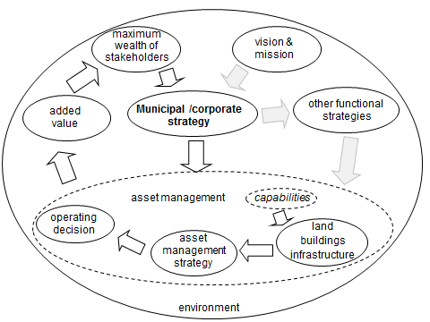
2. Real estate management as a tool for achieving the municipal aim
Figure 2. Importance of decision-making in real estate management for entity global strategy
Source: authors' own elaboration [Hayness and Nunnington, 2010, p. 46].

Slide 12
3. Real estate management determinants
Real estate management decisions are obviously affected by a variety of determinants.
It should be stressed that the same factors can benefit municipals in making one decision, but work to their disadvantage with another.
Furthermore, not every factor affects either of the municipalities to the same degree.

Slide 13
3. Real estate management determinants
Determinants can be devided into:
external factors, connected with the environment of the municipality (close and distant),
internal ones, connected with the municipality itself (resulting from the conditions and the forces within the entity).

Slide 14
3. Real estate management determinants
(external factors)
Item | Specific determinants
Macroenvironment | government policies financial system tax system inflation level and fluctuations regulation sociological changes cultural changes technological progress the environment
Microenvironment | sectoral specifics the competitive market - bargaining power of suppliers - bargaining power of customers (buyers) - threat of the entry of new competitors - threat of substitute products or services - intensity of competition
Source: authors' own elaboration.

Slide 15
3. Real estate management determinants
(internal factors)
Item | Specific determinants
Municipality | resources of the municipality assets (technical condition, legal title, adequacy for the conducted operations, including the type, quantity/area, technological advancement) - financial - human - culture competitive position of the municipality (including its image) quality of broadly viewed management processes (including structure, management structure, strategies and plans)
Source: authors' own elaboration.

Slide 16
4. Real estate management decision types, criteria, process
Strategy types (e.g. decission types):
Increase of production, in operations, improve service delivery
      e.g. selection of location
Cost reduction
      e.g. workplace costs
Risk control
      e.g. development process
Increase of value
      e.g. redevelopment of assets
Increase of flexibility
      e.g. technical flexibility)
Changing the culture
      e.g. communication
Decission criteria:
Availability of financing
Capital intensiveness
Economic
Technical
Ecological
Social
Organisational
Legal and administrative (internal requirements and regulations)
Structural criteria
Notes:
Table 3 below presents real estate management strategies and assessment criteria related to the adopted goals. These criteria are important for decision making process as they are dedicated to measuring the added value for stakeholders.

Slide 17
4. Real estate management decision types, criteria, process
Decision-making process:
multi-stage activity consisting in appropriate recognition of decision environment through obtaining relevant information and transferring it into specific variants which may constitute foundations for making a future decision,
as every activity, it should follow a specific logical cycle,
a classical cycle of decision-making comprises stages of preparation, selection and control.

Slide 18
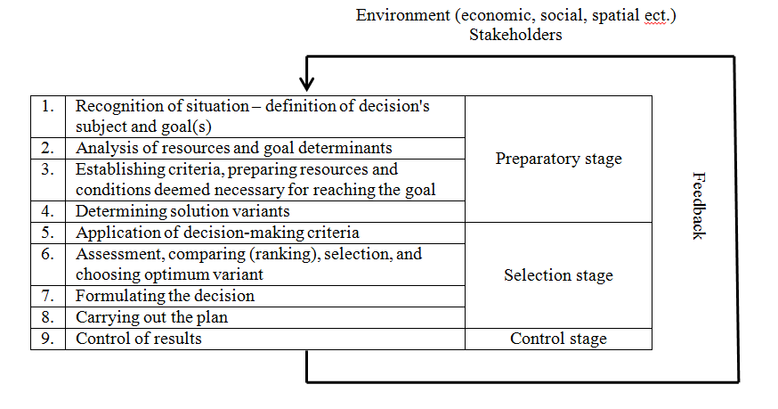
4. Real estate management decision types, criteria, process
Figure 3. Decision making process
Source: authors' own elaboration based on literature review.

Slide 19
5. Conclusions
Real estate classification
Functional
  realization of fundamental municipal objectives
  e. g. residental buildings, administrative buildings, roads, monuments
Instrumental
  of socio-economic and development character
  necessary for realization of future plans
  e. g. land for future road
Commercial
  periodic/single income
Notes:
Companies: Operational/Backup/Investment

Slide 20
5. Conclusion
Criteria
From the public sector's point of view (municipality, population), rationalisation of real estate management should undoubtedly take into consideration both extra-financial and financial criteria.

Slide 21
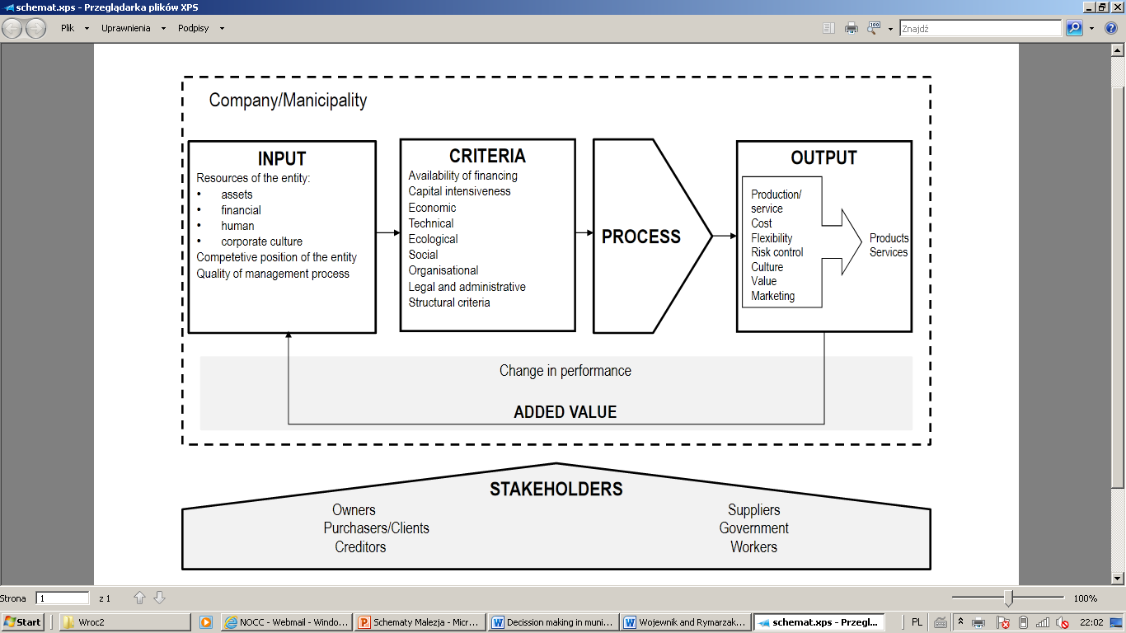
5. Conclusion
Figure 4 Municipality real estate management framework
Source: authors' own elaboration.
Notes:
The diagram below presents asset management framework as a tool of structured way for solving problems and verifying factors which should be included in municipal real estate management.

Slide 22
Thank you for your attention!
Dr. Anna Wojewnik-Filipkowska
wojewnik@wzr.ug.edu.pl
Dr. Małgorzata Rymarzak
mrymarzak@wzr.ug.edu.pl

