Slide 1
Measuring The Impact Of Operational Energy Ratings on Office Valuations In The UK
Jorn van de Wetering, Franz Fuerst, Peter Wyatt
Notes:
3rd year PhD student at Henley Business School, University of Reading

Slide 2
Display Energy Certificate (DEC)
Mandatory Assessment Tool
A DEC shows an operational rating which conveys the actual energy used by the building (rating A-G)
  Assess actual energy performance of building based on size and energy consumption (e.g. gas & electricity)
Required for public authorities, and institutions providing public services to a large number of persons, who occupy space in a building with a total useful floor area greater than 1,000 m²
120,261 DEC ratings have been lodged since scheme began
Notes:
DEC’s show how a building is performing based on energy consumption records;
Yearly recurring operational rating
Government offices, schools, colleges, universities, police stations, prisons, fire stations, etc.

Slide 3
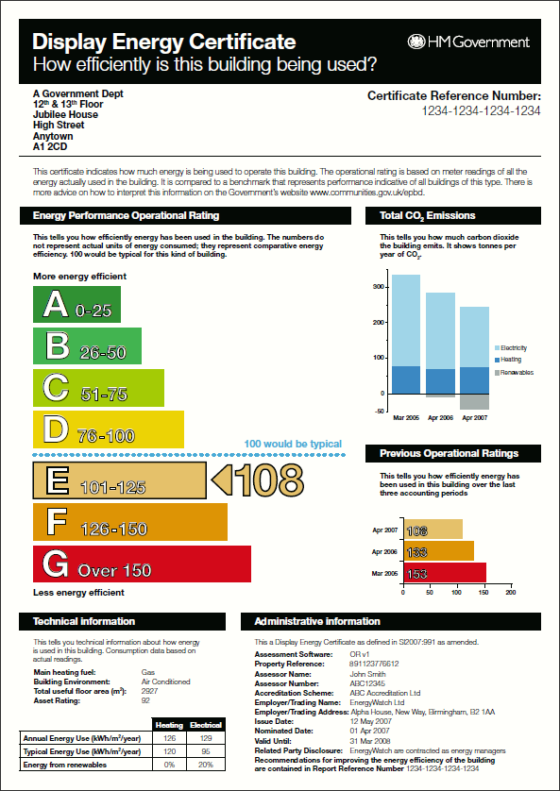
DEC Certificate - Example
Address information
Energy Performance Operational Rating
Total CO₂ Emissions
Previous Operational Ratings
Technical Information
Administrative Information
Notes:
DEC rating should be on public display, so that members of the public who are visiting public authorities and institutions can see how the building is performing.
DEC ratings are likely to be rolled out on a larger scale.
Version used: ORCalc_v2-0-2
New versions not freely available online anymore?
[1] Initial Information
Assessor Information
Assessor details (Purpose of analysis; Assessor Number; Activation Code; etc.)
Insurance details (Insurer Name; Insurance Policy Number; PI Limit (£); etc.)
Building Information
Building details (Address; Property Reference Number; Occupier Name; etc.)
Initial Building Data (Internal Environment; HVAC System; etc.)
Initial Energy Data
Main Heating Fuel; period start/end dates; assessment period alignment; etc.
[2] DEC
Benchmark Categories
e.g. general office, general retail, hotel, etc.
Building Floor Area
General office; Unconditioned Floor Area
Past DEC Data
Previous operational rating 1 and 2; Valid EPC Information
Degree Day Correction
‘General Office’ Benchmark Information; Degree Day Information
Occupancy Correction
Occupancy Level
Electrical Energy Split (n/a for offices)
Energy Consumption
Energy Consumption Data: e.g. Fuel Type, Consumption (kWh), Start Date, End Date, Estimate?
Separable energy
Individually Metered Separable Energy; Separable Energy Floor Area (m²)
On-site renewables
On-site Low and Zero Carbon energy sources
CO₂ conversion factors
CO₂ Conversion Factors (kgCO₂/kWh); CO₂ Emissions (Tonnes CO₂/year)
Air Conditioning Survey
[3] Advisory Report
Building Information
Building Information Data; Advisory Report Dates; Building Information Summary
AR Questionnaire
Background Information; Operation and Management; Fabric; Alternative Energy
Finalise Recommendations
Add/Remove No And Low Cost Recommendations To The Advisory Report
Carbon Impact
Low/Medium/High cost & Additional Recommendations

Slide 4
Literature and data availability
Evidence base using LEED and Energy Star and US data
  Eichholz, Kok & Quigley (2010), Fuerst & McAllister (2011a), Wiley, Benefield & Johnson (2010)
Evidence from United Kingdom
  Fuerst & McAllister (2011b) investigated impact of EPC ratings on IPD UK data to investigate impact of premiums over time
  Chegut, Kok & Eichholtz (2012) investigate the market for green buildings in the UK by investigating impact of BREEAM
Guidance for valuation:
  (RICS) Sustainability and Commercial Property Valuation
Notes:
Eichholtz, Kok, and Quigley (2010) used a sample of some 10,000 subject and control buildings.
They found higher rents for an Energy Star rating of 3.3% at a significant level and a premium of 5.2% for LEED ratings, although this was at an insignificant level.
Fuerst and McAllister (2011a) used a log-linear hedonic rent model and a sample of 10,970 observations.
The authors found a rental premium of approximately 5% for LEED certification and 4% for Energy Star certification.
Using a sample of 6,157 observations they found sales price premia of 25% for LEED-certified buildings and 26% for Energy Star-certified buildings.
Wiley, Benefield, & Johnson (2010), used Ordinary Least Squares and Two-Stage-Least-Squares.
They estimated a rent premium of 7.3% to 8.9% for Energy Star-labelled properties and a premium of 15.2% to 17.3% for LEED rated properties.
This study further found that, relative to comparable properties, Energy Star-labelled properties sold at a premium of $29.71/ft2 and that LEED certified properties sold at a premium of $129.18/ft2.
This study found higher occupancy levels of 10% to 11% for Energy Star-labelled properties and 16.2% to 17.9% for LEED-certified properties relative to comparable properties.
Reichardt, Fuerst, Rottke, and Zietz (Forthcoming) used a panel dataset and found that premiums increased steadily for 2006 to 2008, after which they started to show a moderate decline in subsequent periods.
Fuerst, Gabrieli & McAllister (2012) applied existing economic theory to investigate investor preferences.
Fuerst and McAllister (2011b) conducted a study using data on 708 commercial property assets held by IPD UK but were unable to find significant evidence that suggested that an EPC rating had any significant effect on market rents and market values. The authors did find some evidence that equivalent yields were affected by EPC ratings.
Chegut et al. (2012) found statistically significant premia for BREEAM certified buildings in the United Kingdom.

Slide 5
Data
Rateable value from the Valuation Office Agency (VOA) as an approximation of market rent
  Rateable value represents the open market annual rental value of a business/ non-domestic property
DEC ratings (2006 - June 2010) from Communities and Local Governments
Building characteristics from CoStar UK
Walk Score® from http://www.walkscore.com/
Notes:
DEC Paper
Environmental Information Request

Slide 6
Breakdown of DEC Classification

Slide 7
Summary Statistics
Summary Statistics DEC Sample (N=1,046)
Average Valuation by DEC
 | Mean | Median | Std. Dev.
Values 2010 (£/sq m) | 160.76 | 120.00 | 117.01
Age (yrs) | 48 | 35 | 54
Number of Floors | 6 | 5 | 4
DEC | Valuation (psm)
A rating | 186.27
B rating | 108.11
C rating | 104.81
D rating | 114.78
E rating | 151.28
F rating | 188.57
G rating | 180.45

Slide 8
Walk Scores DEC Sample
DEC Sample (N=923)
Larger Sample (N=26,136)

Slide 9
Methodology (1)
Impact of energy features on market rents (valuation)
Explained variable: Market rent valuation
Explanatory variables:
  DEC ratings: Binary variables: A-G and G200/G9999 “default” ratings
  Energy characteristics: Binary variables: “Typical” Building Energy Category, Building Indoor Environment System
  Building characteristics: Continuous variables: Number of floors; Binary variables: Age
  Location characteristics: Binary variables: Walk Score, Region

Slide 10
Results Model 1
Variable | Coeff. | Prob.
DEC “A” Rating | 0.285 | 0.032**
DEC “B” Rating | 0.038 | 0.637
DEC “C” Rating | -0.031 | 0.441
DEC “E” Rating | 0.057 | 0.148
DEC “F” Rating | 0.139 | 0.002***
DEC “G” Rating | 0.156 | 0.000***
Default DEC “G” Rating | 0.017 | 0.626
Typical Energy: 151-210 | 0.112 | 0.018**
Typical Energy: 211-220 | 0.130 | 0.003***
Typical Energy: 221-230 | 0.156 | 0.000***
Typical Energy: 231-240 | 0.243 | 0.000***
Typical Energy: 241-250 | 0.161 | 0.000***
Typical Energy: 251+ | 0.129 | 0.005***
BE: Heating and Mechanical Ventilation | -0.069 | 0.065*
BE: Heating and Natural Ventilation | -0.190 | 0.000***
BE: Mixed-Mode with Mech. Ventilation | -0.078 | 0.108
BE: Mixed-Mode with Natural Ventilation | -0.055 | 0.328
N = 1,204
Adj R² = 60%
Notes:
Residuals - exclude

Slide 11
Results Model 1 - continued
Continued from Previous Page
Variable | Coeff. | Prob.
Log(Number of Floors) | 0.167 | 0.000***
Age: 10-19 | -0.084 | 0.171
Age 20-29 | -0.173 | 0.003***
Age: 30-39 | -0.287 | 0.000***
Age: 40-49 | -0.395 | 0.000***
Age: 50-59 | -0.522 | 0.000***
Age: 60+ | -0.094 | 0.108
Age: Unknown | -0.281 | 0.000***
Walk Score: 90-99 | -0.162 | 0.000***
Walk Score: 80-89 | -0.311 | 0.000***
Walk Score: 0-79 | -0.165 | 0.004***
Walk Score: Unknown | -0.343 | 0.001***
Region: East of England | 0.447 | 0.000***
Region: Greater London | 1.048 | 0.000***
Region: North East | 0.458 | 0.000***
Region: North West | 0.404 | 0.000***
Region: South East | 0.520 | 0.000***
Region: South West | 0.471 | 0.000***
Region: Wales | 0.242 | 0.026**
Region: West Midlands | 0.447 | 0.000***
Region: Yorkshire and the Humber | 0.396 | 0.000***
N = 1,204
Adj R² = 60%

Slide 12
Methodology (2)
Impact of energy features on market rents (valuation)
Explained variable: Market rent valuation
Explanatory variables:
  Energy Consumption Benchmark: Continuous Variable:
  (Annual Consumption-Typical Consumption)/Typical Consumption
  Actual Energy Consumption: Binary Variable: Annual Energy Consumption Consumption Category
  Building characteristics: Continuous variables: Number of floors; Binary variables: Age
  Location characteristics: Binary variables: Walk Score, Region

Slide 13
Results Model 2
N = 930
Adj R² = 63%
Variable | Coeff | Prob.
Constant | 4.361 | 0.000***
Log(Annual/Typical Energy Benchmark) | -0.170 | 0.002***
Annual Energy: 151-200 | 0.064 | 0.221
Annual Energy: 201-250 | 0.113 | 0.054*
Annual Energy: 251-300 | 0.150 | 0.026**
Annual Energy: 301-350 | 0.191 | 0.011**
Annual Energy: 351-400 | 0.312 | 0.001***
Annual Energy:400+ | 0.372 | 0.000***
BE: Heating and Mechanical Ventilation | -0.060 | 0.150
BE: Heating and Natural Ventilation | -0.199 | 0.000***
BE: Mixed-Mode with Mechanical Vent. | -0.096 | 0.092*
BE: Mixed-Mode with Natural Ventilation | -0.047 | 0.477
Log(Number of Floors) | 0.212 | 0.000***
Age: 10-19 | -0.068 | 0.345
Age: 20-29 | -0.195 | 0.005***
Age: 30-39 | -0.284 | 0.000***
Age: 40-49 | -0.405 | 0.000***
Age: 50-59 | -0.496 | 0.000***
Age: 60+ | -0.088 | 0.211
Age: Unknown | -0.289 | 0.000***

Slide 14
Results Model 2 - continued
N = 930
Adj R² = 63%
Continued from Previous Page
Variable | Coeff. | Prob.
Walk Score: 90-99 | -0.235 | 0.000***
Walk Score: 80-89 | -0.331 | 0.000***
Walk Score: 0-79 | -0.193 | 0.003***
Walk Score: Unknown | -0.355 | 0.002***
Region: East of England | 0.368 | 0.001***
Region: Greater London | 1.107 | 0.000***
Region: North East | 0.451 | 0.000***
Region: North West | 0.389 | 0.000***
Region: South East | 0.535 | 0.000***
Region: South West | 0.446 | 0.000***
Region: Wales | 0.229 | 0.050**
Region: West Midlands | 0.392 | 0.000***
Region: Yorkshire and the Humber | 0.394 | 0.000***

Slide 15
Conclusions
No significance for “average” energy consumption
A-B rated buildings outperform buildings with an average D rating
  Are premiums for energy efficiency found only in office space that is designed and used to the highest standards of energy efficiency?
F-G rated buildings outperform buildings with an average D rating
  Jevons Paradox, Khazzoom-Brookes postulate
Those buildings that outperform their energy consumption benchmark achieve higher valuations and vice versa

Slide 16
Thank you
Questions?
Jorn van de Wetering
E-mail: J.T.VanDeWetering@pgr.reading.ac.uk
Notes:
Key tools:
Energy Performance Certificates
BREEAM (Versions: 2006/2008/2011)

