Slide 1
The analysis of using psychological strategy to decrease illegal motorcycle and bike parking problems in city centers
Kuang-Yih Yeh, Hao-Ching Hsia and Hsu-Sheng Hsieh

Slide 2
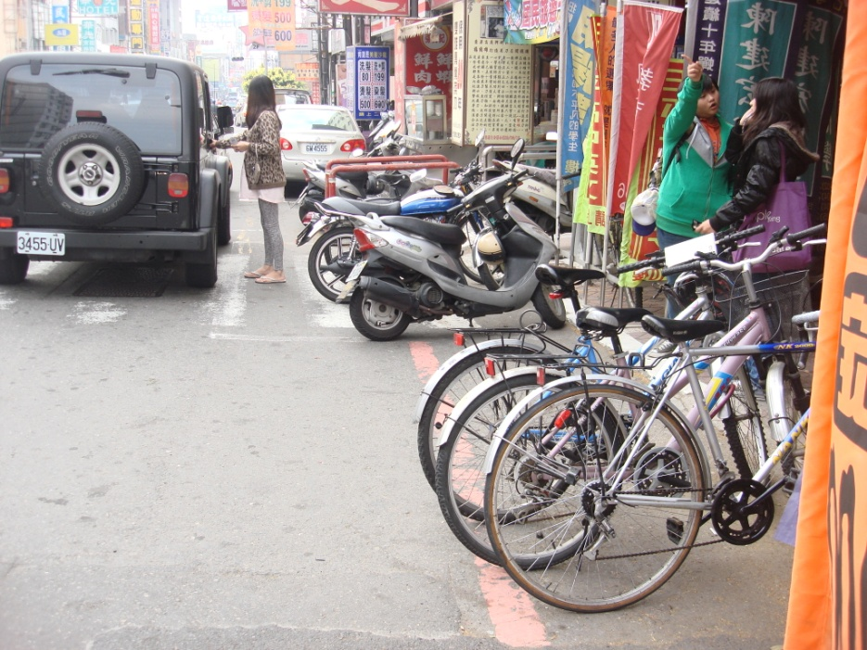
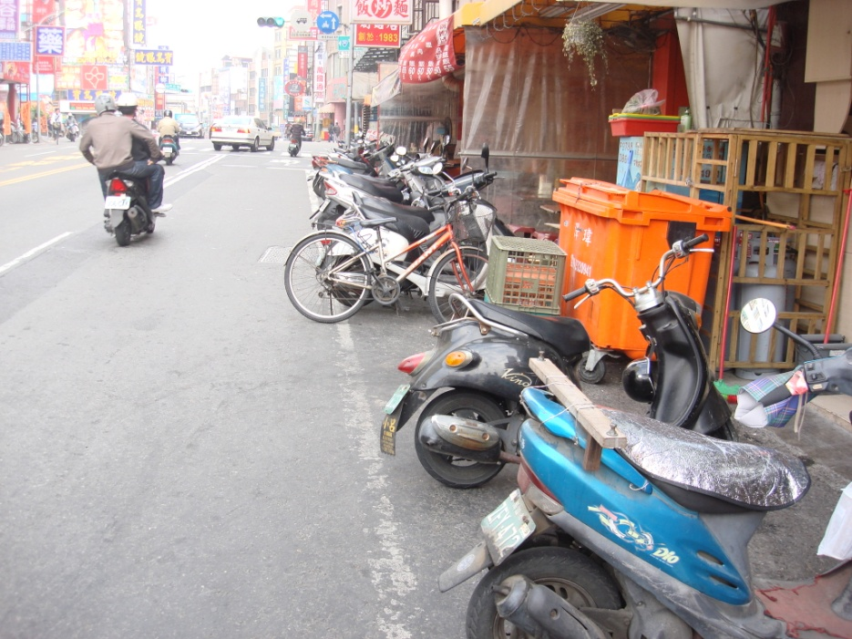
Current situation
Although bikes are very convenient to go everywhere, they also bring a serious parking problems to the city centre

Slide 3
Social dilemmas
Dawes(1980) defined social dilemmas by two properties:
(a) each individual receives a higher payoff for a socially defecting choice than for a socially cooperative choice, no matter what the other individuals in society do, but
(b) all individuals are better off if all cooperate than if all defect.
Notes:
Social dilemmas 的定義

Slide 4
How to solve this problem
Structural strategy
‧demand and supply
‧an institutional change
‧reward and punishment
However,…

Slide 5
The weakness of structural strategy
The new supply will induce new demand.
The behavioral modification caused by the structural strategy is tentative and unstable.
People would like to cooperate in short term, but attempt to find a way to defect in long term.
The severe regulations may cause people’s antipathy toward government.

Slide 6
The process model of behavior modification

Slide 7
Measuring Method
The Psychological construct cannot be observed directly. Therefore, we need to measure the psychological construct by some observed items.
The 7-point scale is adopted to measure the observed items.
If the subjects totally agree the description of the specific item, it would be 7 point. On the contrary, the subjects totally disagree, it would be 1 point.

Slide 8
Perceived importance(3 items)
How much do you agree the following questions?
The illegal on-street parking of bikes would obstruct pedestrians.
The illegal on-street parking of bikes would obstruct the handicapped.
The illegal on-street parking of bikes would cause the disorderly landscape of streets.

Slide 9
Moral consciousness(7 items)
How much do you agree the following questions?
The illegal on-street parking of bikes is a behavior which would damage collective interests.
I will not park my bike arbitrarily except legal parking lots.
There is no moral consideration.
Illegal parking of bikes is a behavior against common sense and usual habit.
Illegal parking of bikes is not a correct behavior.
It is a governmental responsibility to solve the problem of illegal parking.
Everyone should pay attention to the problem of illegal parking.

Slide 10
Goal intention(5 items)
How much do you agree the following questions?
My behavior of illegal parking of bikes does not influence others.
Everyone should have the concept of no illegal parking of bikes.
I have an idea or consciousness of solving illegal parking problem of bikes.
It is an important thing to solve illegal parking problem of bikes.
How much do you expect the disappearance of illegal parking problem of bikes?

Slide 11
Implementation intention(4 items)
How deeply do you think about illegal parking problem of bikes?
How much do you consider the way to prevent illegal parking of bikes?
How many efforts do you make to prevent illegal parking problem of bikes?
How many further ideas of preventing illegal parking problem of bikes do you have?

Slide 12
Persuasive communication
Persuasive communication

Slide 13
The persuasive communication
Request and suggestion
Please do not park your motorcycle and bike on-street.
Providing the reasons why the motorcycle and bike parking on-street
Counsel
How to reduce the amount of illegal parking on-street motorcycle and bike.
The strategies which are drawn up for reducing the frequency of bikes illegal parking on-street are not difficult to achieve. The necessary work is to decrease the intention and desire of parking on-street
Behavioral plan
The subjects of behavioral plan group obtained both the information of request and counsel. In addition, the subjects were requested to write down their opinions on the proposal of reducing the problem of bikes illegal parking.

Slide 14
Purposes of this study
To examine the effect of psychological strategy on behavior modification.
To compare the performance of different ways of persuasive communication.
To know the time effect of communication

Slide 15
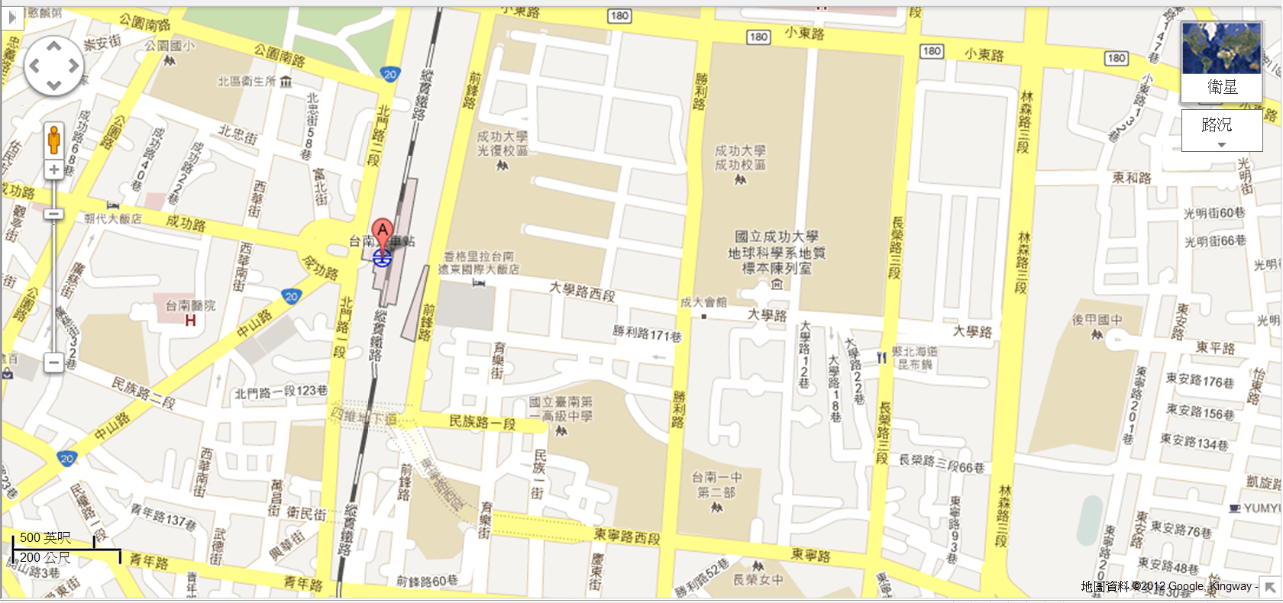
Experiment
Study area
NCKU Campus

Slide 16
Experiment
The number of subjects: 178
Groups:
Control group
Request group
Counsel group
Behavioral plan group
Each subject received a reward about 17 US$.

Slide 17
The flow chart of experiment

Slide 18
The change of illegal parking frequency
Time point 1
Distribute the parking record booklet
Time point 2
Retrieve the parking record booklet
Time point 3
Retrieve the parking record booklet
time
— | (1)The First Week M（STD） | (2)The Second Week M（STD） | Proportion of Change ((2)-(1))/(1)
Control Group | 5.86（5.27） | 5.41（5.84） | －7.68%
Request Group | 4.98（4.19） | 3.67（4.56） | －26.31%
Counsel Group | 5.02（5.10） | 4.02（4.60） | －19.91%
Behavioral Plan Group | 4.00（4.49） | 3.18（5.05） | －20.50%

Slide 19
The change of illegal parking frequency
The result implies the cooperation behavior of people can be induced by persuasive communication and then they do not park their bikes illegally.
According the concept figure, the next step is to examine the change of subject’s mind. That is the changes of perceived importance, moral consciousness, goal intention and implementation intention.

Slide 20
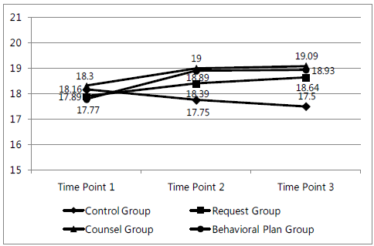
The change of perceived importance at different time points

Slide 21
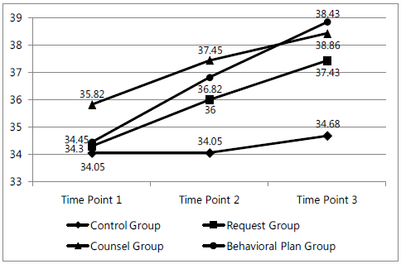
The change of moral consciousness at different time points
38.86
38.43

Slide 22
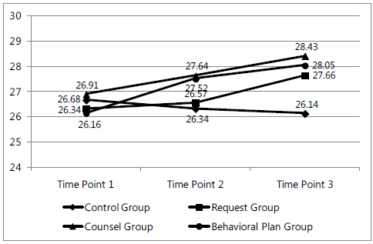
The change of goal intention at different time points

Slide 23
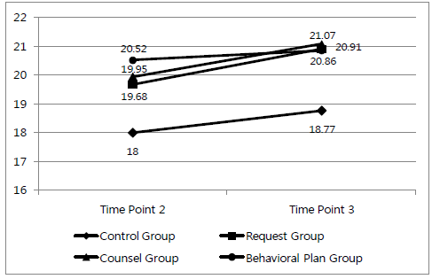
The change of implementation intention at different time points

Slide 24
The change of mind after receiving psychological strategy
The control group do not have a big change because there is nothing given to this group.
The experimental groups including request, counsel, and behavioral plan group all display a monotonic increasing. That implies the persuasive communication has a effect on the behavior modification.

Slide 25
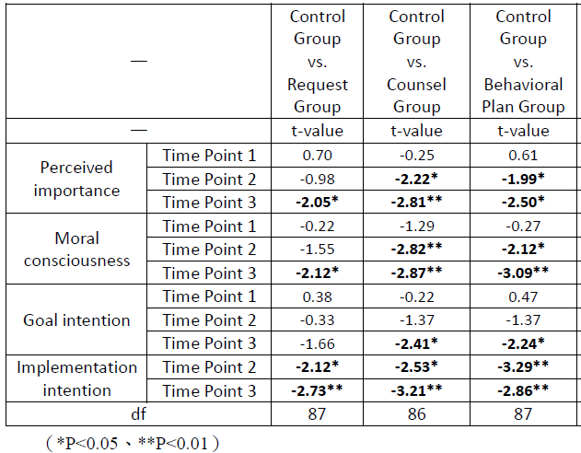
The comparison among control group and other groups

Slide 26
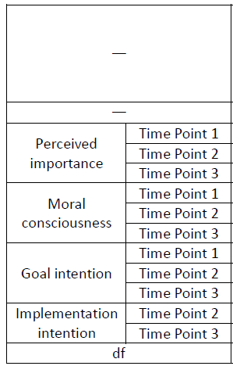

The comparison between different pairs of experimental groups
We can find the difference between different experimental groups from the above figures. However, the difference is not significant in statistical test.

Slide 27
Conclusions
The positive effect of the persuasive communication
Comparing with control group, the experimental groups which receive persuasive communication have a more positive attitude toward legal parking and result in cooperation behavior.

Slide 28
Conclusions
The significance of time effect
The effect of persuasive communication involving request, counsel or behavioral plan at time point 3 is the most significant than other time points.
That implies people need time to digest the information and then act.

Slide 29
Conclusions
It is expected that the behavior can be modified by psychological strategy.
All individuals are better off if all cooperate than if all defect.

Slide 30
Thank you very much

