Slide 1
Estonian housing market after crisis:
Searching for Origins of the demand Changes
Ene Kolbre
Angelika Kallakmaa

Slide 2
The question is:
What is behind the recovery in the Estonian housing market?

Slide 3
Purpose
To discuss the effects of changes in the economic environment
Outline the dynamics of the housing market during and after the crisis
Evaluate the changes in the housing quality
Analyse housing affordability and households behaviour

Slide 4
Framework
Economic indicators in Estonia
 | 2007 | 2008 | 2009 | 2010 | 2011 | 2012* | 2013*
Nominal GDP (EUR billion) | 16,1 | 16,3 | 13.8 | 14.3 | 16.0 | 16.7 | 17.8
Unemployment rate (%) | 4,7 | 5,5 | 13,8 | 16,9 | 12,1 | 10,4 | 9,6
Average monthly gross wages and salaries (EUR) | 724,5 | 825,2 | 783,8 | 792,3 | 847,8 | 879 | 923
General government budget balance (% of GDP) | 2,4 | - 2,9 | -2,0 | 0,2 | 1,0 | -2,0 | -0,7
General government gross debt (% of GDP) | 3,7 | 4,5 | 7,2 | 6,7 | 6,0 | 8,8 | 11,3
Consumer price index | 6,6 | 10,4 | - 0,1 | 3,0 | 5,0 | 3,3 | 3,0
Source: Eurostat, Statistics Estonia Bank of Estonia, Ministry of Finance
Forecast Bank of Estonia, Ministry of Finance
Notes:
On the one hand – debt crieses in Europa
But Estonia still fills the Maastricht crieria

Slide 5
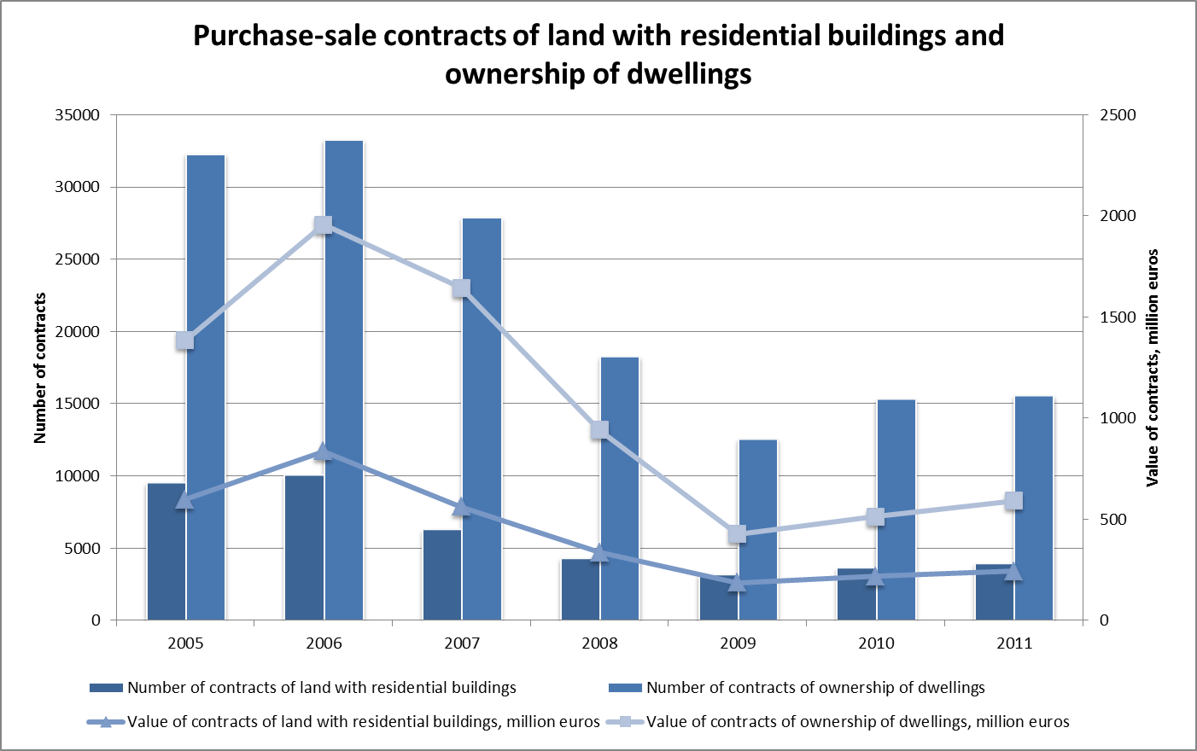

Slide 6
Housing quality
The aim is to investigate the opinions of market participants about the housing quality and make a hierarchy of quality indicators under the new housing market rise.
Quality grade is a complex indicator that represents a combination of factors that characterise the value of the living space taking into consideration that every factor has to assessed based on the principles of sustainable development and saving use and market expectations for these indicators

Slide 7
The basis of the quality rating system
Value is evaluated on the basis of the following attributes:
location and use of the plot,
quality of construction,
real estate management
Valuation of each attribute is based on the factors that influence the respective attribute

Slide 8
Methods
Analytic Hierarchy Process (AHP) method elaborated by Thomas L. Saaty was used to evaluate the hierarchy of the factors influencing the quality grade and the changes in the hierarchy, depending on market changes.

Slide 9
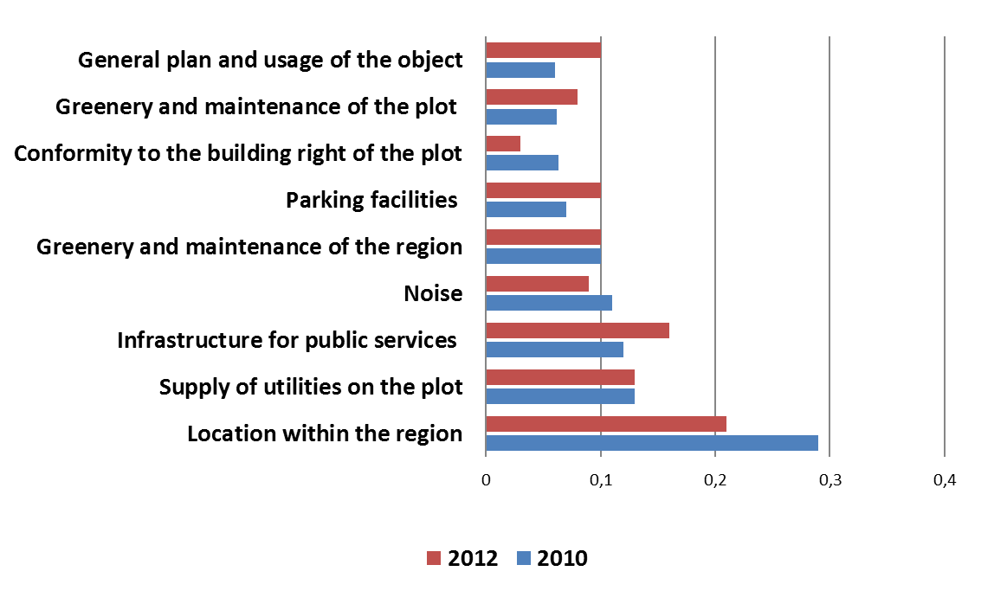
Weightings of factors influencing the quality rating on the basis of location and plot

Slide 10
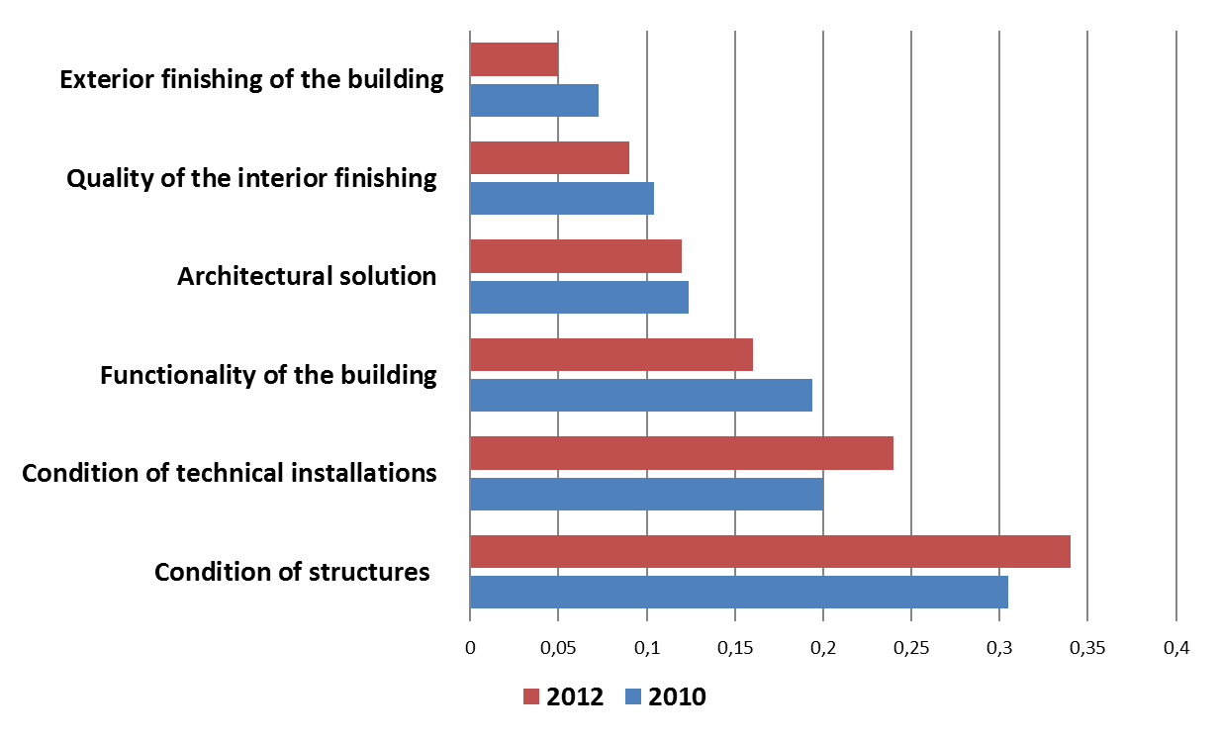
Weightings of factors influencing the quality rating on the basis of construction quality

Slide 11
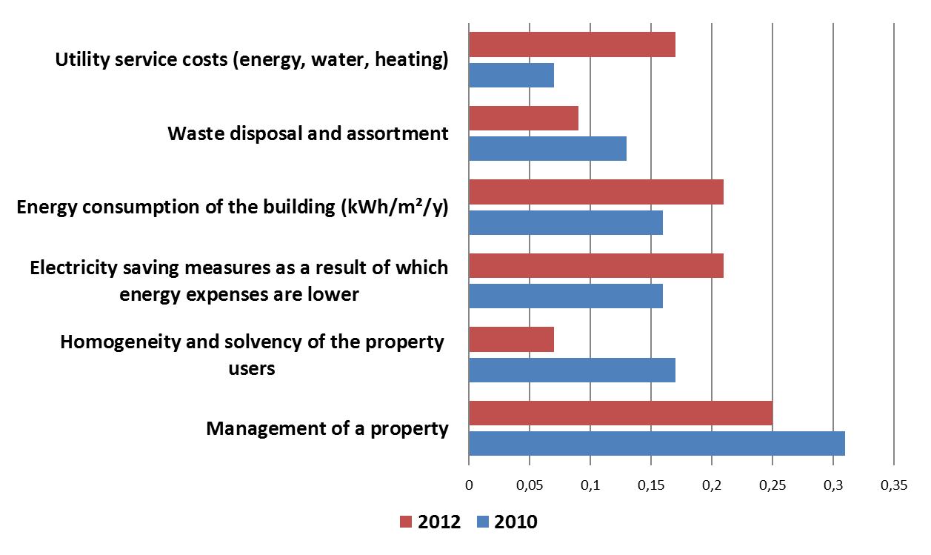
Weightings of factors influencing the quality rating on the basis of real estate management

Slide 12
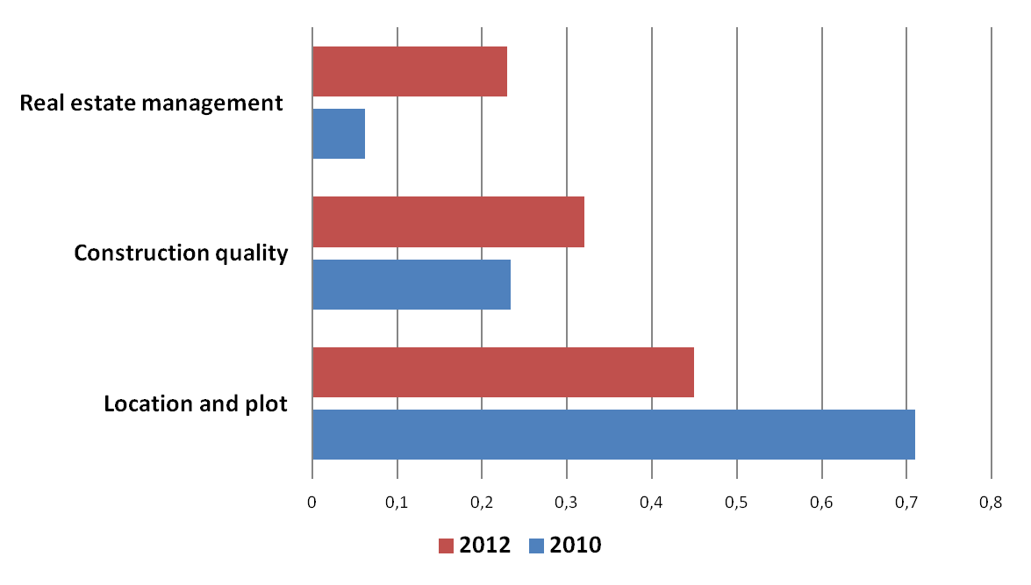
Weightings of attributes

Slide 13
Burnside, G., Eichenbaum, M.,
Rebelo, S. (2011)
„Some booms in housing prices are followed by busts. Others are not.
In either case it is difficult to find observable fundamentals that are correlated with price movements.“
Notes:
Paljudes riikides tuli pärast buumi tuli kriis
Aga Eestis ei tulnud
Tuli järsk kukkumine, sellele on järgnenud kosumine

Slide 14
Affordability
(Maclennan and Williams,1990)
Affordability’ is connected with securing some given standard of housing (or different standards) at a price or rent which does not impose, in the eyes of a third party (usually the government), an unreasonable burden on household incomes

Slide 15

The housing affordability
(Gan, Hill 2008)
Purchase affordability
Repayment affordability

Slide 16
Affordability
On one hand, we can see the purchase affordability, which considers whether a household is able to purchase a house
On the other hand of affordability, there is the repayment affordability, which considers the burden imposed on a household of repaying the mortgage

Slide 17
Affordability in the United States:
Income and Price Contributors
(Kutty, N., 2007)
The paper concludes that the housing affordability problem for renters has been largely income-driven
and for owners - changes in affordability have been related to changes in mortgage costs

Slide 18
P/I ratio for Estonia (dwellings)
Notes:
Eesti keskmine situatsioon on parem kui Tallinnas

Slide 19
P/I ratio for Tallinn
Notes:
Arvutused tehtud Tallinna kohta (2-toaline ning Tallinna keskm sissetulek)
Kas vastab tõele, et tehakse vähem tehinguid, aga kallimaid? Kas tuua juurde keskmise tehingu väärtuse?
Household 1,5 average income

Slide 20
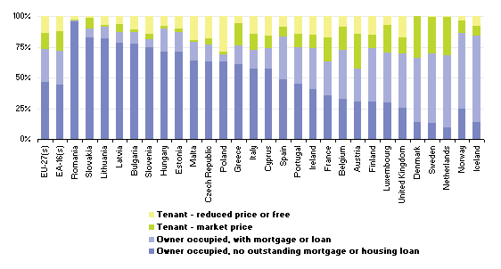
Population by tenure status, 2009 (Eurostat)
Notes:
Eestlane on enamasti eluaseme omanik

Slide 21
Rent to income ratio (Tallinn)
Notes:
Olukord on paranenud, kuid keskmist palka teeniv tallinlane saab üürida ühe, äärmisel juhul kahetoelise
Burden 30 %

Slide 22
HAI index
Notes:
Repayment
Ettekandes tuua välja Mis on HAI sisu

Slide 23
Turnover of housing loans and households´ deposits (EUR million)
Source: Bank of Estonia
Notes:
Deposits turnover reflects deposits (excluding demand and overnight deposits) received during the period from customers other than credit institutions.

Slide 24
Stock of housing loans and stock of households deposits
Notes:
Deposit growth makes banks in Estonia less dependent on financial markets
Average housing loan 2011 ;
Estonia 34 523 eur
Latvia 37 644 eur
Lithuania 45 645 eur

Slide 25
Loan to deposit ratio for Estonian market
Notes:
Hoiused on viimasel ajal kasvanud
Aga samas laenude jääk siiski suurem kui hoiuste jääk

Slide 26
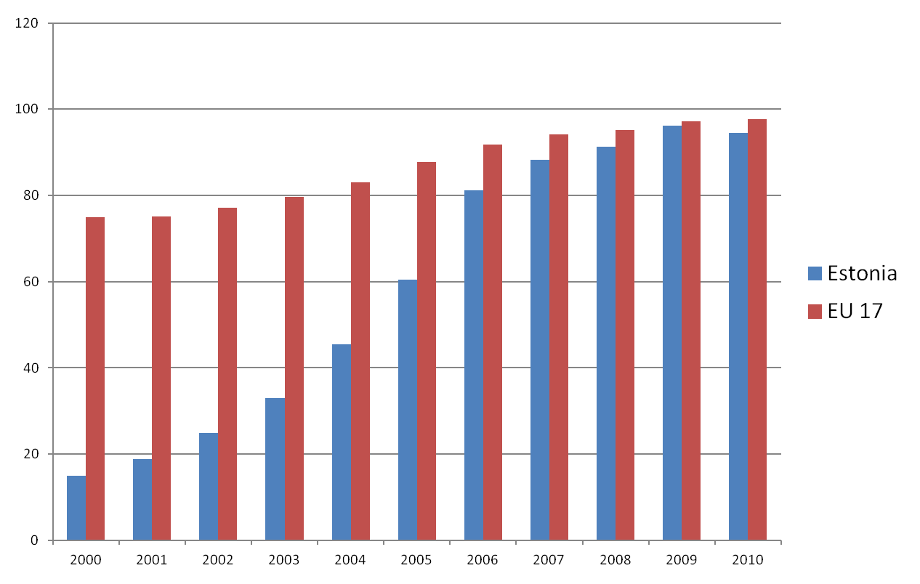
Gross debt-to-income ratio of households %
(Eurostat)
Notes:
Gross debt-to-income ratio of households is defined as loans (ESA95 code: AF4), liabilities divided by gross disposable income (B6G) with the latter being adjusted for the change in the net equity of households in pension funds reserves (D8net). Detailed data and methodology on site http://ec.europa.eu/eurostat/sectoraccounts
In advances economies during the five years preceding 2007 The ratio of household debt to income rose by an average 39
Percentage points to 138 percent (IMF April 2012)
26
Tallinn University of technolgy

Slide 27
Conclusions
The demand is driven by the improved affordability situation
Constructed HAI model shows the that repayment affordability has improved after 2009
P/I ratio shows still difficulties in purchase affordability for one person
Falling house prices have not solved the problem of affordability
Households are strengthening their balance sheet
Housing loan turnover continues to decrease, despite of low interest rate
Deposit growth makes the banks in Estonia less dependent on financial markets

Slide 28
Thank You!
Ene Kolbre
School of Economics and Business Administration, Tallinn University of Technology
3 Akadeemia tee, 19086 Tallinn, Estonia
Phone: 372-6203 952, e-mail: ene.kolbre@tseba.ttu.ee
Angelika Kallakmaa-Kapsta
School of Economics and Business Administration, Tallinn University of Technology
3 Akadeemia tee, 19086 Tallinn, Estonia
Phone: 372-6204 057, e-mail: angelika.kallakmaa@tallinnlv.ee

