Slide 1


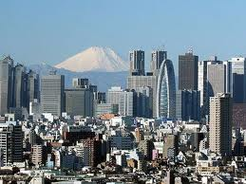



Dynamic Analysis of House Price Diffusion across Asian Financial Centres
J. Yeh and A. Nanda
Presented by
Jia-Huey Yeh
Hong Kong
Singapore
Tokyo
Seoul
Taipei
Bangkok

Slide 2
Agenda
Background and Motivation
Theoretical Consideration
  Determinants of Housing Prices
  Explanations of Diffusion Effects
Methodology
  The GVAR Model
  Estimation of the GVAR Model
Results
Conclusion

Slide 3


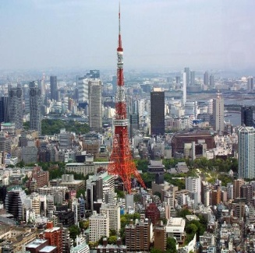



New York
₤6,442/sqm
London
₤8,403/sqm
Tokyo
₤11,018/sqm
L.A.
₤2,656/sqm
Edinburgh
₤2,976/sqm
Osaka
₤3,780/sqm

Slide 4
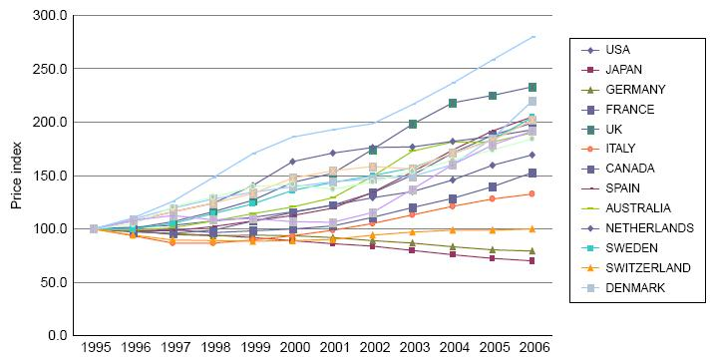
Background and Motivation (cont.)
The Fluctuations of Global Housing Markets
Source: BIS data

Slide 5
Background and Motivation (cont.)
The Gap of Housing Prices between Financial and Non-financial Centre
Source: National Statistics, Taiwan

Slide 6
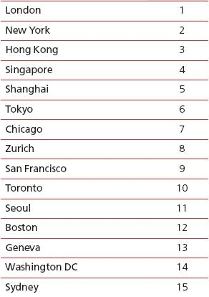
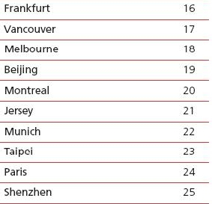
Background and Motivation (cont.)
The importance of Asian Financial Centres
Top 25 the Global Financial Centres Ranks
Source: The Global Financial Centres Index, 2011
Notes:
T

Slide 7
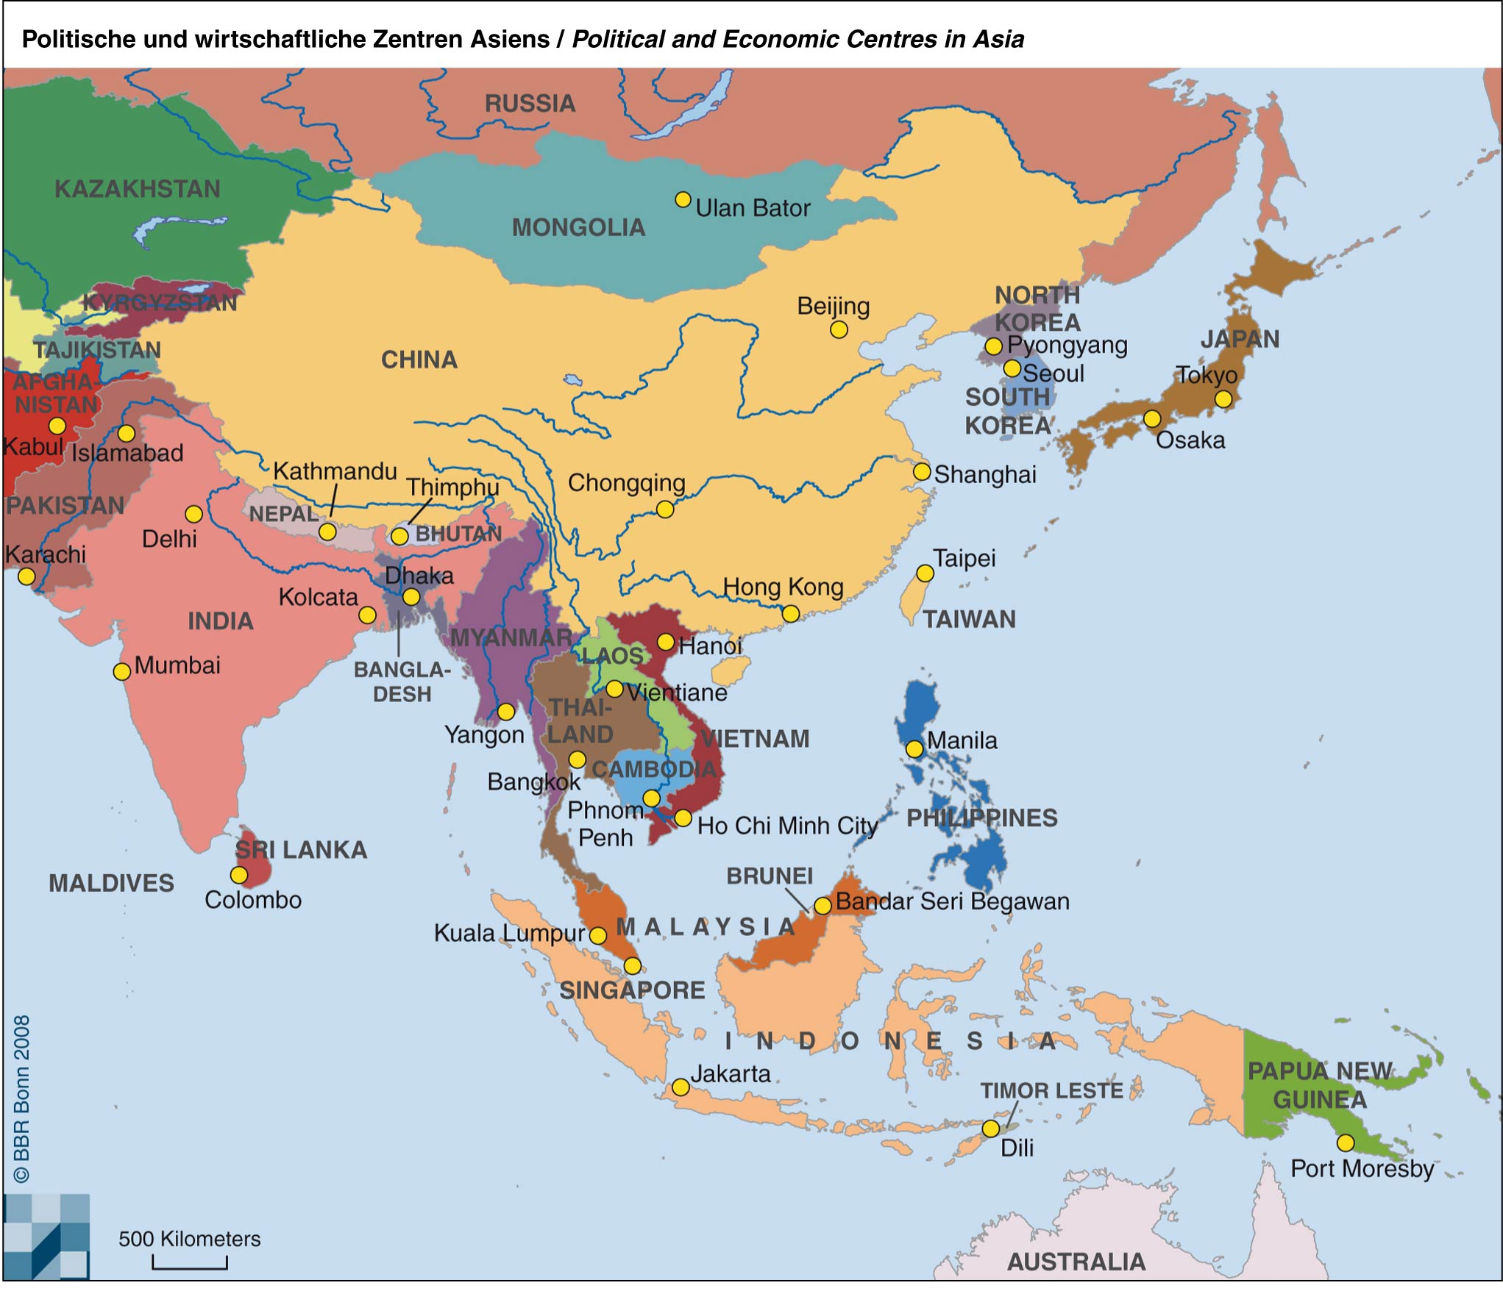
Map of the Regions

Slide 8
Map of the Regions
GDP (ppp) to the World GDP (ppp) Ratios
Source: IMF and Datastream. The ratio of trade flows to GDP based on average weights from 2006 to 2009

Slide 9
Background and Motivation (cont.)
Hypothesis
Global factors determine house prices in Asian financial centres
There is an existence of lead-lag relations between housing markets in Asian financial centres
The diffusion effect causes house prices in Asian financial centres to decouple from those in non- Asian financial centres

Slide 10
Background and Motivation (cont.)
Objective
To investigate whether there exists the ripple effect, why there exists ripple effect and the global macroeconomic determinants of house prices in six financial centres (Hong Kong, Tokyo, Seoul, Singapore, Taipei and Bangkok)
To understand implication for investors and policy makers to understand the causal relationship of housing price movements across these financial cities

Slide 11
Theoretical Consideration
  Determinants of House Prices
  Macroeconomic Conditions
    Monetary policy i.e. interest rate, inflation targeting
    Labour market dynamics
  Global factors
    House price movements not only affected by the national economy but also by the global factors due to integration of economy
    Recession in the global economy affects the national economy and further influencing housing prices

Slide 12
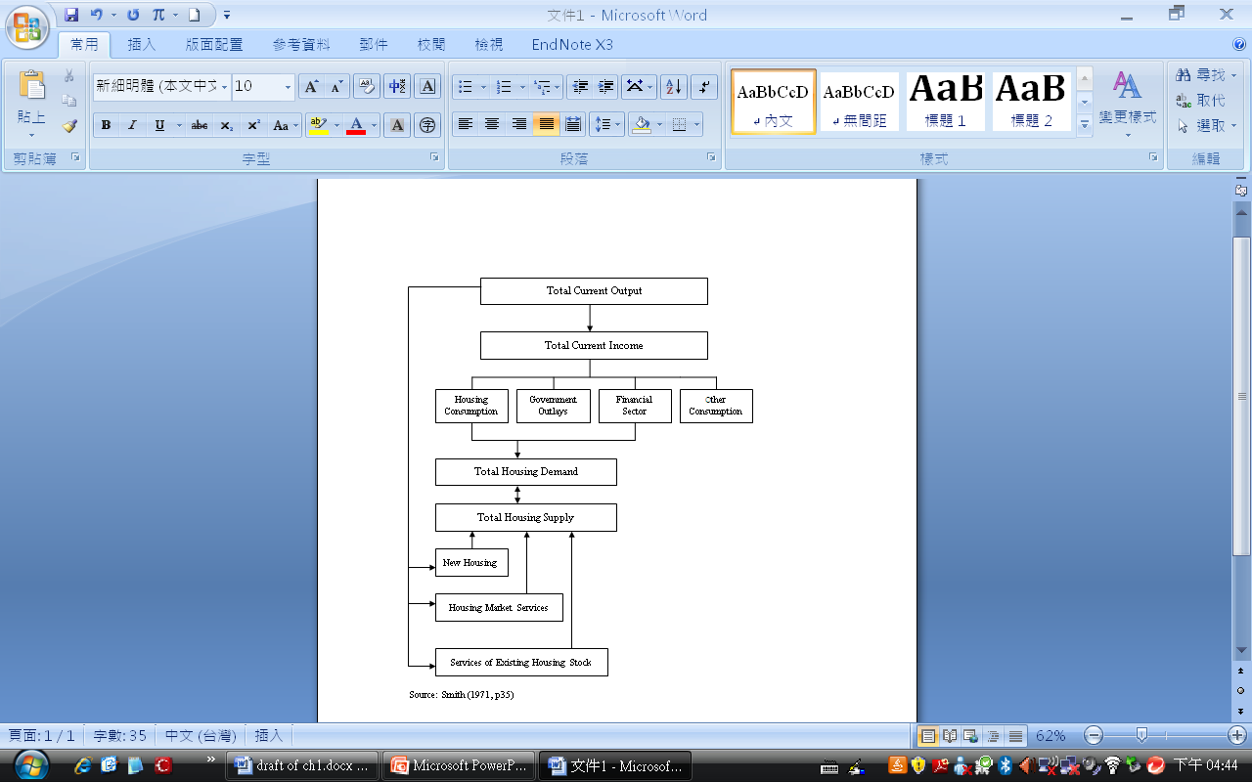
Theoretical Consideration(cont.)
Determinants of House Prices
Global macro conditions
Country macro economy
House prices

Slide 13
Theoretical Consideration (cont.)
  Explanations of Diffusion Effects
Balassa-Samuelson Effect
  Balassa (1964) and Samuelson (1964) suggest that in the long-run the purchasing power parity would be invalid due to the differences of productivity of trade sectors across countries
  A higher degree of open economy will lead to greater productivity of tradable sectors because of economies of scale
  In a small economy the price of tradable goods determined by the international competition and freedom of labour mobility within a country keeping similar wage level between tradable and non-tradable sectors
    Higher productivity of tradable sector causing an increase in wage level and pushing up the relative prices of non-tradables
    Low mobility of labour across countries and spatial fixity causing real estate to have similar characteristics as
    non-tradable sector –[EXPLAIN MORE]

Slide 14
  Theoretical Consideration (cont.)
  Explanations of Diffusion Effects
Balassa-Samuelson Effect
  A higher degree of the openness of the economy has a significant positive impact on house prices
  (non-tradables)
  Low mobility of labour across countries and spatial fixity causing real estate to have similar characteristics as non-tradable sector
Increase in wage level in tradable sector
Increase in wage level in non-tradable sector
Rise in relative prices of non-tradables
Growth in productivity of tradable sector

Slide 15
Theoretical Consideration (cont.)
  Explanations of Diffusion Effects
Housing Wealth Effect Chains
  An increase in housing price raising expected permanent income growth and borrowing capability leading to higher consumption
  Asset price shocks causing changes not only in domestically produced goods/services but also in trade balance through the transmission of consumption as international wealth channel (Holinski and Vermeulen, 2011)
  One country’s economic activity could be affected by the other country’s housing wealth effect causing increase in the country’s housing prices (Oikarinen, 2006)
  Housing wealth effect may contribute to causal relationships between some housing markets with economic interdependence

Slide 16
Theoretical Consideration (cont.)
Housing Wealth Effect Chains
  Housing wealth effect may contribute to causal relationships between some housing markets with economic interdependence
Shock to house prices in Region A
Consumption changes in Region A
Trade balance changes in Region A
Exports changes in Region B
House prices changes in Region B
Balassa-Samuelson effect?

Slide 17
Theoretical Consideration (cont.)
    Process of House Price Diffusion
Balassa-Samuelson Effect
A higher degree of the openness of the economy causing relatively higher house prices (non-tradables)
Gravity Model
Higher GDP and shorter distance between trading partners leading to greater trade flows
Housing Wealth Effect Chains
House price shocks causing changes in domestically produced goods/services and in trade balance by housing wealth effect
One country’s housing wealth effect affecting the other country’s economic activity and influencing the country’s house prices

Slide 18
Literature Review
  Co-movements of Real Estate Markets
Study | Estimated method and period | Results
Chen et al. (2004) | Using structural time-series method to test Hong Kong, Singapore, Tokyo and Taipei housing markets series | Similar trends and cyclical house prices in Hong Kong, Singapore, Tokyo and Taipei
Gerlach et al. (2006) | Property share indices in Hong Kong, Singapore, Malaysia and Japan from 1993 to 2001 based on VAR with Inoue’s (1999) structural break model. | The 1997 Asian financial crisis did influence property markets in the East Asia Region, causing the independence between these real estate markets

Slide 19
Literature Review (cont.)
Determinants of Co-movements
Study | Estimated method and period | Results
Case et al. (1999) | 1987-1997 in 22 cities around the world. | Global GDP is more important in industrial property
Otrok and Terrones (2005) | 1980Q1-2004Q1 in 13 industrial countries by using dynamic VAR | Global factors including low real interest rate and global business cycle are important determinants of house price cycles.
Beltratti and Morana (2010) | 1980Q1-2007Q2 in G-7 areas by using F-VAR model | Global factors drive international house prices.
Goodhart and Hofmann (2008); Adams and Fϋss (2010) | 1970Q1-2006Q4 in 17 industrialised countries. 1975Q1-2007Q2 in 15 OECD countries with panel VAR model | Multidirectional link between house prices, monetary variables and macro activity

Slide 20
Literature Review (cont.)
House Price Diffusion
Study | Estimated method and period | Results
Pollakowski and Ray (1997) | 1975-1994 in the US by using VAR model | Existence of lead-lag relations between neighbouring areas
Meen (1999) | 1973-1994 in the UK Based on life-cycle model | Ripple effect is caused by adjustments within regions rather than between regions
Stevenson (2004) ; Oikarinen (2006); Hui (2010) | 1978 Q1- 2002 Q2 in Ireland and Northern Ireland; 1987-2004 in Finland ; 1989-2001 in Malaysia by using VAR and VECM | Housing price diffusion first from the main economic centre to regional centres and then to the peripheral areas
Vansteenkiste and Hiebert (2011) | 1989-2007 in 10 euro countries by using the GVAR model | There exists positive correlations in the long run in Euro area house prices; country-specific factors still play important roles in house prices

Slide 21
Differences from Previous Research
  Applying Balassa-Samuelson framework from International Trade literature to investigate house price diffusion
  Examining housing price spillovers through the housing wealth effect chains
  Using the GVAR model to combine country-specific as well as international trade and global factors
  Estimating diffusion of house prices across Asian financial centres across different countries
    Consisting of an important period including 1997 AFC and 2007 GFC.

Slide 22
Expected House Price Diffusion
 | Hong Kong | Tokyo | Seoul | Singapore | Taipei | Bangkok
Hong Kong |  | + Small | + Small | + Large | + Large | + Small
Tokyo | + Large |  | + Large | + Large | + Large | + Large
Seoul | + Large | + Large |  | + Large | + Large | + Large
Singapore | + Large | + Small | + Small |  | + Small | + Large
Taipei | + Large | + Small | + Small | + Small |  | + Small
Bangkok | + Small | + Small | + Small | + Large | + Small
Trade partner
Main country
+ indicates positive effect; large/small indicates the extent of diffusion effect

Slide 23
Methodology
The Global Vector Autoregressive Model
(the GVAR)
  Introduced by Dees, di Mauro, Pesaran, and Smith (2007) and Pesaran, Schuermann, and Weiner (2004)
  Combining country-specific variables and their country-specific foreign variables with weighted averages for all other countries
  The GVAR allowing 3 interdependent channels
    Contemporaneous interactions of domestic and foreign variables and their lagged values
    Interrelations between country specific variables and common exogenous variables
    Contemporaneous dynamic analysis by using cross-country covariance

Slide 24
Methodology(cont.)
  Each country can be seen as VAR augmented by weakly exogenous (foreign) variables x*, namely VARX with the first order
  x_{it} = a_{io} + a_{i1}t + Φ_{i}x_{i,t−1} + Λ_{i0}x*_{it} + Λ_{i1}x*_{it−1} + u_{it} t = 1, 2,…, T and i = 1,…,N (1)
  x_{it}* = w_{ij} x_{jt} , with w_{ii} = 0 , w_{ij} =1, j = 1,…, N, based on cross-country trade flows
  Where
  a_{i0} and a_{i1}: k_{i} × 1 vector of fixed intercepts, and the deterministic time trend
  x_{it} : k_{i}× 1 vector of country-specific (domestic) variables
  x_{i}* : k_{i}*× 1 vector of foreign variables specific to the country i
  Φ_{i} : k_{i} × k_{i} matrix of coefficients related to lagged domestic variables
  Λ_{i0} and Λ_{i1} : k_{i} ×k_{i}* matrices of coefficients associated to foreign variables
  U_{it} : k_{i} ×1 vector of country-specific shocks, serially uncorrelated with mean zero and a time invariant covariance matrix Σ_{ii}

Slide 25
Methodology(cont.)
The vector error-correction model (VECMX) for a co-integration VARX can be written as
  ∆x_{it} = c_{i0} − α_{i} β_{i}′[z_{it-1} − γ_{i}(t − 1)] +Λ_{i0}∆x*_{it} + Γ_{i}∆z_{it-1}+ u_{it} (2)
Where
z_{it} = (x_{it}, x_{it}*)′, α_{i} is the speed of adjustment coefficients composing k_{i}× r_{i} matrix of rank r_{i}, and the co-integration vectors β_{i} is a (k_{i} + k_{i}*)× r_{i} matrix of rank r_{i}.
The r_{i} error-correction terms defined by the above model can now be followed as
β_{i}′(z_{it} − γ_{i}t) = β_{ix}′x_{it} + β_{ix*}′x*_{it} −(β_{i}′ γ_{i}) t (3)
The GVAR(1) model for each country model X_{t} as:
G_{t} = a₁₀ + a₁t + Hx_{t-1} + u_{t} (4)
G = (X₁W₁…X_{N}W_{N})′, H = (B₁W₁…B_{N}W_{N})′, a₀ = (a₁₀…a_{N0})′,
a₁ = (a₁₁…a_{N1})′, u_{t} = (u_{1t}…u_{Nt})′
Where
W_{i} : (k_{i} + k_{i}*) × k matrix of fixed constants defined in terms of the country-specific weights

Slide 26
Methodology (cont.)
Estimation of the GVAR
  Model 1, considering the VARX(1,1) as
x_{it} = a_{io} + a_{i1}t + Φ_{i}x_{it−1} + Λ_{i0}x*_{it} + Λ_{i1}x*_{it−1} + u_{it} (1)
x_{it} = (hp_{it}, y_{it}, r_{it}, m_{it}, c_{it}, housing_{it})', x*_{i,t} = (hp*_{it}, y*_{it}, r*_{it}, m*_{it}, c*_{it})'
hp*_{it} = w_{ij} hp_{jt} , y*_{it} = w_{ij} y_{jt ,} r*_{it} = w_{ij} r_{jt} , m*_{it} = w_{ij} m_{jt­}; c*_{it} = w_{ij} c_{jt} ,
  Model 2, the equation (1) can be augmented to investigate the Balassa-Samuelson effect as
  x_{it} =(hp_{it}, y_{it}, r_{it}, m_{it}, c_{it}, housing_{it}, open_{it})', x*_{it} = (hp*_{it}, y*_{it}, r*_{it}, m*_{it}, c*_{it})‘

Slide 27
Methodology (cont.)
Estimation of the GVAR
  Model 3, the equation (1) can be changed to examine the housing wealth effect chains
  x_{it} = (hp_{it}, y_{it}, r_{it}, m_{it}, c_{it}, housing_{it}, open_{it}, tb_{it})’
  x*_{it} = (hp*_{it} , y*_{it} , c*_{it} , r*_{it} , m*_{it} )‘
Where
Hp: house price index; y: the GDP; C: private consumption; r: interest rates; m: money supply; housing: the share of housing in the GDP
open: trade shares (exports + imports) in the GDP; tb: trade balance
hp*, y*, c*, r*and m*: the county-specific foreign variables
(weakly exogenous ) with fixed trade weights computed by average trade flows from 2006 to 2009

Slide 28
Data
  Quarterly data from 1991 Q1 to 2011 Q2 in Hong Kong, Japan, South Korea, Singapore, Taiwan and Thailand and house price indices in Hong Kong, Tokyo, Seoul, Singapore, Taipei and Bangkok
  Data is obtained from Bloomberg, Datastream and national sources
  Real data except for interest rates are used and seasonally adjusted. Also, apart from interest rates, housing and openness, all variables are calculated in changes in percentage.
Fluctuations of Real Housing Price Index
2000Q2=100
Notes:
[EXPLAIN DATA CAREFULLY]

Slide 29
Methodology (cont.)
Estimation of the GVAR
Fluctuations of Real Housing Price Index 2000Q2=100

Slide 30
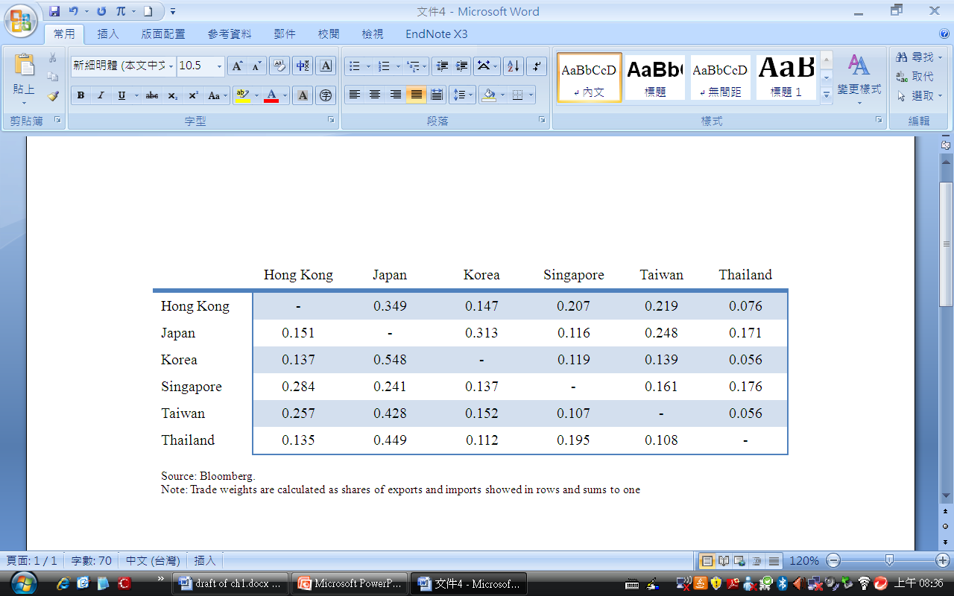
Methodology (cont.)
Estimation of the GVAR
Trade weights
  Using the average trade flows from 2006 to 2009 for each country/region to compute the weights of country-specific foreign variables
Source: Bloomberg.
Note: Trade weights are calculated as shares of exports and imports showed in rows and sum to one.

Slide 31
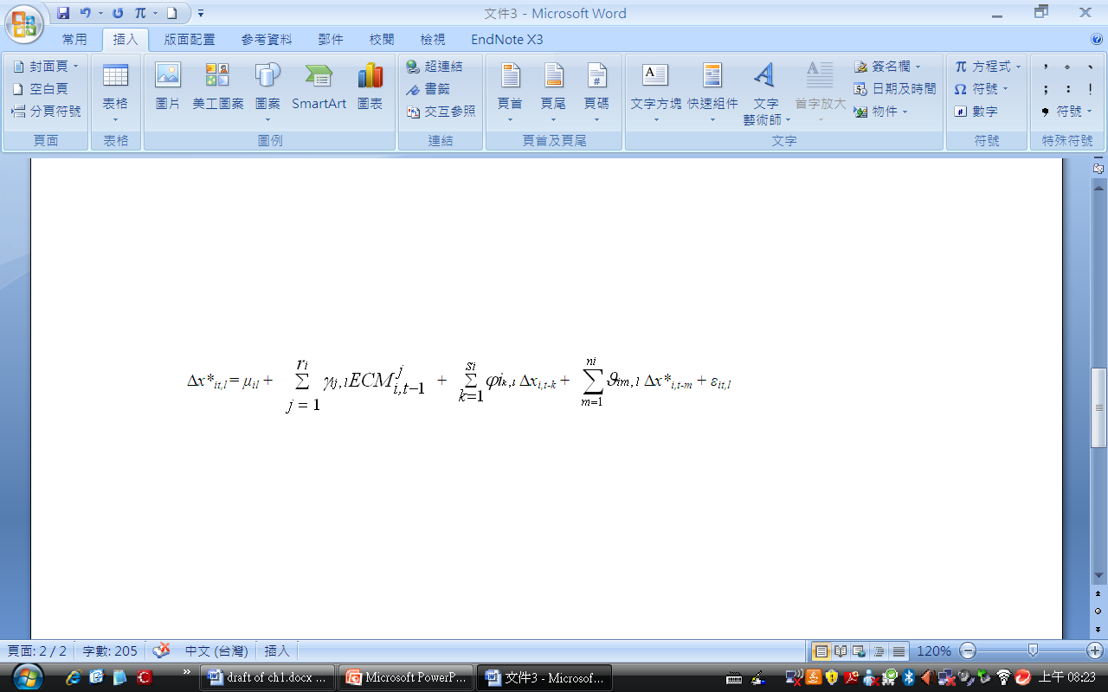
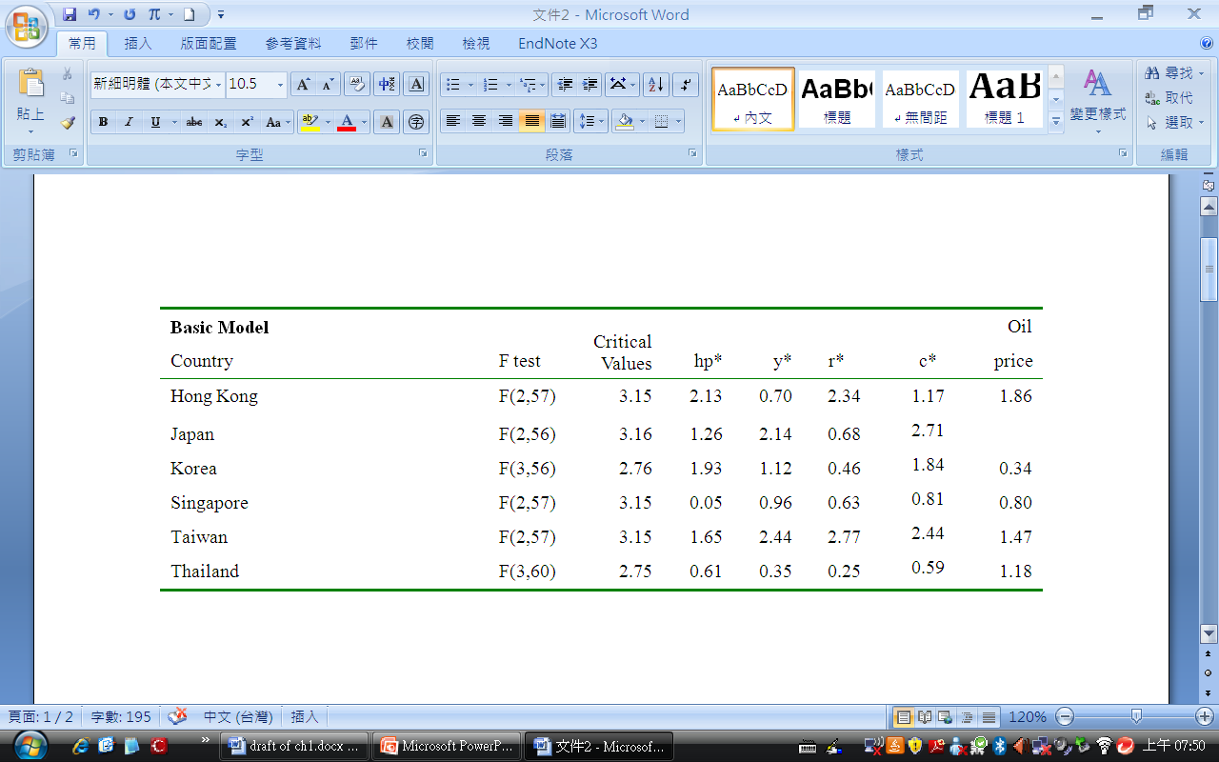
Methodology (cont.)
Estimation of the GVAR
Weak Exogeneity Test for Foreign Variables
To test γ_{ij,l} = 0, implying no long run information from domestic variables to foreign variables, but contemporaneous and lagged short run feedbacks exist between these two variables

Slide 32
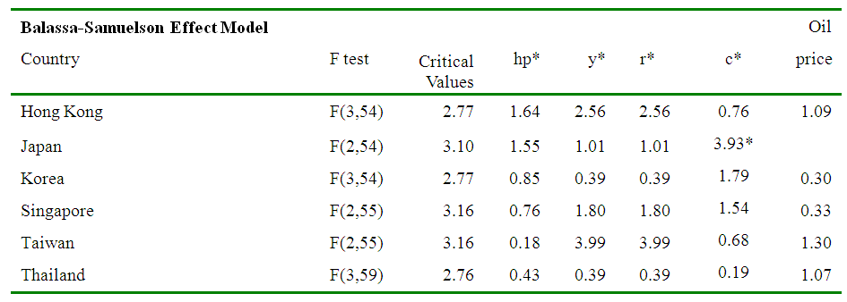
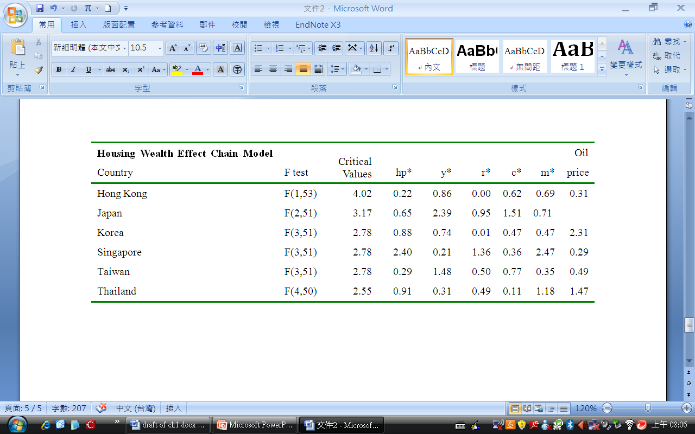
Weak Exogeneity Test for Foreign Variables
Methodology (cont.)
Estimation of the GVAR

Slide 33
Methodology (cont.)
Estimation of the GVAR
  VARX* Order and Number of Co-integration in the Country-Specific Models
 | Basic Model |  |  | Balassa-Samuelson Effect Model |  |  | Housing Wealth Effect Chain Model
 | VAR* (p_{i},q_{i}) |  |  | VAR* (p_{i},q_{i}) |  |  | VAR* (p_{i},q_{i})
Country/Region | p_{i} | q_{i} | Number of cointegration | p_{i} | q_{i} | Number of cointegration | p_{i} | q_{i} | Number of cointegration
Hong Kong | 1 | 1 | 4 | 2 | 1 | 3 | 2 | 1 | 3
Japan | 2 | 1 | 3 | 2 | 1 | 4 | 2 | 1 | 4
South Korea | 2 | 1 | 3 | 2 | 1 | 2 | 2 | 1 | 4
Singapore | 1 | 1 | 4 | 2 | 1 | 5 | 2 | 1 | 6
Taiwan | 1 | 1 | 3 | 2 | 1 | 3 | 2 | 1 | 5
Thailand | 2 | 1 | 4 | 2 | 1 | 6 | 2 | 1 | 7

Slide 34
Results
Following the Generalized Impulse Response Function (Koop, Pesaran and Potter,1996; Pesaran and Shin, 1998) to estimate the dynamics of housing price diffusion effects
  Global Macro Shocks Based on Basic Model (Model 1)
    Defined as a weighted average (using PPP GDP weights) of variable-specific shocks across all the regions in the model
  Openness Shock Based on Balassa-Samuelson Hypothesis Model (Model 2)
  House Price Shocks Based on Housing Wealth Effect Chain Model (Model 3)

Slide 35
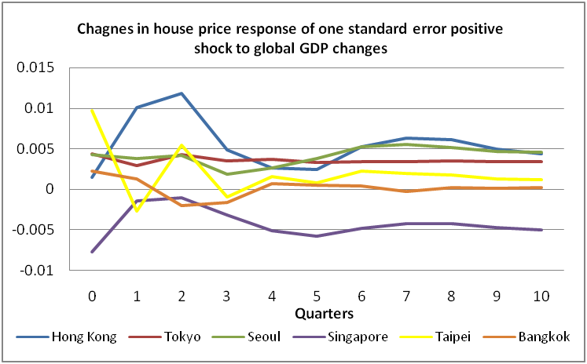
Results (conts.)
Global Macro Shocks Based on Basic Model (Model 1)

Slide 36
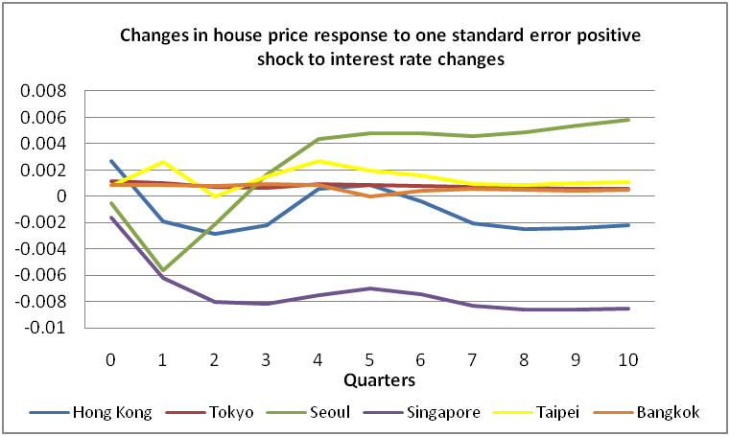
Results (cont.)
Global Macro Shocks Based on Basic Model (Model 1)

Slide 37
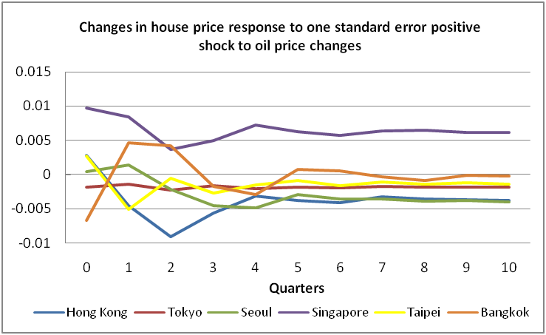
Results (cont.)
Global Macro Shocks Based on Basic Model (Model 1)
Notes:
THINK ABOUT HK

Slide 38
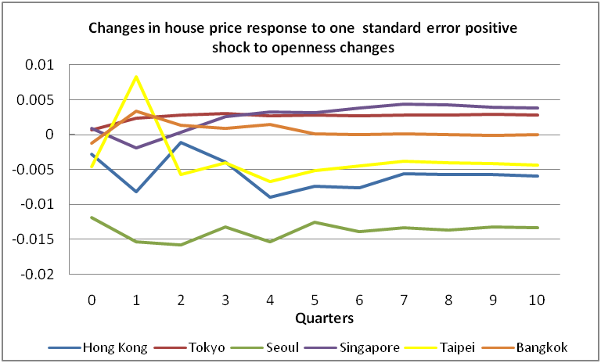
Results (cont.)
Openness Shock Based on Balassa-Samuelson Hypothesis

Slide 39
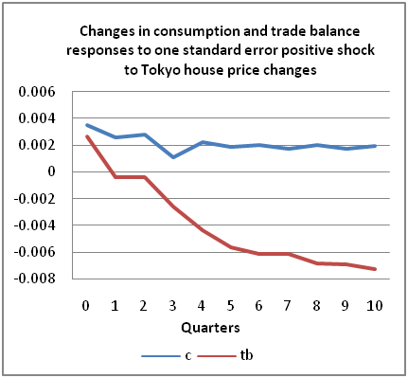
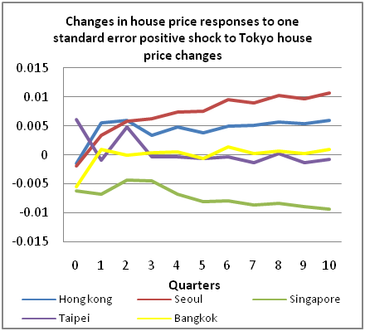
Results (cont.)
House Price Shock Based on Housing Wealth Effect Chain Model

Slide 40
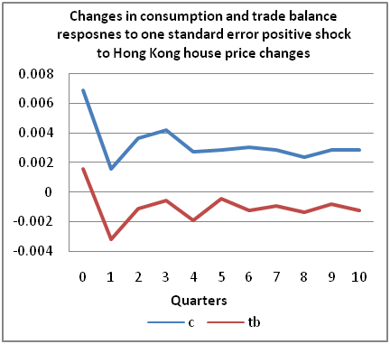
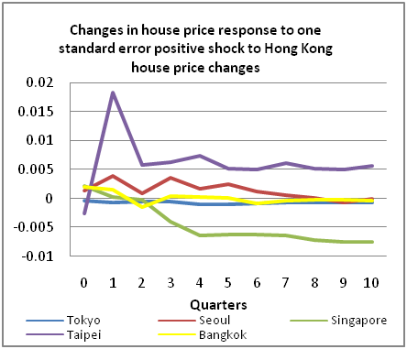
Results (cont.)
House Price Shock Based on Housing Wealth Effect Chain Model

Slide 41
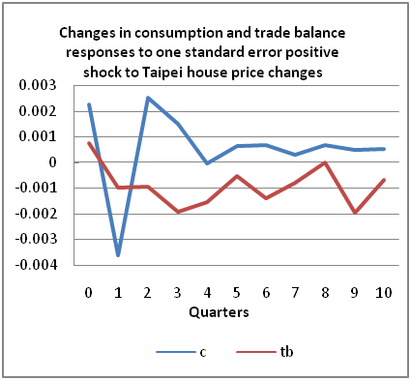
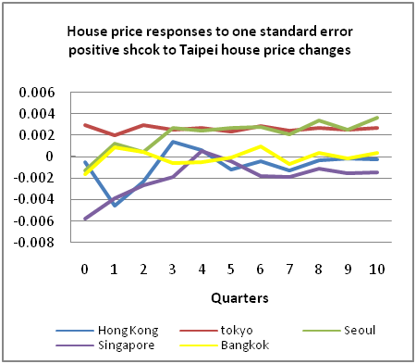
Results (cont.)
House Price Shock Based on Housing Wealth Effect Chain Model

Slide 42
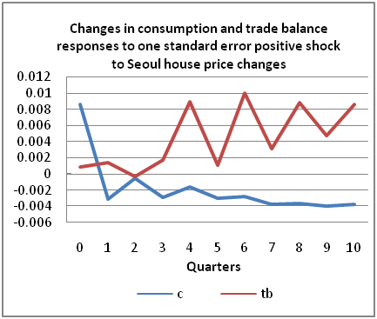
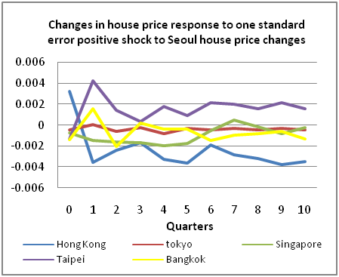
Results (cont.)
House Price Shock Based on Housing Wealth Effect Chain Model

Slide 43
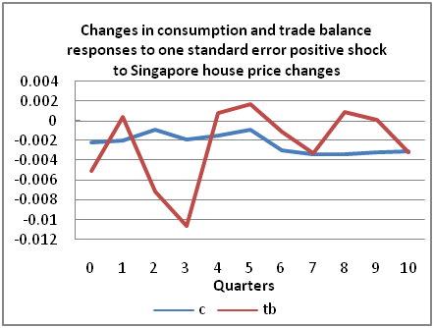
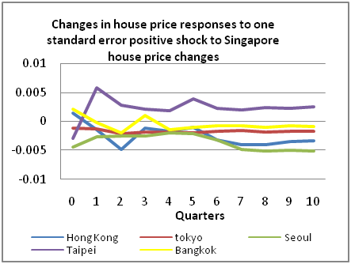
Results (cont.)
House Price Shock Based on Housing Wealth Effect Chain Model

Slide 44
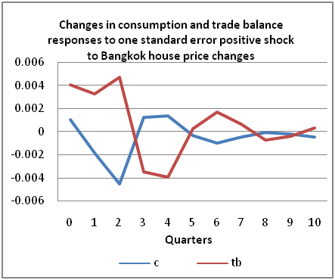
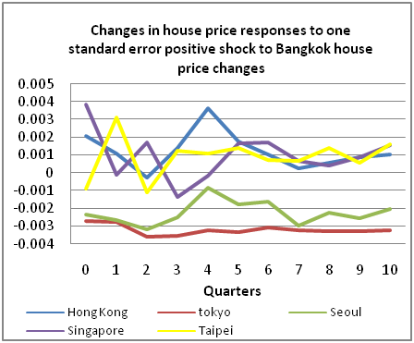
Results (cont.)
House Price Shock Based on Housing Wealth Effect Chain Model

Slide 45
Estimated House Price Diffusion
Trade partner
 | Hong Kong | Tokyo | Seoul | Singapore | Taipei | Bangkok
Hong Kong |  | − Small/None | + Some | - Some | + Large | + Small/None
Tokyo | + Some |  | + Large | - Some | + Some/None | None
Seoul | - Small | None |  | - Small | + Some | None
Singapore | − Small | None | − Small |  | + Some | None
Taipei | None | - Small | + Small | - Small |  | None
Bangkok | + Small | − Small | - Small | + Small | + Small
Main country
+/− indicates positive or negative effect; large/some/small indicates the extent of house price index responses more than 1%, 0.5% and under 0.5%, respectively.

Slide 46
Estimated House Price Diffusion
Trade partner
 | Hong Kong | Tokyo | Seoul | Singapore | Taipei | Bangkok
Hong Kong |  | Coeff??
Tokyo
Seoul
Singapore
Taipei
Bangkok
Main country
+/− indicates positive or negative effect; large/some/small indicates the extent of house price index responses more than 2%, 1% and under 1%, respectively.

Slide 47
Conclusions on Global Marco Shocks
Housing market in Hong Kong shows relatively strong responses to global macro shocks possibly due to its high degree of openness to global economies.
Heavy reliance on foreign investment may cause Hong Kong more vulnerable to external economic conditions.
Singapore, being another highly open economy and financial centre, shows quite different housing market dynamics, which can be possibly explained by restrictive public policies.
Over 80% of house stock owned by the Singapore government indicates public policies largely deciding the public housing prices.
Significant impacts from global interest rates on Singapore’s house price index may attribute to Singapore’s liberalisation of financial market.

Slide 48
Overall Conclusion
House price in Hong Kong reacts rapidly in response to global increases in world market, while those in Singapore only show sensitivity to global interest rates.
Tokyo and Singapore, which suggest a positive correlation between openness and house price, providing evidence of the Balassa-Samuelson effect.
Tokyo reveals the diffusion effects on house price via housing wealth effect chains.
A high degree of economic linkage between Japan and other Asian countries shows positive lead-lag relations in house prices across financial centres.
Region-specific conditions also play important roles as determinants of house prices, partly due to restrictive housing policies and demand-supply imbalances as in Singapore and Bangkok.
Future research will look into intra-regional dynamics of the house price diffusion in Taipei.

