Slide 1

Planning regulations and their impact on European commercial property dynamics
Ed Nozeman & Arno van der Vlist
Edinburgh, 15 June 2012

Slide 2
Central issue
Impact planning regulations
Whether and to what degree differences in local commercial markets relate to differences in planning regulations?

Slide 3
Impact planning regulations
`
Research design
Step 1
Review of the literature on how planning regulations and commercial market behaviour are intertwined.
Step 2
Measuring the degree of differences in commercial market returns between countries/cities
Step 3
Considering the interrelations between commercial market dynamics and planning regulations

Slide 4
Impact planning regulations
Step 1
Review of literature
Direct causal effect is lacking because of variation in regulations and methodological imprecision
Lack of empirical research relating land use regulations and development of prices in commercial r.e.

Slide 5
Impact planning regulations
Step 1
Defining planning regulations as part of institutions
Man-made rules that are meant to constrain possibly opportunistic human behaviour
Comprising
1 (In)formal rules
2 property rights
3 institutions of local
governance

Slide 6
Impact planning regulations
Step 2
Establishing the impact on performance of commercial real estate
Hypothesis
Land use regulations
comprising actors,
factors and reviews
have impact on
performance of
commercial real estate

Slide 7
Impact planning regulations
Step 2
Data and methodology
Finding data on stock, yield and rent
2. Finding proxies for land use regulations
Selecting the empirical
model

Slide 8
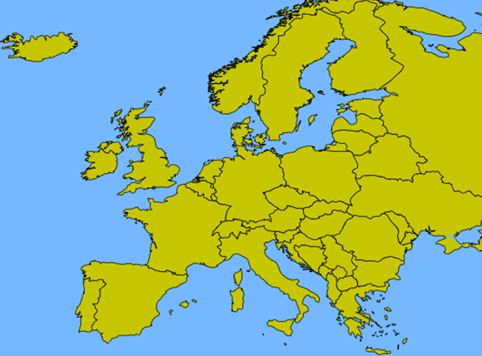

Slide 9
Impact planning regulations
2 Finding proxies for land
use regulations
Adaptation of Quigley’s questionnaire to European political structure and to commercial real estate
Type of actors involved
Type of factors involved
Required reviews
Relevance development caps, density restrictions, open space requirements, infrastructure improvents and inclusionary requirements

Slide 10


Impact planning regulations
3 Selecting the empirical model

Slide 11
Impact planning regulations
Mean RENT M2 for Offices and Retail over 2000-2010, by MSA

Slide 12
Impact planning regulations
Mean YIELD for Offices and Retail over 2000-2010, by MSA

Slide 13
Impact planning regulations
Development in Stock of offices and retail (average percentage change per year)

Slide 14
Impact planning regulations
%stock increase
BLURI political influence index 2011 per MSA

Slide 15
Impact planning regulations
Estimation results for the dynamic panel model, corrected LSDV estimates
 | RETAIL |  |  | OFFICES
log RENTM2 | Parameter |  | s.e. | Parameter |  | s.e.
log RENTM2 it-1 | .97 | *** | .05 | .64 | *** | .06
log STOCK it | -.16 | * | .08 | -.06 |  | .10
log GDP it | .40 | ** | .21 | .33 | ** | .17
logESI t | .14 | ** | .06 | .32 | *** | .06
, *, **, ***significant at 10, 5 and 1 percent , respectively

Slide 16
Impact planning regulations
Estimation results for the fixed effect of the land use regulatory index for RETAIL and OFFICES, least squares estimates
 | RETAIL |  |  | OFFICES
U | Parameter |  | s.e. | Parameter |  | s.e.
log BLURI I | 1.61 | *** | .17 | 1.21 | *** | .21
ACCOUNTABILITY i | .11 | * | .01 | .09 | *** | .02
CORRUPTION i | -.06 | ** | .01 | -.05 | *** | .01
CONSTANT | -10.4 | *** | .69 | -8.19 | *** | .87
, *, **, ***significant at 10, 5 and 1 percent , respectively

Slide 17
Impact planning regulations
Conclusions
Difference in markets related
to differences in market
fundamentals
2 Markets with stronger
political influence on land
use and development have
higher rents
Retail is more affected by land use regulations than office
markets

Slide 18

Impact planning regulations
Questions ?

