Slide 1
From state affairs to asset management
Peter Höflechner, MRICS

Slide 2
Content
History
Reorganisation
Challenges
Tools, enhancement leverages
Conclusio

Slide 3
History
Public servants were responsible for maintenance and facility management
Due to budget
Bound by instructions
Following regulations, laws etc.

Slide 4
History
No incentive for cost savings
No strategy
Restrained to spend the money within a certain period e.g. one year

Slide 5
History
Politicians made the decision to source out the state owned Real Estate Management
Real Estate Company (in this case became owner of the properties) is now responsible for property management

Slide 6
History
Alternatives
  outsourcing of property management
  public servants do the property management for the new ownership

Slide 7
Reorganisation
In both cases: part of property owner is to be played
Role of asset manager was created

Slide 8
Reorganisation
Asset manager of public properties - duties and responsibilities
  Management of properties following efficiency and economic viability
  Enhancement in value
  Introduction of strategies

Slide 9
Challenges
Lack of proven value enhancement leverages and tools
Real estate investment Management is serving as an ideal
Classical Asset Management approach is to be conveyed to the Public Real Estate management
REAM

Slide 10
Multilevel composition
Investor
Real Estate Portfoliomanagement
Real Estate
Asset Management
Property Management
Facilities Management
Project Developement, maintenance management, sales etc.

Slide 11
Multilevel composition
ALTERNATIVE
Management
Management staff office
Real Estate Management
Property Management
Facilities Management

Slide 12
Tools, Enhancement Leverages
Asset allocation
Clustering
Capital Asset Pricing model
Discounted Cash Flow

Slide 13
Tools, Enhancement Leverages
Optimizing of communication
Key performance Indicators
Object - scoring
Object - strategy

Slide 14
Tools, Enhancement Leverages
Standard scoring model according to TEGoVA/vdp

Slide 15
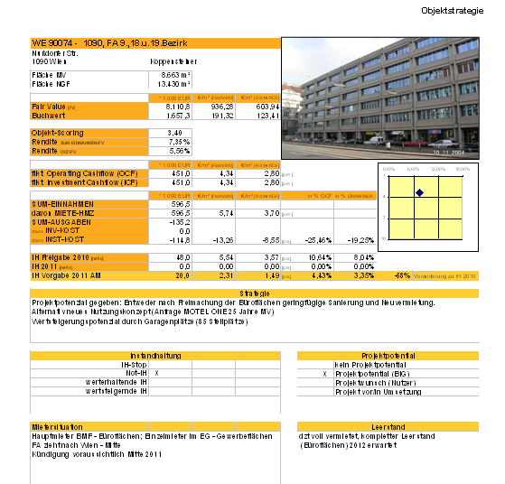
Tools, e.g.:Object Strategy
Example
(office buildings)
keywords:
benchmarks
maintenance
potential (project development)
tenant mix
vacancies

Slide 16
Tools, Enhancement Leverages
Implementation of action plan:
  limited management possibilities & leverage
  small variety in rental agreements
  defined portfolio of tenants
  defined real estate standards in public sector
  low risk position
Importance of maintenance costs

Slide 17
Tools, Enhancement Leverages
maintenance strategy
maintenance management
Determination of condition of the building
Prioritisation of components and of defects
Plannning top down and bottom up
Budgeting
reporting

Slide 18
Tools, Enhancement Leverages
Developement
Raising of potential
Rental management

Slide 19
Conclusio
„Strategic Real Estate Management particularly Asset Management
is essential
for the further development of
Public Real Estate Management.“

