Slide 1
Sustainable Buildings:
Performance, Users, Investors
Piet Eichholtz
Maastricht University
June 2011, ERES Eindhoven
Notes:
1
Some firms have a “preference” for green space
Why understand those preferences?
To undertake green development, understand potential demand
To understand scope for voluntary measures to promote green investments

Slide 2
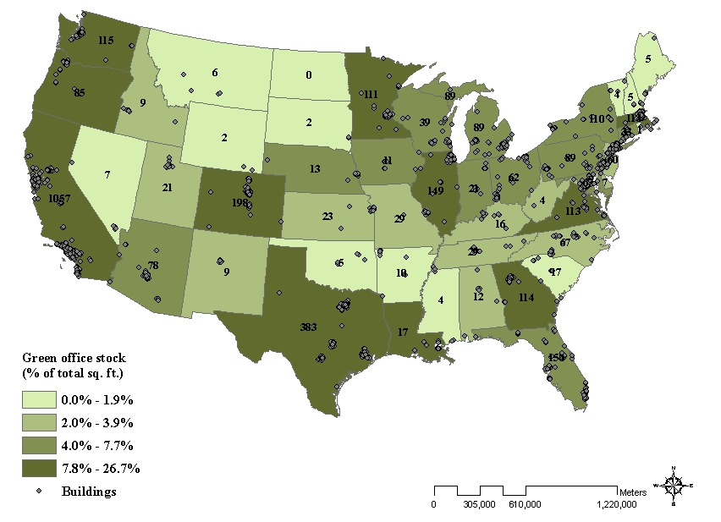

Slide 3
Do we still see economic effects of green labels?
Investment dynamics and the source of green increments
Sample of 28,000 office buildings (2009 cross section), 3,000 of which are certified by EPA or USGBC
  New evidence on the economic premium for green office buildings
    Rigorous control for quality differences (PSM)
    Label vintage
  Identify the sources of rent and value increments
    Explicit link to
      LEED: the USGBC measure of “sustainability”
      Energy Star: the EPA measures of energy efficiency

Slide 4
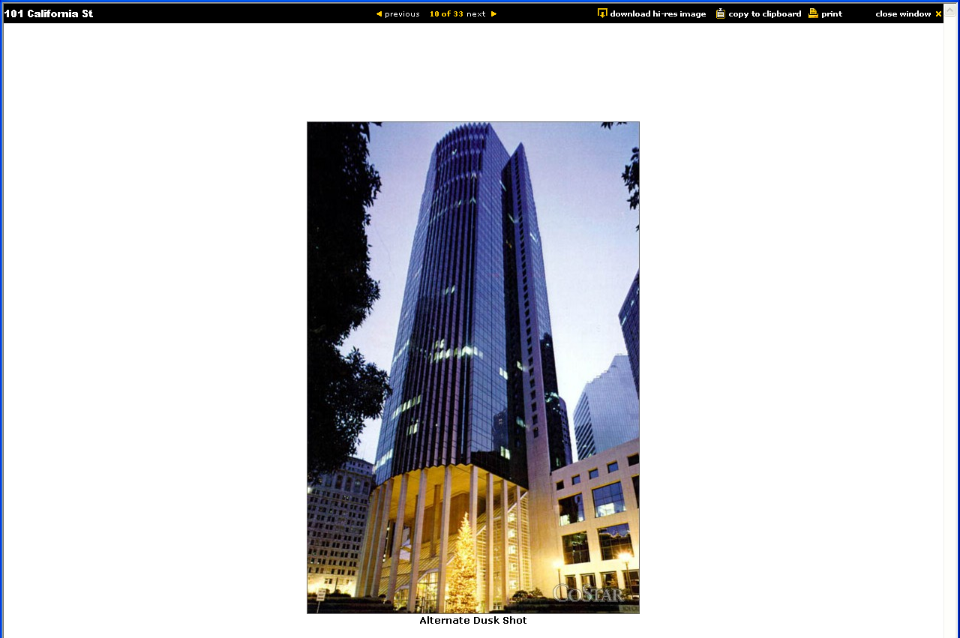
Example: 101 California St, San Francisco
Energy Star certified, LEED Gold

Slide 5
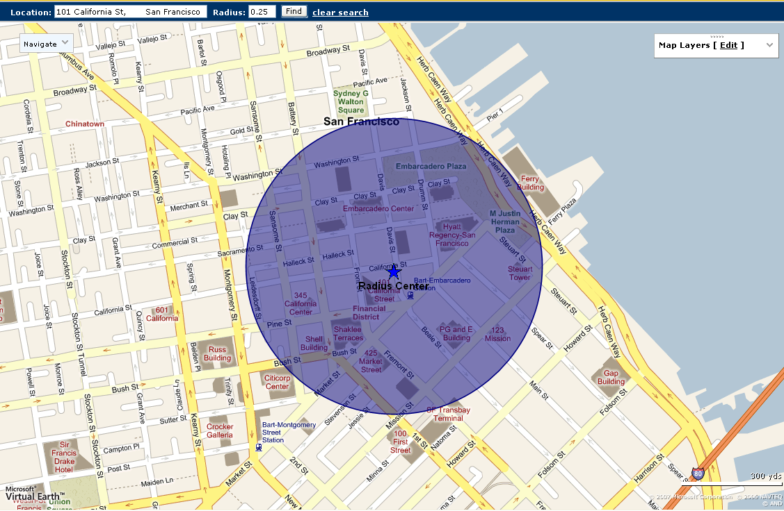
Example: 101 California St, San Francisco
Energy Star certified, LEED Gold

Slide 6
Findings and implications
Eco-investment real estate sector is not only “doing good”
Ceteris Paribus, green buildings
  Have Higher Rents by 2-5%
  Have Higher Effective Rents by 6-7%
  Have Higher Selling Prices by 11-13%
The average non-green building in the rental sample would be worth $5.6 M more if it were converted to green.
The average non-green building sold in 2004-2009 would have been worth $11.1 M more if it had been converted to green.
This suggests that property investors value the lower risk premium inherent in certified commercial office buildings
The missing piece…what are the costs of “greening” properties?

Slide 7
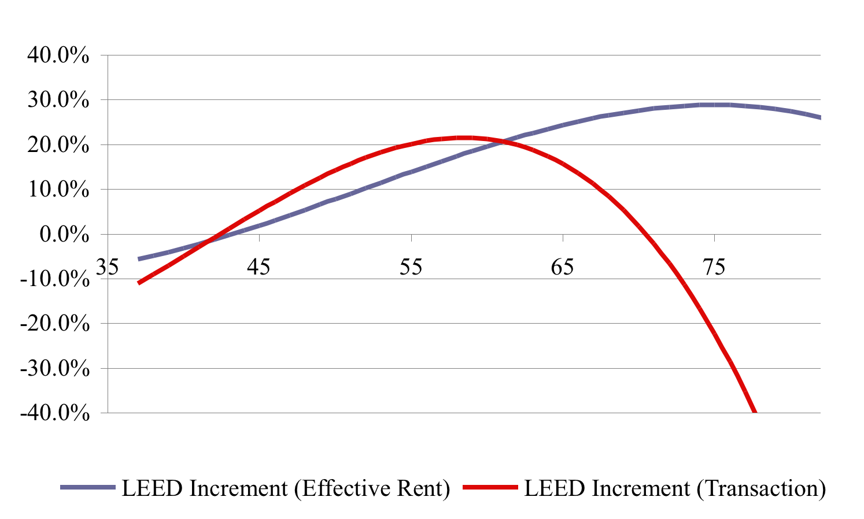
Further regression results
There seems to be an optimal LEED rating

Slide 8
Information on Energy Star-rated buildings
Emissions are substantial, and energy savings create value
Average emission of a building in our sample: 4,326 tons of CO2
  750 cars, 9,000 barrels of oil, …
  Energy Star-rated buildings emit at least a quarter less carbon as compared to conventional office buildings
A $1 saving in energy costs is associated with an increase in effective rent of 95 cents
A $1 saving in energy costs is associated with a 4.9 percent premium in market capitalization, which is equivalent to $13/sq.ft.
  This implies a cap rate of about 8 percent
Notes:
Discrepancy between total Energy Star in sample and subset of sample with data due to: Energy Star data only available after 2003 through 2007

Slide 9
Conclusions on building performance
LEED and Energy Star labels seem to be complimentary
Effects on rent and value still present despite economic crisis and increased supply of green office space
The green value effects are systematically related to the underlying characteristics of energy efficiency or “sustainability”
  Market seems to be relatively efficient in pricing these aspects
LEED and Energy Star measure somewhat different aspects of “sustainability” and complement each other
  Low correlation between LEED-score and EUI-score
  Low correlation between LEED score and energy consumption

Slide 10
Why would users rent green (and pay more)?
Theoretical framework
Direct economic benefits
  Lower service costs of housing by reduced energy costs
  Higher employee productivity
2. Indirect economic benefits: Improved reputation and image
  Investors – cost of capital
  Employees – labor market
  Customers – sales and prices
3. Ethical behavior
  “Do the right thing”
  Non-profit, government, and governmental organizations
Notes:
ABN AMRO Chicago

Slide 11
Green space utilization of major tenants
Fraction of firm’s office space housed in green buildings

Slide 12
Green space utilization per industry
Fraction of office space located in green buildings

Slide 13
And what do property investors do?
Global sustainability survey: GRESB
Maastricht University surveyed global universe of property investors
  Initial collaboration with APG, PGGM, USS
  Tool for engagement and dialogue between investors and managers
Survey develops Global Real Estate Sustainability Benchmark: GRESB 2009
  Policy issues: transparency, environmental policy, ...
  Implementation issues: environmental information systems, actual consumption of resources, employee training and remuneration, …
  Score of 100 means that potential for shareholder value creation is used
GRESB 2011 now underway, results expected in Fall 2011
  Now in cooperation with 15 leading pension investors worldwide
  All major industry bodies involved

Slide 14
GRESB 2009 results
Response
  688 listed property companies and unlisted property funds surveyed
  Response rate
    198 respondents, or 29% of total
    Market-weighted response rate was over 50%
    Response rate related to score on JLL transparency index
Strong variation in environmental performance across respondents
  Better performers are
    from Australia, Sweden, U.K.
    listed
  Weaker performers are
    from Asia, the U.S., southern Europe, Germany
    non-listed

Slide 15
Do investors do what they say?
Property investors talk the talk, but hardly walk the walk
Notes:
[TEXT]

Slide 16
And the relation with financial indicators?
Size matters, as do ROA and openness to equity market
 | M&P | I&M | Total
Financials
Market Capitalization | 5.620* | 7.897*** | 6.994***
(log) | [3.014] | [2.183] | [2.269]
Debt to Total Assets | -0.0186 | -0.0809 | -0.0562
 | [0.319] | [0.192] | [0.230]
Return on Assets | 0.582 | 0.978** | 0.821*
 | [0.487] | [0.446] | [0.441]
Percentage of Closely Held Shares | -0.207 | -0.296** | -0.260**
 | [0.159] | [0.129] | [0.128]
Property Type Controls | Y | Y | Y
Country Controls | Y | Y | Y
Observations | 61 | 61 | 61
R-squared | 0.436 | 0.640 | 0.588
Adj R2 | 0.231 | 0.509 | 0.439

Slide 17
For questions and remarks:
p.eichholtz@maastrichtuniversity.nl
For more research:
www.epri.eu
www.gresb.com

