Slide 1
Q: If the world is flat, why isn’t real estate?
M. Gordon Brown
Space Analytics, LLC
Chicago, IL USA

Slide 2
Q: If the world isn’t flat, why is real estate?
M. Gordon Brown
Space Analytics, LLC
Chicago, IL USA

Slide 3
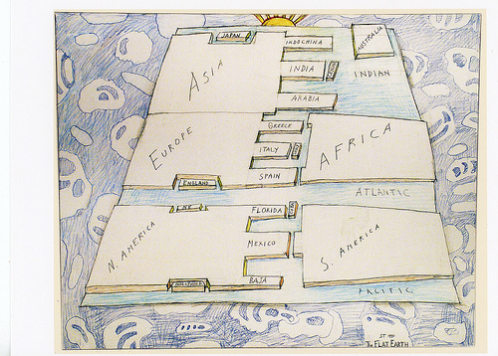
If the world is flat…

Slide 4
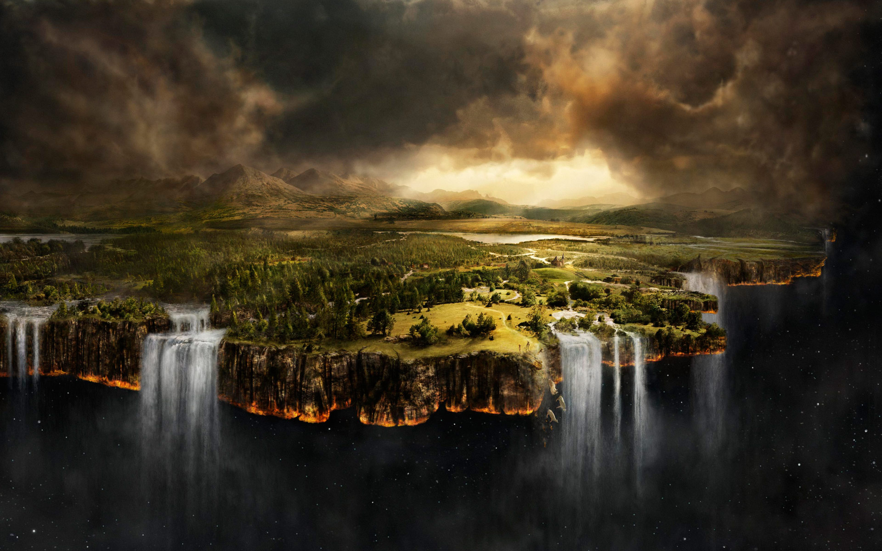
If the world is flat…

Slide 5

If the world isn’t flat…

Slide 6

If the world isn’t flat…

Slide 7
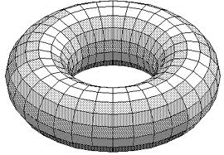
If the world isn’t flat…

Slide 8
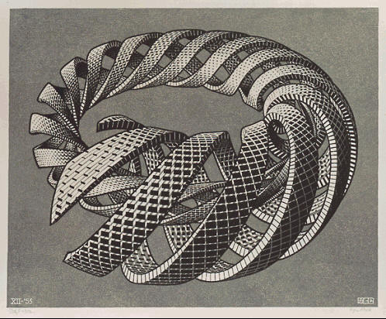
If the world isn’t flat…

Slide 9
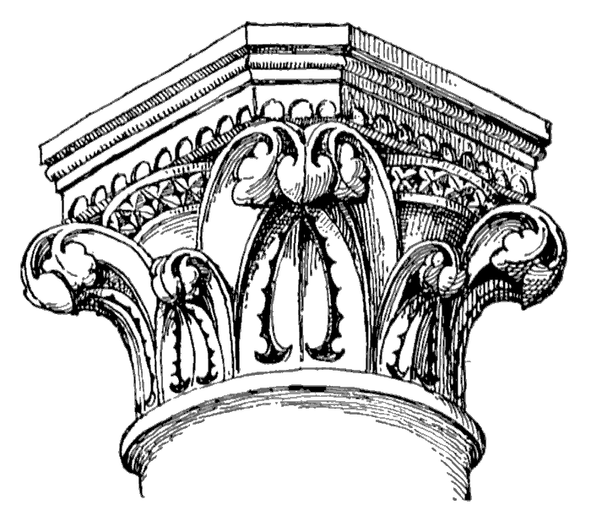
Capital… is at the top of things

Slide 10
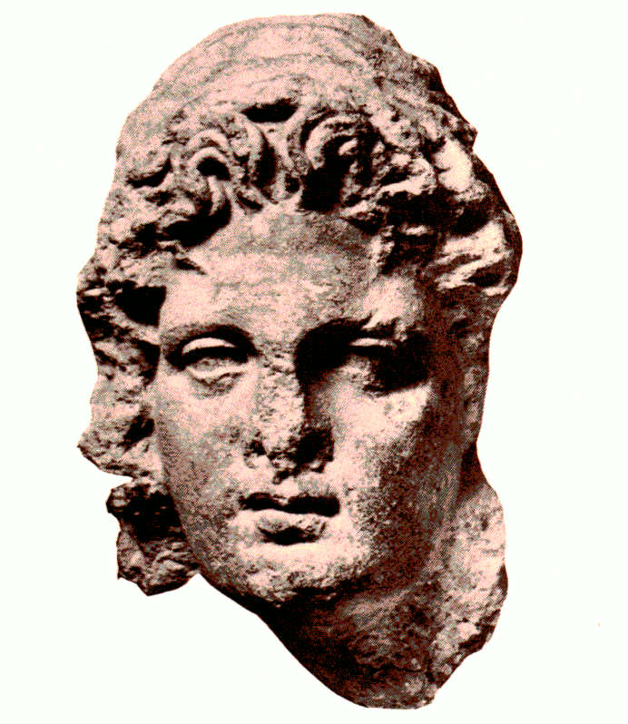
Latin: capit = head

Slide 11
Types of capital
natural capital
  oil, natural gas, coal, and mineral resources, cropland, pastureland, forested areas
produced capital
  machinery, equipment, buildings, infrastructure
intangible capital
  raw labor, human capital, social capital, institutions.

Slide 12
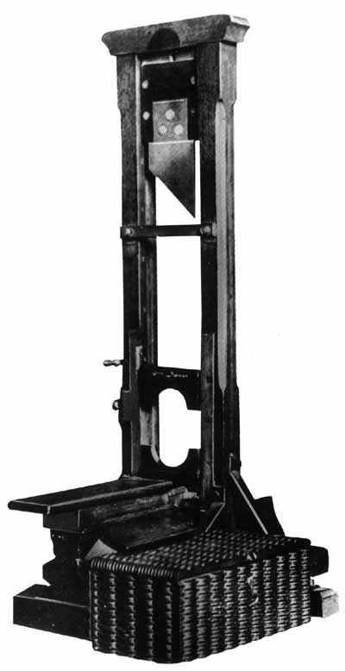
Capital punishment

Slide 13
From Google News, 13 January 2008
Odds Are Growing for Economic Recession
By JEANNINE AVERSA – 1 hour ago
WASHINGTON (AP) — The unemployment rate leaps to a two-year high, record numbers of people are forced from their homes and Wall Street nose-dives again. Such is the fallout from a housing meltdown that threatens to slingshot the country into a recession.

Slide 14
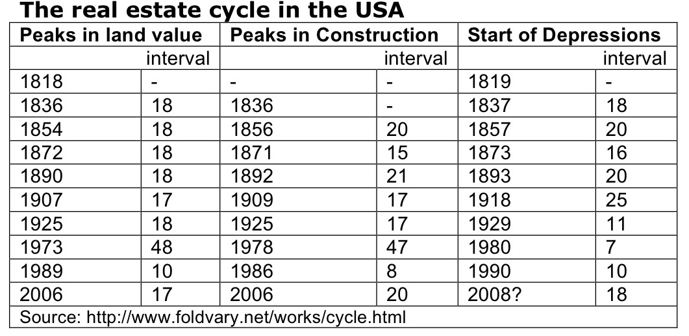
Many (most?) economic crashes are preceded by real estate crashes

Slide 15
Richard Herring and Susan Wachter, Real Estate Booms and Banking Busts, 1999.
Crashes
US Farmland prices - 1981
Property in Sweden- 1989
Property in Japan - 1990
Commercial real estate in Boston - 1992
Property in Thailand - 1997
Causes
Excessive leverage
Disaster myopia (availability heuristic ∩ threshold heuristic)
Inadequate data
Weak analysis
Perverse incentives
Cognitive dissonance

Slide 16
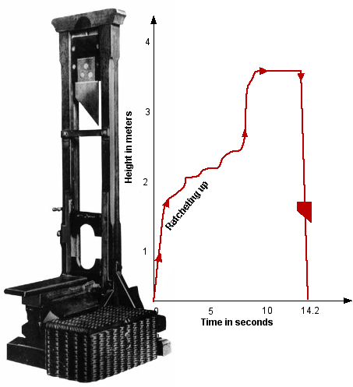
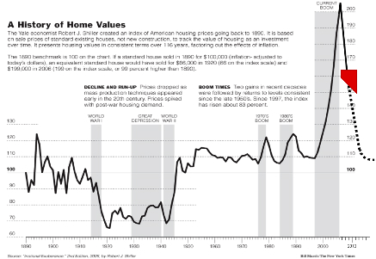
Cause of capital punishment: real estate

Slide 17
Obsolescence and risk crevices
Obsolescence
Risk crevices
Is occurring more rapidly
Affects distressed real estate
Will be continue to be a recurring problem
Result in project cost overruns, project delays and sub-performing projects
Result in higher prices that do not reflect longer term value

Slide 18
Obsolescence: a recurring problem. Why:
A continuous fresh supply in greenfields means tenants, especially prime tenants, have a greater selection. Because new buildings in almost every category have state-of-the-art features, they provide benchmark standards against which older buildings are compared, often adversely.
Technical obsolescence may be expensive to correct but it can be observed; the most difficult kinds of obsolescence are latent factors like image, configuration, access, context – functional obsolescence.
Biases described in behavioral economic analyses inhibit rational decisions of investors and managers - conservatism, optimism, overconfidence and the disposition effect.

Slide 19
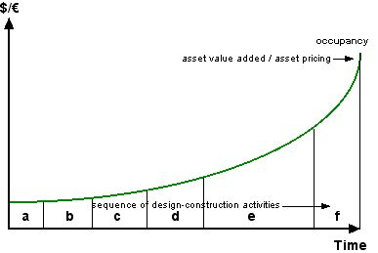
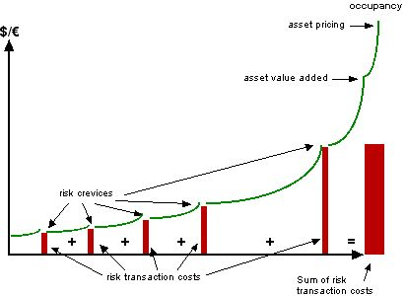
Risk crevices

Slide 20
Risk crevices: a growing problem. Why:
Increased complexity at input phase: social, consumer, environmental, economic, governmental factors simultaneous with increased specialization which reduces redundancy in perceived problem structure leads to …
More economic firms (silos) required for projects >> increased risk as the project moves into the next silo because risk management applies to the firm which will reduce its own risk, not to the project >> higher transaction costs from the crevices that accumulate as higher project costs.

Slide 21


Tetlock on the efficacy of expert predictions
hedgehogs
foxes

Slide 22
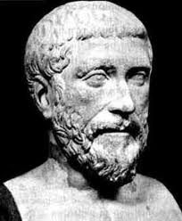
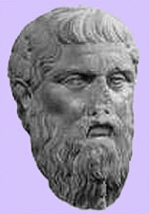
Kelly on types of real estate knowledge
Pythagoreans
Protagoreans

Slide 23
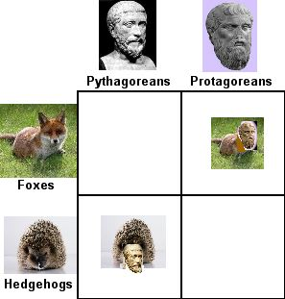

Slide 24
ARES meeting, Seattle, April 2011
Steve Laposa’s question: What do your members need in the next 2-3 years?
Answers:
career reprogramming;
to reinvent our organization;
to know what paths to avoid.

Slide 25
Path dependence in real estate education
Real estate education has depended on three principal and converging paths:
The path of rational choice
The path of equilibrium
The path of real estate as capital
The landscape forming these paths is changing and they are being repaved and widened.

Slide 26
The path of rational choice…
…is being repaved and widened with prospect theory (behavioral economics)

Slide 27
The path of equilibrium…
… originally shaped by the prestige of physical science, has become overgrown with new forms known in the life sciences.
Comparative anatomy of built assets will help identify which become extinct and which reproduce.

Slide 28
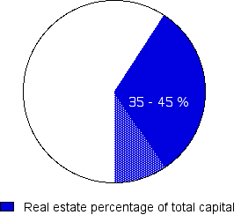
The path of real estate as capital…
…says real estate constitutes over 40% of the world’s capital?

Slide 29
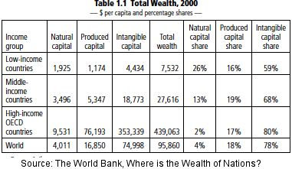
Shares of capital

Slide 30
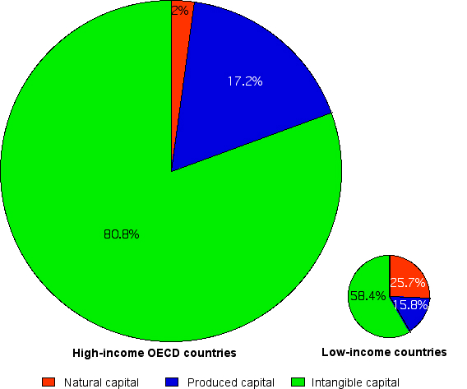
Distribution of capital

Slide 31
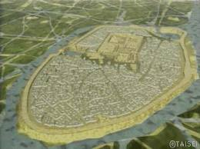
Produced capital has been leveraging intangible capital for millennia
Uruk was founded in 5000 bc

Slide 32
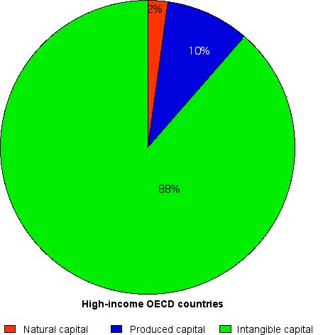

Slide 33
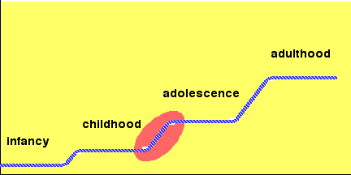
Erik Erikson: as we develop, 1) the world gets bigger 2) failure is cumulative
We are here.

Slide 34
Institutionalized study of failure
Engineering – 1830s
Medicine - 1910
Aircraft design and operation - 1935

Slide 35
“Good judgment is usually the result of experience. And experience is frequently the result of bad judgment. But to learn from the experience of others requires those who have the experience to share the knowledge with those who follow.”
  Construction attorney Barry LePatner

Slide 36
Institutionalized study of failure addresses…
the complexity of the phenomena underlying professional knowledge and how science can develop and organize this knowledge.
the human cognitive limitations that lead to inept use of that knowledge.

Slide 37
Is it too much to suggest that RE education be comparable with that in law, engineering and medicine?

Slide 38
A ‘modest’ proposal
Eliminate boom-bust cycles
Rebuild real estate education

Slide 39











Main sponsor
Gold sponsors
Platinum sponsors
Event sponsors

