Slide 1
European Real Estate Society Conference
The Short term impact of flooding on residential property markets
Prof Chris Eves
School of Urban Development

Slide 2
Flooding and Property Markets
Previous studies
Flooding in Australia
Brisbane floods 2011
Flooding and media coverage

Slide 3
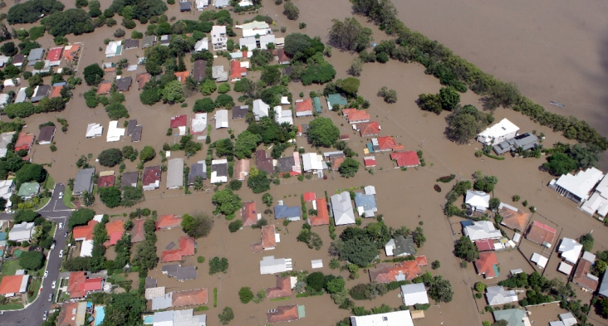
Brisbane 2011

Slide 4
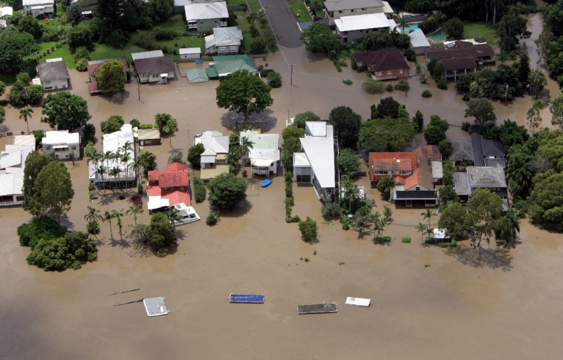

Slide 5
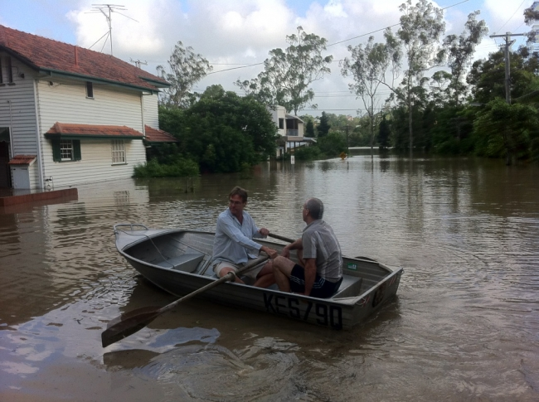

Slide 6
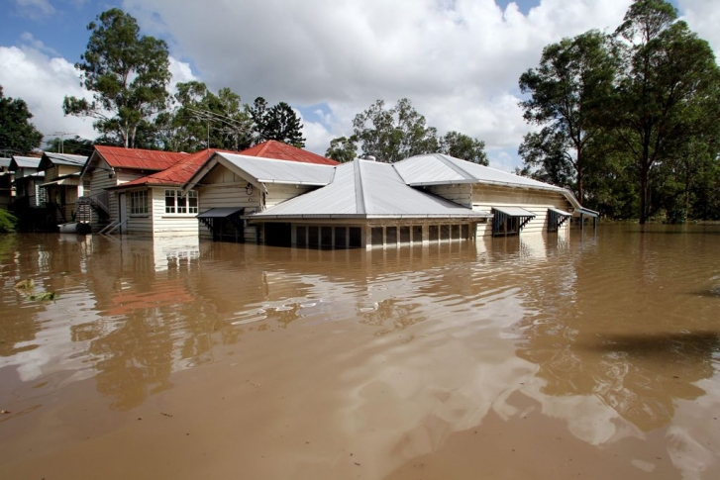

Slide 7


Slide 8
Research Methodology
Study area
Suburb selection
Research data
Residential market issues
  Sale listings
  Rental listings
  Sales

Slide 9
Flood Affected Suburbs
Suburb | Location | Status | Suburb | Location | Status
Albion | North | High | Milton | North | Middle
Ascot | North | High | Newmarket | North | Middle
Bulimba | South | High | Oxley | West | Low
Chelmer | West | High | Paddington | North | High
East Brisbane | South | Middle | Redbank plains | West | Low
Fairfield | South | Middle | Rocklea | West | Low
Graceville | West | Middle | Sherwood | West | Middle
Herston | North | Middle | South Brisbane | South | Middle
Indooroopilly | West | High | St lucia | North | High
Jindalee | West | Low | Tennyson | West | Middle
Kelvin Grove | North | Middle | Toowong | West | High
Macgregor | South | Low | Yeronga | South | Middle

Slide 10
Non Flood Affected Suburbs
Suburb | Location | Status | Suburb | Location | Status
Alexandra Hills | North | Low | Hamilton | North | High
Ashgrove | North | High | Joyner | West | Low
Bardon | North | High | Kingston | North | Middle
Bracken Ridge | North | Low | Morayfield | North | Low
Carindale | South | Middle | Mt Gravatt | South | Middle
Chapel Hill | West | High | North lakes | North | Middle
Clayfield | North | Middle | Sandgate | North | Middle
Cleveland | South | Low | Spring Hill | North | High
Grange | West | Middle | Sunnybank Hills | South | Middle
Greenslopes | South | Middle | Wynnum | South | Low

Slide 11
Research Results
Residential property house sales listings
Residential property unit sales listings
Residential property house rental listings
Residential property unit rental listings
Residential property house sales transactions
Residential property unit sales transactions

Slide 12
Total Flood Property Listings: Units and Houses

Slide 13
House Listings: Flood v Non Flood

Slide 14
Unit Listings: Flood v Non Flood

Slide 15
Flood House Listing Comparison: Suburb Value

Slide 16
Comparison Low Value House Listings: Flood v Non Flood

Slide 17
Comparison Middle Value House Listings: Flood v Non Flood

Slide 18
Comparison Sales Listing High Value Suburbs

Slide 19
Rental Listings

Slide 20
Total Flood Property Rental Listings: Units and Houses

Slide 21
House Rental Listings: Flood v Non Flood

Slide 22
Unit Rental Listings: Flood v Non Flood

Slide 23
Comparison Low Value House Rental Listings: Flood v Non Flood

Slide 24
Comparison Middle Value House Rental Listings: Flood v Non Flood

Slide 25
Comparison High Value House Sales: Flood v Non Flood

Slide 26
Sales

Slide 27
Total Residential Property Sales

Slide 28
House Sales: Flood v Non Flood

Slide 29
Comparison Low Value House Sales: Flood v Non Flood

Slide 30
Comparison Middle Value House Sales: Flood v Non Flood

Slide 31
Comparison High Value House Sales: Flood v Non Flood

Slide 32
Sales to Listing Percentage: Low Value Suburbs

Slide 33
Sales to Listing Percentage: Middle Value Suburbs

Slide 34
Sales to Listing Percentage: High Value Suburbs

Slide 35
Conclusions
The number of sale listings falls immediately following the flood for affected suburbs, with the fall in house listings greater than the fall in unit listings.
Non affected suburbs show an increase in sales listings immediately after a flood.
After the initial major fall in listings, the listings in the flood affected suburbs increase at a greater rate compared to the non flood suburbs
Listings in the lower value suburbs decline for a 5 week period, 4 weeks for the middle value suburbs and only 3 weeks for the high value suburbs, with the increase considerably greater than equivalent non flood suburbs

Slide 36
Conclusions
Rental listings in the flood affected suburbs decline significantly in the 3 to 5 weeks following the flood, especially for units. Flood victims appear to prefer to rent in the same location. Those flood victims who leave the area tend to rent units rather than houses, particularly the high value market.
In the week following the flood there was no change in the number of sales in the non flood suburbs, but a decrease of 40% in the flood affected suburbs.
After a month, sales in the flood affected suburbs increased by 60%, compared to 20% for non affected suburbs

Slide 37
Conclusions
The impact on property sales is greater in the low and middle value suburbs compared to the higher value suburbs. This could be a factor of insurance
Lower value suburbs have the greatest variation in sales to listings, especially for the first 6 weeks flowing the flood, at which point the markets tend to trend in similar way

