Slide 1
How do relationship factors influence FM outsourcing success?
Cynthia. H. Y. Hou
The Department of Real Estate & Construction
The University of Hong Kong

Slide 2
Question1: Why should we study FM service outsourcing relationship
Question 2: Why is FM service outsourcing relationship worthwhile for a study?
The termination of outsourcing contract
Outsourcing has not increased the comparative advantage of the company

Slide 3
Theoretical Background
Transaction Cost Economic Approach in FM service outsourcing
Outsourcing is a transaction process
Bounded rationality; Opportunism; Environment uncertainty; Small numbers bargaining; Information asymmetry; Asset specificity and frequency.

Slide 4
Williamson (1979)
Asset specificity, Uncertainty, Frequency are three factors that might cause difficulties to outsourcing transaction
Asset specificity: Asset specificity refers to the non-trivial investment in transaction-specific assets (Williamson, 1985).
Money: not unique for any transaction; value not change
Knowledge, Technology, Human resource

Slide 5
RELATIONSHIP: Unique,
Investment (time, money, efforts)
The specificity of relationship is high in FM service outsourcing transaction.

Slide 6
Uncertainty: The extent to which future contingencies cannot be accurately specified or accounted for in decision-making (Reve and Levitt, 1984)
Environment uncertainty
Task uncertainty
Relationship uncertainty: supplier uncertainty; performance uncertainty; behavioral uncertainty
In order to reduce the uncertainty or prepare for the contingencies, we use contract to identify as mush as possible.

Slide 7
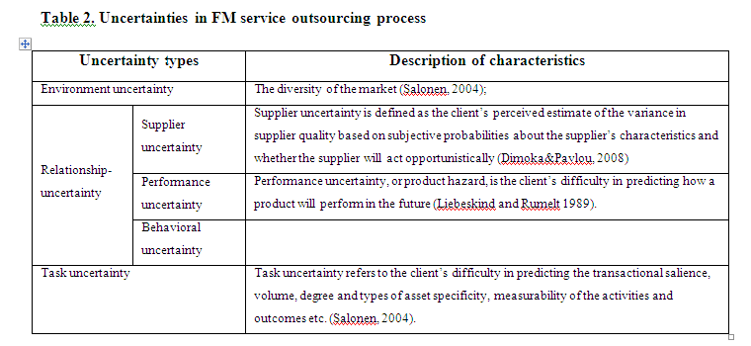

Slide 8
Behavioral Uncertainty:
Bounded rationality Uncertainty
(human’s inability to process the information correctly)
Opportunism Information asymmetry
(Seeking for self-interest)

Slide 9
The main issues in FM service outsourcing
(Analysis with TCE theory)
Outsourcing relationship is the main concern for an outsourcing transaction.
Behavioral uncertainty will affect outsourcing relationship and it needs governance.

Slide 10
Transaction cost economics mainly is used to determine the efficacy of one mode of exchange (hierarchical) over another (market).
TCE theory helps the organization determine which of their supportive, non-core functions they should buy and which they should produce or make in-house (Logan, 2000).
Simply stated, it answers the question: should the firm make or buy the product or service?

Slide 11
Other Theoretical Approaches towards Outsourcing Relationship
Agency theory: on an contract base
Resourced-based theory: analyze resource or ability; comparative advantage
Social exchange theory : focuses on behavioral phenomenon. It analyzes people’s social behavior during the resource exchange process. It is originated from individual level and has been extended to organizational and inter-organizational levels(Das and Teng, 2002).

Slide 12
An outsourcing relationship: organizational dimension; behavioral dimension.
Organizational dimension
Behavioral dimension
Research question 1: What relationship factors that affect FM service outsourcing success?

Slide 13
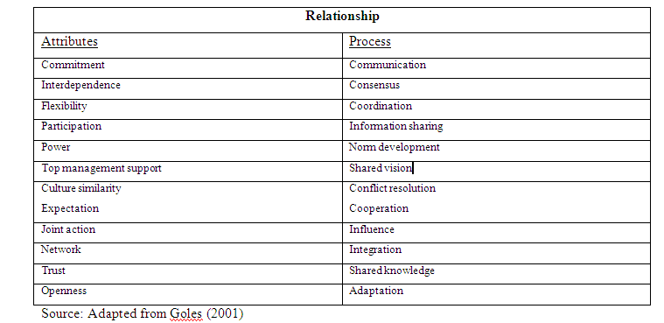
Relationship Factors

Slide 14
Research question 2: How do the relationship factors manifest themselves during the outsourcing processes?

Slide 15
Case Description
Case 1: A Commercial Bank and Outsourced Dining Service (Hong Kong)
Office building
Dinning canteen --- outsourced dinning service to Café De Carol

Slide 16
Trust , Openness and Flexibility
Trust
1. Willing to share information/communicate
2. Willing to share the burden for each other
3. Willing to give each other free space
4. Willing to make each other better

Slide 17
Openness
Willing to communicate/share information (client/supplier)
(For supplier) willing to tell the difficulties or constrains
(For client) willing to reconcile and corporate

Slide 18
Flexibility
Supplier:
You can not eliminate complaints. All you can do is to deal with it as soon as possible before the incident goes too far and beyond control
We will try our best to cater the client. Even when the requirement is beyond our ability, we still try to make things done in other possible way.
If we cannot provide the dish they want, we will tell them our limitation and come up with similar dish that can satisfy them.

Slide 19
Flexibility
Client:
When we receive complaints from the staff, we will look into the issue first. We will try to convey the message to the supplier in a more presentable way.
If they can not provide what we exactly want and if the reason is acceptable, we will try to adapt to them.
We will try to encourage them to make more profit by providing more variety of food.

Slide 20
Exchange, Communication and Strategic Interaction
Exchange

Slide 21
Communication
Meeting : frequent; formal/informal
Report: Annual/monthly/daily report; Email; Phone calls; iphone reporting
Feedback
Proposal
Satisfaction survey

Slide 22
Incidents/special cases
Communication
Client Supplier
Hygiene issues Better training
Food quality Better monitoring
Service quality “Price” “within budget”
Variation of food Balance of cost
Amount of food
Conflict

Slide 23
Client Supplier
Requirements; Try to provide satisfactory service
Understand Difficulties; Constraints; Limitation
Adaptation
Coordinate the staff and the service provider
Coordinate the benefit and good quality service
Coordination
Help the canteen make more profits
Balance partnership/long-term relationship
Integration

Slide 24
Conclusion
Trust, openness and flexibility are the factors that influence outsourcing relationship in individual interaction
They manifest themselves through adaptation, corporation and integration.

Slide 25
Thank You

