Slide 1
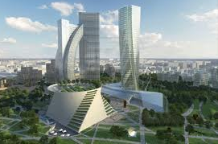
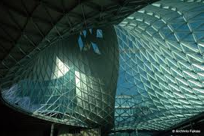
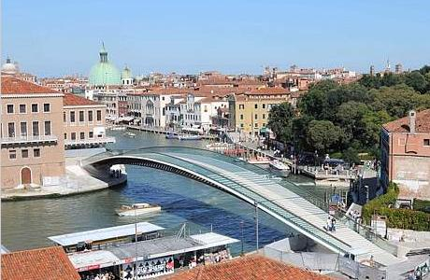
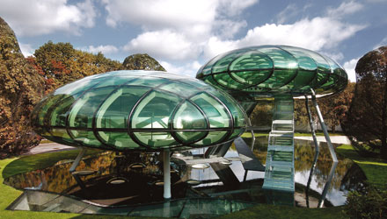

Real Estate Education in Italy:
Assessing the current state of the art
ERES _ European Real Estate Society Conference
Einhdoven, 15 th – 18 th June 2011
Laura Gabrielli
University of Ferrara
Faculty of Architecture
e-mail: laura.gabrielli@unife.it

Slide 2
Why this research?
This paper aims to present the results of a research which is currently developed in Italy
A new Law (Law Gelmini no. 308, dec. 2010) aims to change the role of University in terms of efficiency:
    Do Universities equip graduates with the appropriate skills & knowledge for their career in Real Estate?
    Do the Real Estate educators seek inputs from RE practitioners in order to define knowledge and skill goals of curriculums?

Slide 3
Aims and objectives
Objectives
  Identify
    How, if at all, should real estate course be modified in order to adapt to market or market changes?
    Are courses are employing most suitable teaching / learning strategies?
    What real estate industry expects from real estate graduates/postgraduates?
Goal
  Enhance quality and standing of real estate teaching in Italy
Methodology
  Analysis of academics within the various courses at undergraduate and postgraduate level in comparison with real estate market trends and real estate jobs evolution
  Questionnaires submitted to Real estate Industry

Slide 4
Literature
Different approaches in literature on real estate education and how to improve the relationship between real estate education and the industry :
  The first focus on improving the education process and the fundamental approach to working with the students (see Shulte 2005, Lizieri and Baum, 2002), Gibler, 2001
  The second have stressed the importance of connectivity between the academics and business community (Butler, Guntermann and Wolverton, 1998, Anderson, Loviscek, Webb, 2000., Manning and Roulac, 2001, Galuppo Worzala, 2004)
  Others have analysed the extend to which faculties have developed programs that facilitate integration between academia and business industry (Chambers, Holm, Worzala, 2006)
  Others studied the essential elements for successful Real estate program (Worzala, Tu, Lukens, Weinstein, 2008, Galuppo Worzala, 2004)

Slide 5
Market Condition for Real estate education in Italy
The Italian property market has experienced a sustained period of growth since the end of the 1990s until the end of 2005
  Introduction of Real Estate Funds and the rapid integration of the real estate market into the capital market
  New urban regeneration planning system
  New laws for public assets & portfolios in order to improve their performance
  PPP has been strongly encourage
  Presence of International investors in the market
Demands:
  More accurate information about performance, prices, indexes
  Introduction of standards in valuation
  Need of new real estate professions with skills, knowledge and competencies
  Larger use of IT

Slide 6
Methodology
The Methodology used for this first part of the analysis is:
An internet research on Real Estate education at undergraduate and post graduate level in order to identify real estate programs
  Examination of the website and materials of several programs
    From Miur (Italian Ministry of University and Research) to course website
Other information has been collected by personal contacts (e mails, phones or interviews)

Slide 7
Higher Education in Italy
19
22
1° year
2° year
3° year
First level degree
(180 credits)
(60 credits)
1 level Master Degree
Second
level degree
(120 Credits)
1° year LM
2° year LM
(60 credits)
(180 credits)
2 level Master Degree
PhD

Slide 8
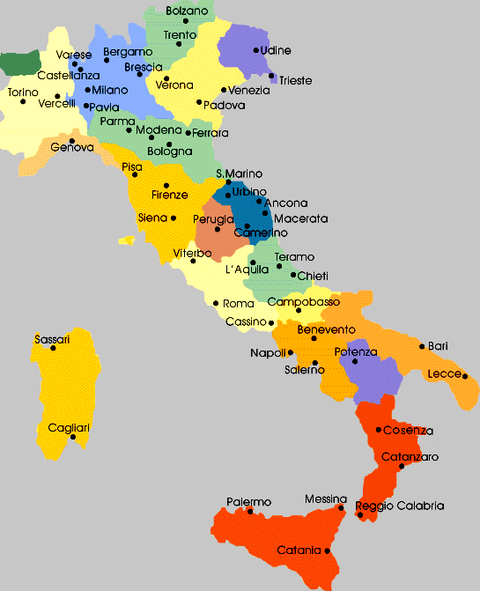
In Italy:
  95 Universities
  617 Faculties
  1710 Departments
  181 Institute
They offer:
  53 first level degree-classes
  101 second level degree-classes
  6 Magister degrees- classes
REDUCE!!!!!!

Slide 9
Surveys
We surveyed 17 Undergraduate classes of courses (8 first level + 11 second level) in 59 different Universities. All are Full time courses
FIRST LEVEL DEGREES
Before 1995
After 1995
DESIGN
CIVIL AND ENVIRONMENTAL ENGINEERING
ARCHITECTURE
URBAN PLANNING
CONSTRUCTION MANAGEMENT
HISTORIC BUILDINGS CONSERVATION
RURAL ENTERPRISE AND LM
ECONOMICS
SECOND LEVEL DEGREES
DESIGN
CIVIL ENGINEERING
ARCHITECTURE
URBAN PLANNING
CONSTRUCTION MANAGEMENT
HISTORIC BUILDINGS CONSERVATION
RURAL ENTERPRISE AND LM
ECONOMICS
ENVIRONMENTPROTECTION
CONSTRUCTION ENGINEERING
ENVIRONMENTAL ENGINEERING

Slide 10
Course contents
We analysed 369 programs and syllabus in order to find the topics in Real Estate education
Each exam has an average of 5 credits with a minimum of 2 credits (RE in interdisciplinary laboratories) and a maximum of 10 credits (Real Estate Investment or Real Estate Valuation)
Each course has 50 up to 150 students

Slide 11
Responses to the revolution in real estate jobs
At the end of 90iest the Universities had the following modules in the curriculum:
  Fundamentals of economics
  Property valuation
  Urban Planning
  Rural policy, land use and valuation of rural areas
In 2011 the modules growth in number:
  Fundamental of Economics
  RE valuation
  RE management
  RE finance
  RE investment
  Urban Planning
  RE Development
  Environment & sustainability
  Professional studies
  RE Law
1990
2011

Slide 12
Modules
CORE
OPTIONAL

Slide 13
Teaching and assessment
Academics is complemented by direct teaching input from practicing property professionals (80% - 20%)
Teaching :
  Various teaching methods are used, including lectures, seminars, workshops, group sessions
3 types of approaches:
  First approach: lectures and written/oral examination at the end of the module theoretical approach
  Second approach: coursework and oral/written examination. The first comprises seminar presentations with discussion with the class of their project work integrated approach with other disciplines
  Third approach: integration of academic and real estate profession, simulation of real case, teamwork, role plays, real world problem solving with professionals Learning by doing

Slide 14
RE Msc in Italy
Currently in Italy there are 13 MSc in Real Estate
  7 are first level MSc
  4 are second level MSc
  2 are Executive MSc
Programs
  7 in Real Estate Management
  2 in Real Estate Finance
  2 in Real Estate
  1 in Real Estate Development
  1 in Urban Planning and Real Estate Markets

Slide 15
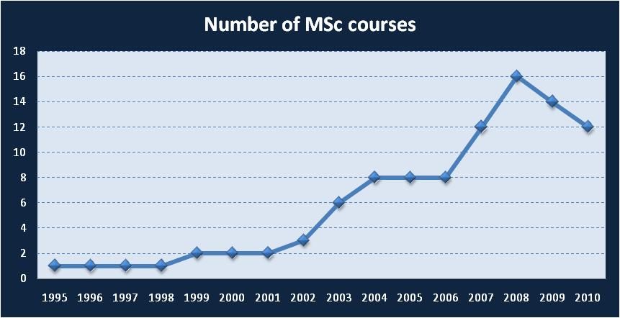
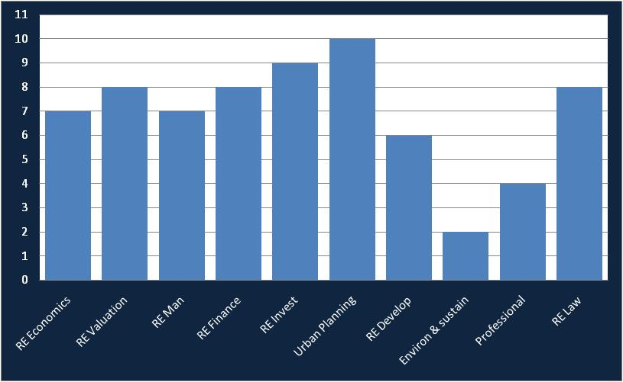
Master in Real Estate curriculum
Due to the economic crisis some of programs had to be terminated
All Master are full time/1 year/ 60 credits courses
  350 hours of lecture (47 credits)
  300 hours of internship (12 credits)
  75 final project work (3 credits)
2 Masters are accredited by RICS (Real Estate and Real Estate Finance Masters held in Milan)
Despite the different names, all Masters present very similar structure, included in their courses

Slide 16
Property industry survey
The property industry survey was conducted to collect comments from practitioners on RE topics offered by undergraduates and post graduates courses
The aims of the survey was to test the curricula:
  see if they are meeting the industry requirements
  receive views from professional practitioners with regards of the topics which needs further improvement

Slide 17
Questionnaire
PROPERTY COMPANIES
The opinions of RE players has been collected using two methods:
  A questionnaire sent by e mail (55 qs)
  Structured interviews with real estate practitioners at conferences and seminars
ADVISORS
Real estate market
REAL ESTATE FUNDS
DEVELOPERS

Slide 18
The structure of questionnaire
The questionnaire is structure in three parts:
  Details of the practitioners
  Questions about ranking real estate topics in order of their importance (Lickert scale)
  Question about level of knowledge of RE employers about those topics (Linkert Scale)
  Open questions:
    Other real estate topics to be included in the real estate education courses (if any)
    Comments and suggestions
    Any opinion about a RE degree

Slide 19
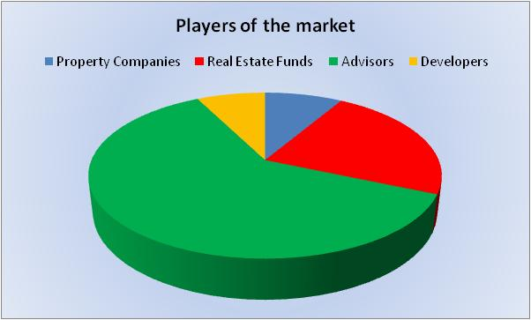
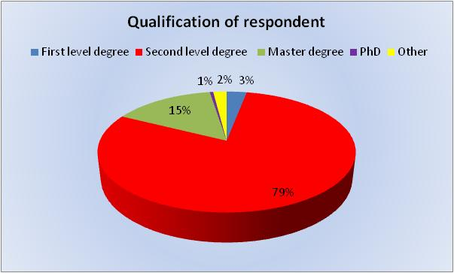
Details of the practitioners
55 questionnaires sent with a responses rate of 33,54%
+ 14 interviews with Ceo, Presidents, or RE Managers

Slide 20
The results: topics ranking
None gets 3 or 1
Real estate investment gets the lowest standard deviation: consistency in opinions

Slide 21
The results: students
Real estate investment topic is at the top of the list
Lack of knowledge of RE finance (which Is considered an important topic!)

Slide 22
Employers backgrounds
Most of the employers in RE market have a background in Economics or Law (in RE funds or RE companies) while advisor company or developers employ architects and engineers mostly
Both have some lack of knowledge!

Slide 23
Skills
If you combine the last two answers RE professionals would employ people with :
  Skill in accounting, financial and quantitative analysis
  Experience in evaluating and managing risk and uncertainty (due to turmoil of the markets)
  A clear understanding of real estate market
  The ability to use and apply IT (excel, statistics program, etc...)
  A clear understanding of how buildings works
  Writing, oral communication, presentation skills

Slide 24
A real estate degree?
63% of the respondents said that there is no need of a Real Estate Degree in Italy:
  Post grads course are able to bridge the gap
    Post grads in RE are more recognised and professionals have started to recruit and hire students with these more specialised degrees
  Lot of advisor companies prefer to teach their employed the “core” topics of real estate with internal seminars

Slide 25
Conclusions
From a first analysis of the state of the art, Universities seem to integrate the real world:
    In the long run is evident that Universities have changed their modules in order to match what the market asks to graduates
    There is lot of work to do in order to improve how to teach RE (and where!)
    Poor integration of Industry and academics at Undergraduates level
    Quality of students are too dependent from local educators and their way of teaching
  Masters seems be more valuable from industry while many academic programs are out of touch with the industry

