Slide 1
Green Agenda and Green Performance: Is There a Link? Quantifying the Financial Benefits of Sustainability for European Listed Real Estate Companies
Marcelo Cajias Peter Geiger Sven Bienert
18th European Real Estate Society Conference; June 2011; Eindhoven, Netherlands
Notes:
March 25, 2000
1

Slide 2
Sustainability and European Listed Real Estate Companies
Introduction
Real estate companies are important participants in the international development and implementation of sustainable policies.
The real estate industry accounts for 42% of the EU’s final energy consumption and for about 35% off all greenhouse gas emissions (RREEF, 2010).
The Global Reporting Initiative (GRI) develops international sustainability reporting guidelines across different industry sectors.
The European Public Real Estate Association (EPRA) “aims to include sustainability guidelines into its ‘Best Practices and Recommendations’ in order to respond to the GRI-guidelines, as an application for the field of real estate” (EPRA, 2010)
Marcelo Cajias, Peter Geiger and Sven Bienert - 18th European Real Estate Society Conference; June 2011; Eindhoven, Netherlands

Slide 3
Sustainability and European Listed Real Estate Companies Green Agenda
Challenges
Definition of Sustainability
Definition of Sustainability in the field of Real Estate
Measurement Method
Measure the level of Sustainability across Europe
Questionnaire
Survey
Marcelo Cajias, Peter Geiger and Sven Bienert - 18th European Real Estate Society Conference; June 2011; Eindhoven, Netherlands

Slide 4
Sustainability and European Listed Real Estate Companies Green Agenda
Real Estate Sustainability Survey – Considered Areas
Human Rights & General Goals
Human Capital & Training Programs
Diversity
Policy Structure
Environmental activities and intensity
(Certified) Building Information
Sustainability for Real Estate Companies
Human Rights & Social Responsibility
Environmental Responsibility
Investment/ Financial Responsibility
Additional Disclosure Quality
Social, Environmental & Ethical Activities
Social, Environmental & Ethical Decision Process
EPRA Best Practices and Recommendations
EPRA Portfolio Disclosure
Corporate Governance Mechanism
Financial risks due to climate changes
Economical impact of energy price fluctuation
Marcelo Cajias, Peter Geiger and Sven Bienert - 18th European Real Estate Society Conference; June 2011; Eindhoven, Netherlands

Slide 5
Sustainability and European Listed Real Estate Companies Green Agenda
Real Estate Sustainability Survey – Results
Overall Score
Sustainability Areas
Marcelo Cajias, Peter Geiger and Sven Bienert - 18th European Real Estate Society Conference; June 2011; Eindhoven, Netherlands

Slide 6
Sustainability and European Listed Real Estate Companies Green Agenda and Green Performance
Sustainability and Financial Performance – The Link
Within the Company
Intangible Capital
Shareholder Value
Moral Capital
Sustainability for Real Estate Companies
Financial Performance
Human Rights & Social Responsibility
Environmental Responsibility
Investment/ Financial Responsibility
Within the Market
Information Asymmetry
Transparency
Reputation
Risk Profile
Additional Disclosure Quality
Marcelo Cajias, Peter Geiger and Sven Bienert - 18th European Real Estate Society Conference; June 2011; Eindhoven, Netherlands

Slide 7
Sustainability and European Listed Real Estate Companies The Financial Consequences of a Sustainability Agenda
Real Estate Sustainability enhance Firm’s Efficiency
Dependent variable: Present Asset Turnover |  |  | (I) | (II) | (III) | (IV) | (V) | (VI)
 |  | Constant | 0.157** | 0.144** | 0.220** | 0.210** | NA | NA
CSR Overall and Areas
 | CSR-Overall |  | 0.009* |  | 0.011* |  | 0.009*
 | Human Rights |  |  | 0.043*** |  | 0.035** |  | 0.043***
 | Environmental |  |  | -0.014 |  | -0.008 |  | -0.014
 | Investment |  |  | -0.003 |  | 0.005 |  | -0.002
 | Disclosure |  |  | -0.024** |  | -0.016* |  | -0.024**
Financial Variables
 | Log(Market Cap) |  | -0.011** | -0.010** | -0.016*** | -0.015** | -0.011** | -0.010**
 | Tobin´s Q |  | -0.070** | -0.069** | -0.078* | -0.077* | -0.063* | -0.062**
 | Leverage |  | 0.096** | 0.100*** | 0.109** | 0.110** | 0.093** | 0.100**
Media and DJSI Variables
 | DJSI |  | 0.008 | 0.010 | 0.011 | 0.011 | 0.004 | 0.005
Time-invariant Effects |  |  | Sector and Time Effects |  | Country and Time Effects |  | Company and Time Effects
Adj. R² |  |  | 12.16 | 16.18 | 22.06 | 23.21 | 11.64 | 15.69
AIC |  |  | -0.248 | -0.280 | -0.383 | -0.384 | -0.243 | -0.274
F-Statistic |  |  | 4.452*** | 4.795*** | 4.621*** | 4.310*** | 8.463*** | 7.498***
Marcelo Cajias, Peter Geiger and Sven Bienert - 18th European Real Estate Society Conference; June 2011; Eindhoven, Netherlands

Slide 8
Sustainability and European Listed Real Estate Companies The Financial Consequences of a Sustainability Agenda
Real Estate Sustainability diminish Companies’ Risk Profile
Dependent variable: Future Idiosyncratic Risk |  |  | (I) | (II) | (III) | (IV) | (V) | (VI)
 |  | Constant | 6.877*** | 7.105*** | 7.891*** | 7.893*** | NA | NA
CSR Overall and Areas
 | CSR-Overall |  | -0.383*** |  | -0.270** |  | -0.368***
 | Human Rights |  |  | -0.498** |  | -0.265 |  | -0.497**
 | Environmental |  |  | -0.650** |  | -0.682** |  | -0.646*
 | Investment |  |  | 0.590* |  | 0.493* |  | 0.601*
 | Disclosure |  |  | -0.015 |  | 0.238 |  | -0.020
Financial Variables
 | Log(Market Cap) |  | -0.473*** | -0.494*** | -0.509*** | -0.530*** | -0.479*** | -0.495***
 | Tobin´s Q |  | 1.232** | 1.309** | 0.997* | 1.060* | 1.274** | 1.361**
 | Return on Assets |  | -0.005 | -0.002 | -0.000 | 0.002 | -0.006 | -0.003
 | Assets Growth |  | -0.001 | -0.001 | -0.002 | 0.003 | -0.000 | 0.001
 | Leverage |  | -0.416 | -0.311 | -0.785* | -0.726 | -0.506 | -0.455
Media and DJSI Variables
 | Media Visibility |  | -0.164* | -0.187** | -0.163* | -0.184** | -0.166* | -0.186**
 | DJSI |  | 0.152 | 0.047 | 0.129 | 0.045 | 0.202 | 0.126
Time-invariant Effects |  |  | Sector and Time Effects |  | Country and Time Effects |  | Company and Time Effects
Adj. R² |  |  | 32.07 | 31.90 | 40.24 | 40.24 | 28.96 | 28.91
AIC |  |  | 6.130 | 6.147 | 5.968 | 5.979 | 6.137 | 6.152
F-Statistic |  |  | 11.876*** | 9.623*** | 9.909*** | 8.837*** | 16.571*** | 12.073***
Marcelo Cajias, Peter Geiger and Sven Bienert - 18th European Real Estate Society Conference; June 2011; Eindhoven, Netherlands

Slide 9
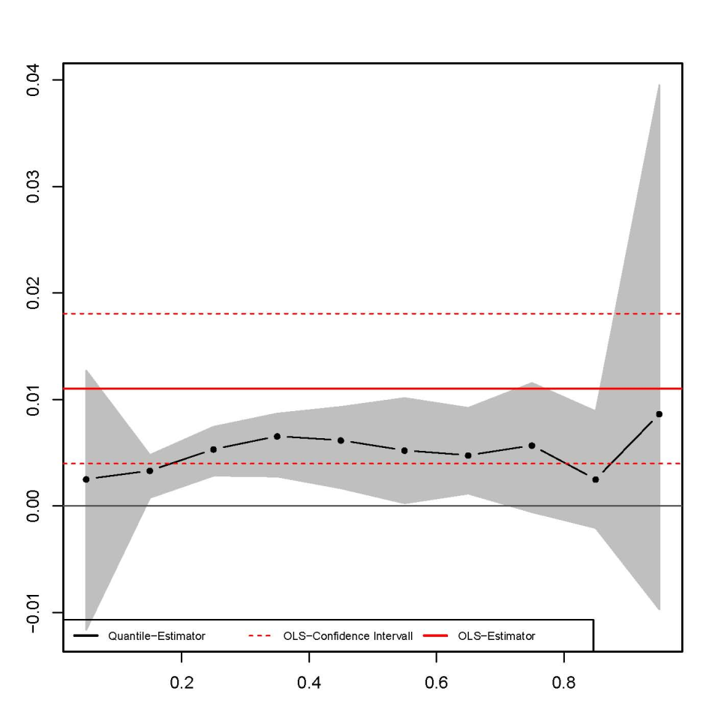
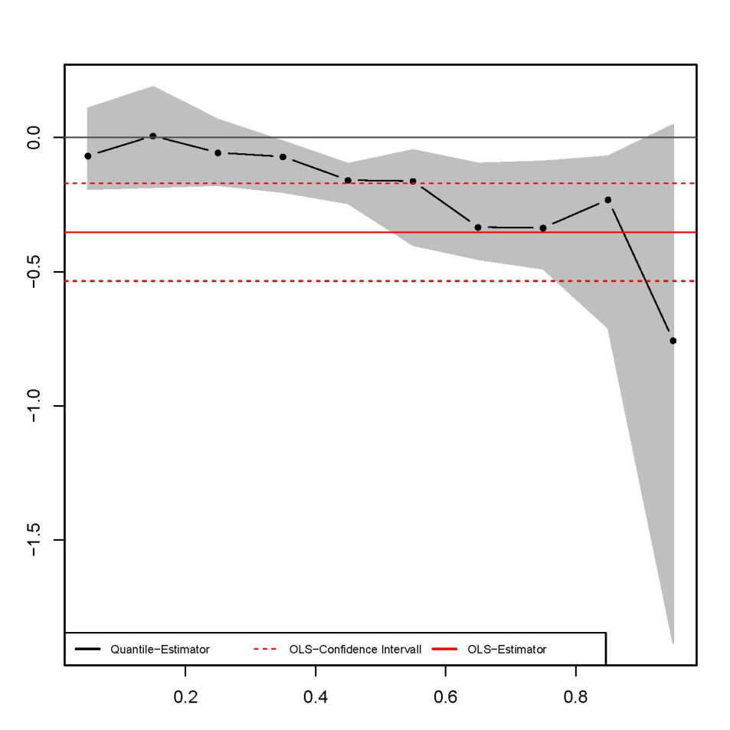
Sustainability and European Listed Real Estate Companies Overall Conclusions
The Effect and Response of a Sustainability Agenda
EFFECT: Sustainability Agenda
EFFECT: Sustainability Agenda
RESPONSE: Present Financial Performance
RESPONSE: Future Idiosyncratic Risk
Marcelo Cajias, Peter Geiger and Sven Bienert - 18th European Real Estate Society Conference; June 2011; Eindhoven, Netherlands

Slide 10
Sustainability and European Listed Real Estate Companies Overall Conclusions
Conclusions
European listed real estate companies show increasing concern regarding responsible and sustainable activities.
At the end of June the GRI and the EPRA will establish the Construction and Real Estate Sector Supplement (CREES).
RE-Companies disclosing information about their concern to global changes:
are 1% more efficient in using their assets to generate revenues (Asset Turnover);
enjoy a lower level of non-diversifiable risk (the idiosyncratic risk).
A green agenda pays off !
Marcelo Cajias, Peter Geiger and Sven Bienert - 18th European Real Estate Society Conference; June 2011; Eindhoven, Netherlands

Slide 11
Thank you for your attention Questions and Comments
Marcelo Cajias Peter Geiger Sven Bienert
18th European Real Estate Society Conference; June 2011; Eindhoven, Netherlands
Notes:
March 25, 2000
11

