Slide 2
Prime versus Secondary Real Estate – No guts No glory Taking Calculated Risks
18th European Real Estate Society Conference, 15-18 June 2011, Eindhoven
Berry, JN¹; Lim, LC¹; and Sieracki, KA²
¹ University of Ulster, Built Environment Research Institute
² Kaspar Associates and Visiting Professor, University of Ulster

Slide 3
Contextual background
Downturn phase all property goes down at the same time
Recovery phase sees divergent returns
across market segments/sectors
in prime and secondary properties
This presentation/paper
highlights these differences
investigates performance characteristics
discusses buy and sell decisions of institutional investors

Slide 4
Contextual background
Impact of economic downturn on prime properties
Demand and supply constraints
Lack of institutional grade stock
Divergence across sectors
Secondary locations decreasing in importance
Prime stock becoming more difficult to source
Investors forced up the risk curve
Tensions in the decision making process
Impact on buying & selling of prime & secondary product

Slide 5
Contextual background
Decision making behaviour of institutional investors
Targeting prime commercial UK real estate – risk adverse
Maximising risk adjusted returns
Seeking diversification potential including
Quality real estate stock
Tenant covenant strength
Lease structure
Income growth/revenue streams
Investing in the dynamics of London property investment market

Slide 6
Contextual background
Prime is the most sought after from both the occupier and the investor with secondary stock lagging.
Demand from both occupiers and investors has been selective due to the volatility and uncertainties of real estate markets.
Lease length is an important factor in determining price with longer unexpired term showing higher capital values relative to shorter unexpired lease terms.
Lack of new development constrains the supply side making improved secondary stock more attractive at a relatively higher price.

Slide 7
Contextual background
There are areas which the fund manager can exploit to make money. London is a global city which sustains demand for Central London offices and retail. This momentum can benefit secondary product that can be refurbished, let and then sold.
There is a lack of new development which puts the squeeze on space, making improved secondary more attractive at a relatively higher price.

Slide 8
Definition
The simple definition of ‘secondary’ is that it is not ‘prime’ property (Sieracki, 2000)
Prime property can be defined on the basis of the high quality of tenant covenant, the building and the location.
The definition will vary between regions and by property types so the data needs to be divided into sub-sectors.

Slide 9
Definition
Lack of clarity in the differentiation between ‘prime’ and ‘secondary’ property
Particularly those properties meeting the best criteria for rental income
Identifying secondary property will include proprietary data, institutional analysis, bank lending analysis and auction data.
A clearer distinction would help identify more accurately the quality of assets and contribute to better risk management.

Slide 10
Definition
Prime defined as properties with an equivalent yield in the lowest quartile.
Secondary defined as properties with an equivalent yield in the highest quartile.
Source: IPD

Slide 11
Literature: Content Analysis
Hutchinson et al (2011); impact of covenant strength on pricing in prime commercial property
Kohlert, (2010); determinants of regional real estate return in office markets
Krystalogianni and Tsolacos, (2010); yield structure and real estate investment;
Scholders (2010); does prime property always outperform
King Sturge (2010); divergence of values between “prime” and “secondary” property
GVA Grimley (2009); post recession and implications for prime and secondary commercial property

Slide 12
Methodology
Utilises IPD data to investigate the divergent performance play amongst the commercial sectors (office, retail and industrial) and sub sectors (business parks, retail warehousing, rest of UK offices).
Undertakes a quantitative analysis of total return on an annual and quarterly basis including high and low quartile total returns across the different sectors and sub sectors.
Considers the rolling four quarters total return to illustrate the shift in prime and secondary performance for the different sub sectors.

Slide 13
Methodology
Determines performance differential between the highest and lowest quartile of different UK property segments
Provides an indication of when to buy and sell secondary real estate
Demonstrates how to optimise property performance through stock selection

Slide 14
Data
IPD quarterly data from March 2001 to March 2011
Total return, capital growth, rental growth and income return across the various market sectors and sub sectors
Yield quartile data to assess performance differential between the highest and lowest quartile of the different UK property segments
Spread of the yield differential to determine investment strategy and timing of buying and selling secondary real estate

Slide 15
Commercial Property Cycle
Prime v Secondary
Central London offices
Total returns Rental value growth Initial yield
Six months annualised % Six months annualised % %
Source: IPD

Slide 16
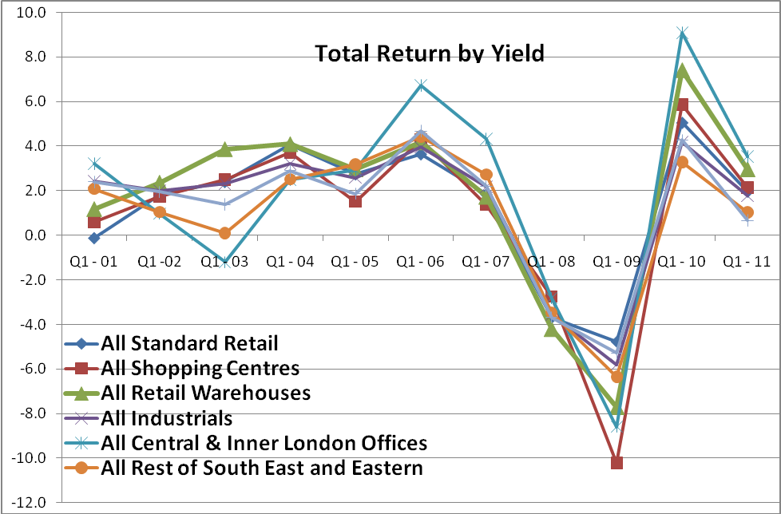
Data Analysis
Source: IPD

Slide 17
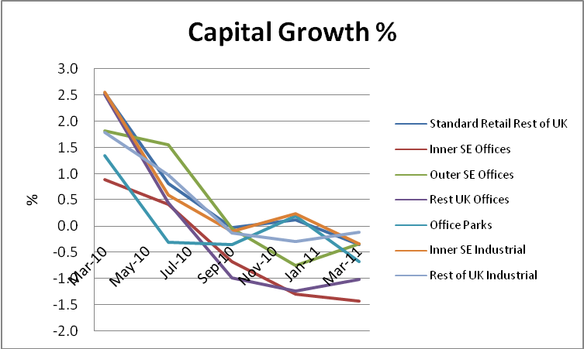
Data Analysis
Source: IPD
Notes:
Capital values recovered at 19.9% since June 2009 from the total capital loss of 42.2% seen from June 2007 to June 2009.
There was negative capital growth for most sectors outside Central London and the South East: Standard Retail Rest of UK, Inner SE offices (3rd consecutive quarter), Outer SE offices (2nd consecutive quarter), Rest UK offices (3rd consecutive quarter), Office Parks, Inner SE Industrial and Rest of UK Industrial (3rd consecutive quarter).

Slide 18
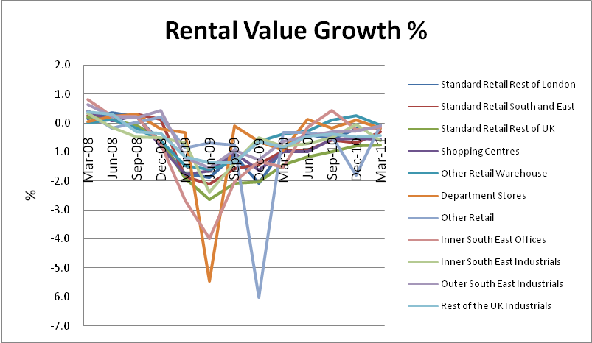
Data Analysis
Source: IPD
Notes:
There was negative rental growth for most sectors outside
Central London: Standard Retail Rest of London (10th consecutive quarter),
Standard Retail South and Eastern (9th consecutive quarter), Standard Retail Rest of UK (11th consecutive quarter),
Shopping Centres (10th consecutive quarter),
Other Retail Warehouse, Department Stores, Other Retail (9th consecutive quarter),
Inner South East Offices (2nd consecutive quarter), I
nner South East Industrials (12th consecutive quarter),
outer South East Industrials (9th consecutive quarter) and
Rest of the UK Industrial (11th consecutive quarter).
Rental growth has on average been negative for over the past two years for some subsectors as illustrated in the graph below.

Slide 19
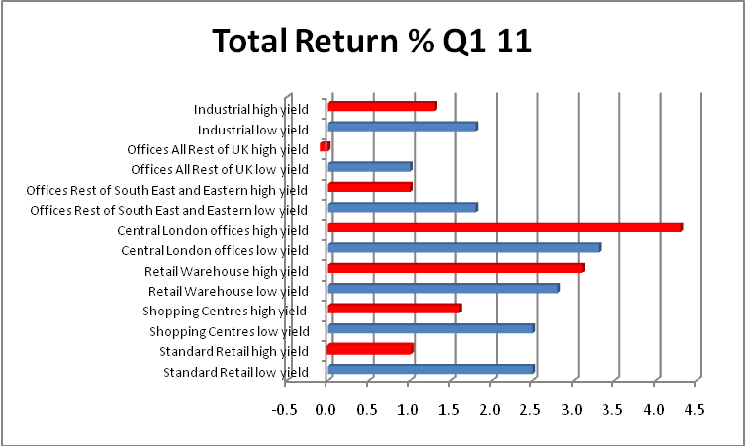
Data Analysis
Source: IPD
Notes:
Lower yields across the various sectors did not always show better performance as demonstrated below.
Central London offices high yield properties outperformed Central London office low yield properties.
It was the same for retail warehouses.

Slide 20
Data Analysis
Source: IPD
Notes:
There was total net investment of £773m for Q1 11, with £3.76bn of purchases and £2.98bn of sales.
City offices and retail parks were the main subsectors for sales with other retail warehouses and South Eastern Industrials the main subsectors for purchases as shown in the graph below.

Slide 21
Data Analysis
IPD Quarterly Performance by Sector Yield Differential for 2010
Sector | Yield | Total Return 2010 % pa | Differential bps | Comments
Standard Retail | Low | 15.7 | 500 | Prime better, look for opportunities
 | High | 10.7
Retail Warehouse | Low | 15.1 | 340 | Sell secondary
 | High | 18.5
Central and Inner London Offices | Low | 22.0 | 270 | Sell secondary
 | High | 24.7
SE Offices | Low | 10.2 | 790 | Prime better, look for opportunities
 | High | 2.3
Rest UK Offices | Low | 10.0 | 830 | Prime better, look for opportunities
 | High | 1.7
Industrial | Low | 11.1 | 440 | Prime better, look for opportunities
 | High | 7.7
Source: IPD

Slide 22
Cap Rate Quartile Distribution for 2010
Source: Real Capital Analytics

Slide 23
Key impacts
Prime and secondary properties’ performance and impact on investment decisions
Greater volatility in secondary commercial property values compared to prime core location
Closer the gap between prime and secondary, time to sell secondary
Wider the gap could be opportunities for purchasing both prime and secondary.

Slide 24
Key impacts
There is a shift in prime and secondary stocks
Non prime non core locations becoming more popular but only in certain geographic locations
Investors need to take calculated risk on both buy and sell side
Investors can optimise property performance through stock selection

