Slide 1




Land price transparency
Less is known by many
Authors: W.J. (Wim) van der Post Msc
M.I.A. (Martijn) Boerkoel BA Msc
Date: 2010, June 24
Notes:
Thank you “name chairman” for given us the floor as first speakers of this Urban economic session. In our presentation we will talk about land price transparency, with as a general thought that less is known by many regarding this subject.
Let me introduce to you on the left hand side Wim van der Post. Wim is a member of the real estate staff from the Amsterdam school of Real Estate and is currently working on a dissertation about land prices methods.
My name is Martijn Boerkoel and I am working as a real estate consultant at Fakton, a consultancy firm from the NL, which is specialised in valuing and structuring large scale area and real estate projects in terms of financial feasibility, the negotiation process and finance issues.

Slide 2

Notes:
I would like to start with a this mind cracker, which shows us that there are several ways to serve tea.
Land prices and land pricing methods are also constrcuted in may ways throughout Europe.

Slide 3
Content of the presentation
Introduction
Live mini field research
The goal of a yearly research
The research process
Research results
Conclusions
Notes:
Our main goal of today is to show you our research goal for the coming years and make you aware of the lack of transparency in the land market compared to the general real estate market. This seems like an obvious conclusions but nevertheless the issue seems not an attractive research subject.
We will start with a slightly different approach than usually on an ERES conference, we are adding a real interactive component, and that is a live mini research trying to underline our conclusion. We hope that you as a well informed scientific audience are able to disagree with the general obstacles that have been characterizing our data search process.

Slide 4

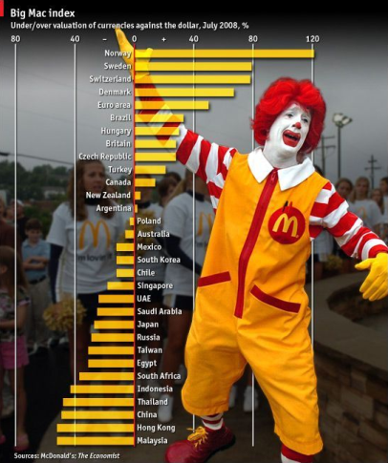
Live mini field research
Methodology: a couple of questions to the audience
Goal: creating awareness about the lack of land price data
Question 1: Where are you from?
Question 2: What is the price of a Big Mac in your own city?
Notes:
So lets start with the live mini research now. The methodology is quite simple: we will ask some questions to you as a well respected scientific audience and we will inventory some of you answers. The goal is trying to create awareness about the data issues.
Inventarise countries / cities? We have some people from …
The second question seems perhaps a bit aud but it will come clear why we are asking this.
→ Perhaps you have heard of the big mac index. It shows us what the price of a big mac is in different countries. So exactly the same product in totally different countries. A lot conclusions and analysis can be drawn from this information. This seems not really scientific but it is about the thought is interesting.

Slide 5
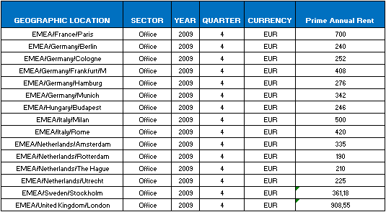

Live mini field research
Question 3: What is the average rental price of a prime office location of your city?
Notes:
Let’s go to a field of which we know a lot more, the real estate market. Question 3 is…
With a couple of clicks a found real reliable data about rentlevels for Q4 2009. So if I look for a gross initial yield as well I can easily make a first estimation of the investment value.

Slide 6
Live mini field research
Question 4: What is the land price of a m² land in your own city?
Question 5: Which land pricing systems are used by your own municipality?
Land price system = is the main public instrument that determines a land value for the transferring of land rights between different actors.
Notes:
4) What ever you known might be in handy? Office / Residential
5) In general we define land pricing systems as the main public instrument that determines a land value for the transferring of land rights between different actors.
So I think that we all agree that concerning land price data: …

Slide 7

The research goal
Investment Value
Building costs (incl. P&R)
Land costs
Inner-city office development
Less is known by many
More transparency on the land market in order to create :
  A better understanding of the tension between supply and demand;
  To gain more trust and certainty for foreign investors and reducing risks;
  Insights in effects of a financial crisis, different models different outcomes;
  To benchmark land price data;
  A more efficient market.
Notes:
2) And therefore have some better understanding about the pricing of real estate and margins of developers as well
3) So if I ask what will happen with the rentlevels of office space in Greece? Same go’s for the gross initial yields you will You can probably make a good estimation, but if I ask what the land prices will do, we will definitaly come up with a lot more resaerch questions instead of answers.

Slide 8
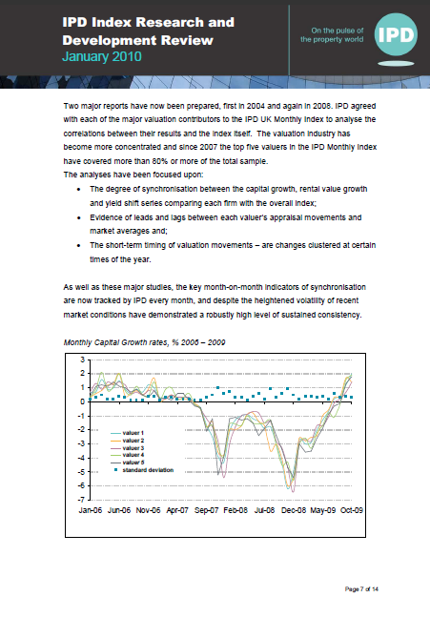
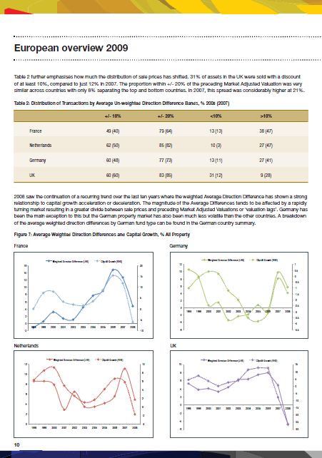
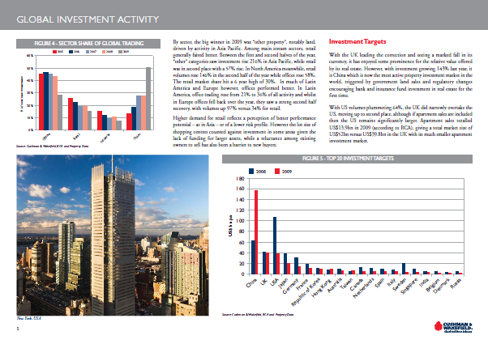
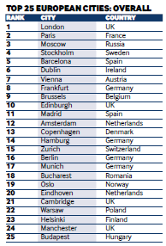
The research goal
Notes:
Before I give the floor to Wim some examples of how we see the future of land price data

Slide 9
The research process
The combination of theory and practice
Literature / Desk research
→ Not a large body of literature
Field research, collecting the land price data
→ 50 e-mails to academic and business relations across Europe
→ about 15 e-mails reply
→ Result is quite surprising...
Notes:
When we translate these interesting reports and graphics into actual research question four main questions arise.
First of all, of course, the question is which models are implemented in different cities to determine the land price
Secondly, this leads to the focus on the effects of this models, so, which actual price is the result of these methods
The third and fourth questions are of a more abstract level.
It concerns a focus on the position of the land prices in the local context, so we want to compare the land price data with for example the GDP, local rents, yields or income.
The fourth question relies on possible changes in generating more optimal market outcomes. In which way prices will be changing if the theoretical optimal land pricing method will be applied?
Today we shall explicitly focus on the second question, which land prices are set in different cities across Europe.
So what did we do?
We contacted 50 key persons from academic and business world with our first two questions about pricing methods and land prices. The response was around 15 e-mails so 30% returned with at least an answer or with documents, advices etcetera.
What this brought was quite a surprise....

Slide 10
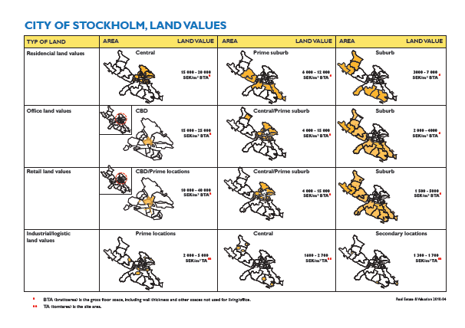

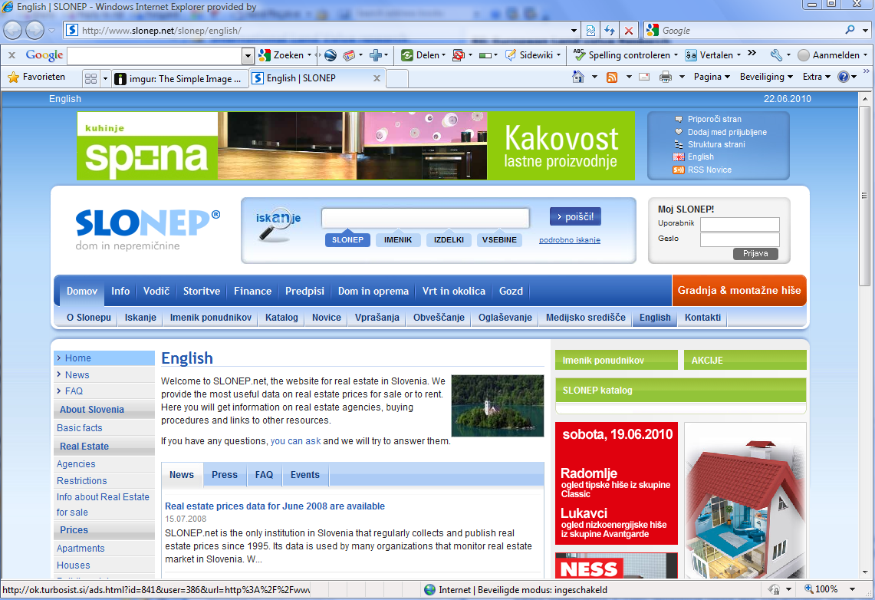
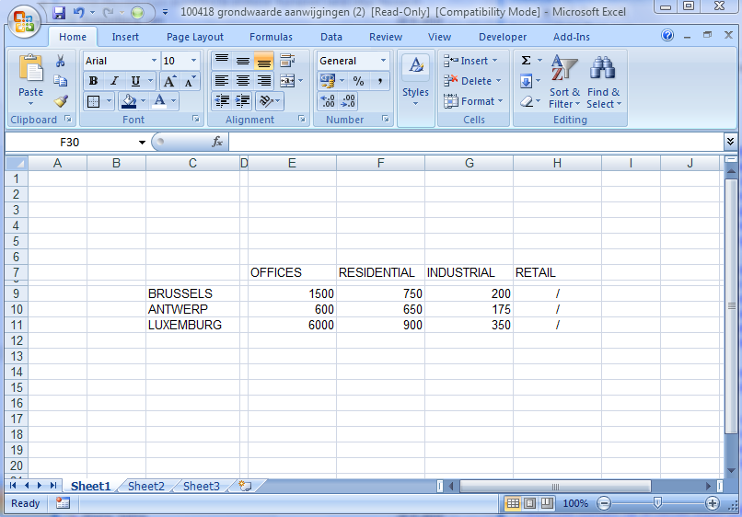

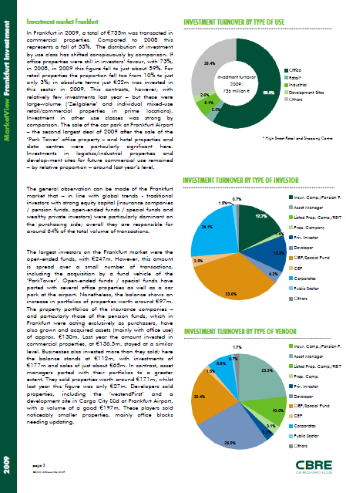
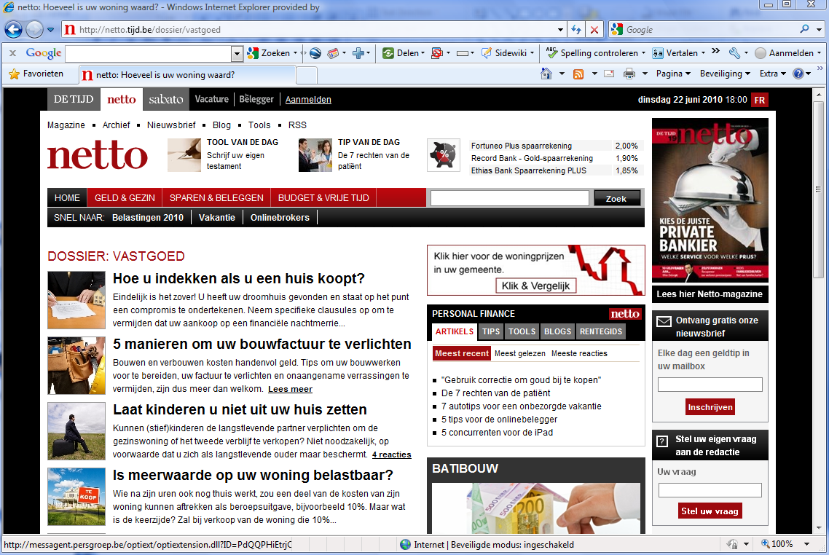
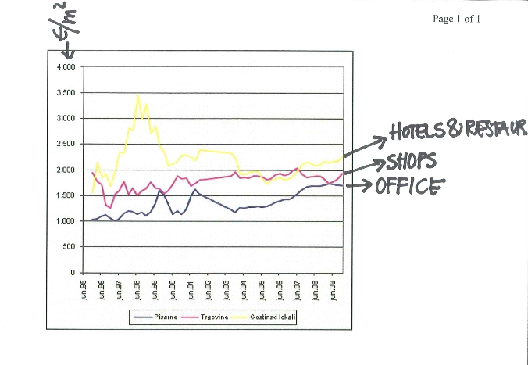
Data was given in many ways…
Notes:
The data given to us by highly respected partners and customers was very poor.
The first group got the question a bit wrong and send us a lot of real estate data, very interesting though but not for our research.
Some of the contacts send us a general e-mail link which should contain something about land value
Some of them got the question but did not exactly knew understand the scientific part of the research
Last but not least some municipalities have it all…

Slide 11
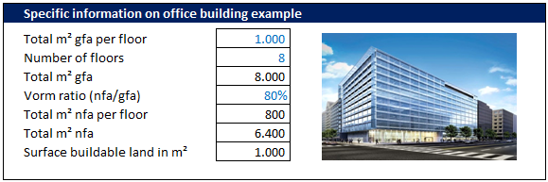
First research results
Notes:
What did we do with this data.
The first conclusion is that the different cities all apply different land pricing methods.
Stockholm uses something like a fixed price for there leasehold sites
Amsterdam and The Hague apply the residual value method
Dusseldorf relies on a fixed price
Stockholm Amsterdam and The Hague calculate prices per gross floor area. So the actual land price depends highly on the amount of real estate that will be developped.
Dusseldorf only uses a fixed price but adds a restriction on the amount of square meters that are allowed to develop.
To make these different methods and data comparable we set up an average development project that can be build in all the selected cities. The key question is, which price must be paid in the different cities when we develop this office building?
Amsterdam shows a significant higher prices for low quality locations
In stockholm you pay the highest price for the piece of land underneath the office building
We see that both Stockhol and Dusseldorf have a big bandwidte

Slide 12
Conclusions
A big lack of quantitative data:
  Land price data is not or poorly centrally collected by public or private companies;
  If data is collected it is hardly comparable because of different methods;
  Also land price methods itself are very in transparent;
Transparency issues:
  Is it relevant enough to have a transparent land price market?
  For whom is it important that the land market is not transparent?
  For whom is it important that the land market will be more transparent?
Notes:
Tension between advantage of transparency for real estate and land markets and institutions that currently profit from the intransparancy.

Slide 13
Conclusions
What if transparency on the land price market is our goal:
→ How can we organise a collective responsibility?
  Public / Private initiative;
  One central European organisation;
  A sub department of the IPD;
  A yearly research by ERES / ULI / RICS / … .
Notes:
Tension between advantage of transparency for real estate and land markets and institutions that currently profit from the intransparancy.

Slide 14
Any questions?
In order to get a copy of our paper, please leave your business card
W.J. (Wim) van der Post Msc
w.vanderpost@asre.uva.nl
M.I.A. (Martijn) Boerkoel BA Msc
mbo@fakton.com

