Slide 1
Return to the bricks
ERES 2010 Milan June, 23-25
Peter de Jong
Delft University of Technology
Real Estate & Housing
Building Economics/Design & Construction Management
Co-author: Hans Wamelink
Notes:
The title may seem ambiguous; is it about a good return on property investment, or is it about reintroducing the basic material of these properties. Actually it is meant to be about getting a good return by looking at the basics of the objects involved.
By now everyone involved in the building industry knows, the way of thinking in order to improve the building process as well as the products of this industry should change from a focus on the total investment into a focus on total cost of ownership or subsequently the total life cycle costs. At the same time everyone is aware of the long and difficult path to reach this transition. The same hurdles may be expected for a similar process for the investors: to change the standard approach on direct return on investment into real value creation during the life time of the assets. Being at the demand side of the investment market, the investors are the most important party to set the goals for the sustainable total life cycle focus, but regrettably they hardly do.
Project developers altered their focus into more sustainable development in the previous years. This could have been observed at for instance the World Congress of the Council for Tall Buildings and Urban Habitat in 2008. Even in Dubai, not beforehand the most obvious place for sustainability, and concerning high rise, not sustainable in itself, every attendee was convinced new development needs to meet the new set of requirements. Mohamed Ali Alabbar of Emaar (Alabbar, 2008) stated that, if the Burj Dubai, now known as the Burj Khalifa, was designed in that year, it would have been the most sustainable tower too (next to the highest tower and all other superlatives). Besides their personal attachment, developers are straightforward enough to declare the most important drives for a sustainable approach is the client demand. If in the following financial crises one ray of hope can be distinguished, it is the continued awareness on the environment and the lasting claim for green development, as long as the investor wants to pay the bill.
Institutional investors and especially those with a public background like pension funds have even a more distinct claim on sustainable investment. Every website or annual report of these institutes is giving evidence of this sense of necessity to change. Environmental, Social & Governance aspects is the common phrase for this policy. See for instance the latest annual report of ABP, one of the largest pension funds.

Slide 2
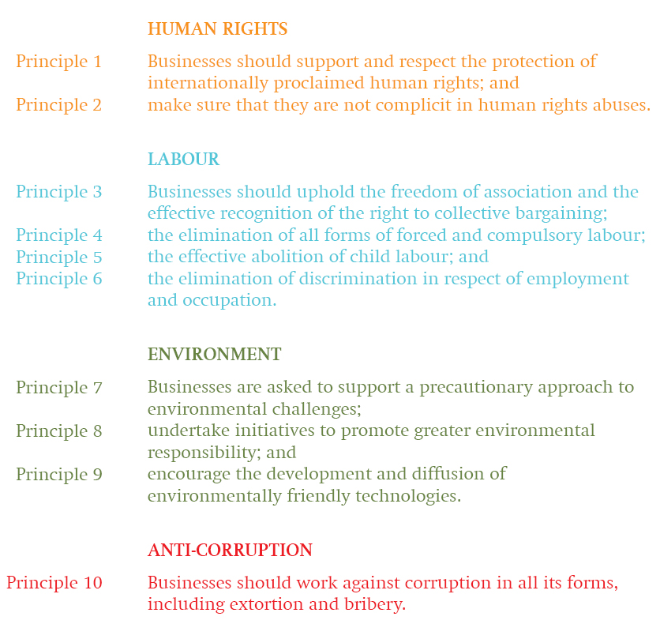
Environmental, Social and Governance
Institutional investors apply:
United Nations Global Compact
OECD Guidelines for Multinational Enterprises
OECD Principles of Corporate Governance
International Corporate Governance Network Statement on Global Corporate Governance Principles
Very usable for shares and stocks, hardly for real estate
Notes:
Investments in companies and funds are due to this policy restricted to those meeting the necessary requirements and norms, laid down in e.g. the United Nations Global Compact, the OECD Guidelines for Multinational Enterprises, the OECD Principles of Corporate Governance and the International Corporate Governance Network Statement on Global Corporate Governance Principles. As long as companies committed to such guidelines are neatly listed, the investors’ institute can focus on its core business, making money with money, excluding the blacklisted companies. However these guidelines, principles and so on are formulated rather general. As an (important) example the Global Compact (2008):
The OECD Guidelines for Multinational Enterprises will be updated in 2010.
De methods for valuating are less simple then suggested; used are subsequently: (1) Mark-to-market, (2) Broker quotes, (3) External estimates and taxation, (4) Mark-to-model and (5) Best estimates.
Human rights
(1) Businesses should support and respect the protection of internationally proclaimed human rights; (2) and make sure that they are not complicit in human rights abuses.
Labour
(3) Businesses should uphold the freedom of association and the effective recognition of the right to collective bargaining; (4) the elimination of all forms of forced and compulsory labour; (5) the effective abolition of child labour; (6) and the elimination of discrimination in respect of employment and occupation.
Environment
(7) Businesses are asked to support a precautionary approach to environmental challenges; (8) undertake initiatives to promote greater environmental responsibility; (9) and encourage the development and diffusion of environmentally friendly technologies.
Anti-corruption
(10) Businesses should work against corruption in all its forms, including extortion and bribery.
Doing so requirements at institutional level, like not investing in companies involved child labour or weapon industry can be easily fulfilled.

Slide 3
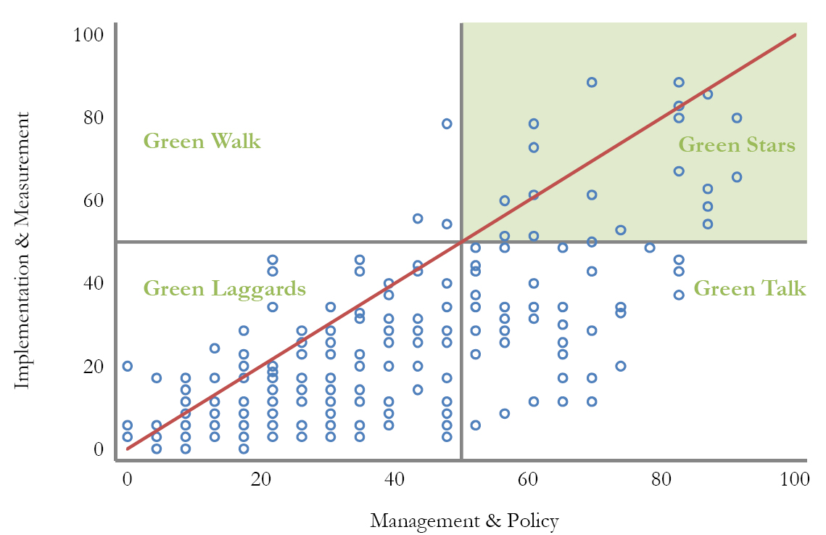
Environmental, Social and Governance
green performance
high rise buildings
vacancy and adaptability
sustainability
transparency
education
Property investors talk the talk, but hardly walk the walk; source Environmental Real Estate Survey, Nils Kok
Notes:
However the real estate market is a substantial market for which the blacklist approach is not that apparent. There are no builders meeting the same guidelines by default. Building projects are treated as unique projects, where the client sets the conditions. If the investor is the final client and he only formulates financial boundaries that is what he gets. As long as the investor does not take this client role full-hearted, and instead transpose the formulation of building requirements to the virtual, or in the initial phase non-existing, tenants with shortening lease terms, it will be by incident if a building meets the Environmental, Social & Governance aspects. In other words, if the investor wants to give a meaning to the ESG-aspects, they have to return to the bricks – valuing the building in a broader context than the financial performance. The following chapters are dealing with several aspects, green performance, high rise buildings, vacancy and adaptability, sustainability, transparency and education, all related to building characteristics and contributing to the vision on the eloquent ESG-aspects.

Slide 4
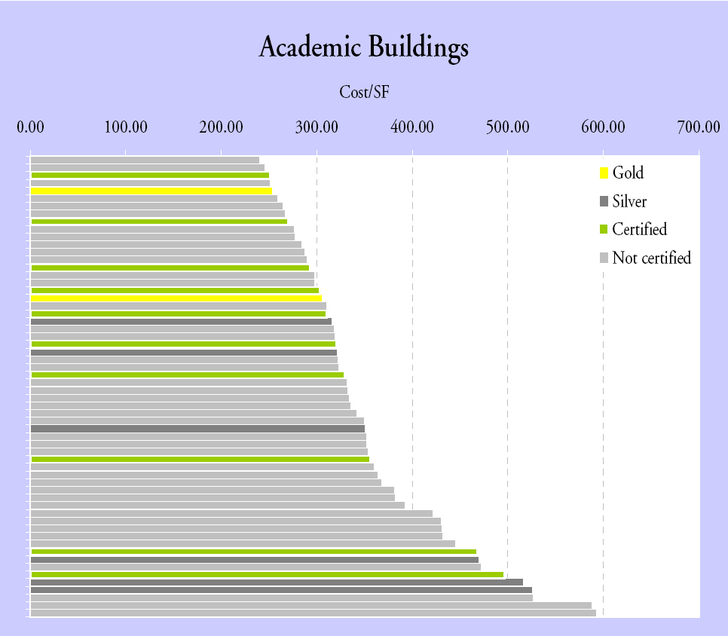
Green performance
Doing Well by Doing Good
(Eichholtz/Kok, 2010
effective rent > 6%
selling price > 16%
Energy Star and/or LEED
Cost of Green Revisited
(Davis Langdon, 2007)
integrated, no additional costs
Notes:
A leading Dutch financial newspaper, Financieele Dagblad (Gossink, 2010), is giving evidence of the notion that most of the real estate funds are not capable of establishing a far-reaching policy on sustainability. This newspaper article was based on a global Environmental Real Estate Survey, commissioned by the European Centre for Corporate Engagement (ECCE) at Maastricht University (Kok, 2010). This report reveals an increasing awareness of environmental issues among property investors, and some property companies and private property funds being successful in green investment and scoring heavily on the Global Environmental Real Estate Index. But overall property investors are not coming close to achieving the maximum score. The global quest for the right approach is demonstrated by Figure 1, taken from this report.
The more positive reflection is that only due to the fact investors are talking the talk, which is the sensible thing to do before walking the walk; these kinds of studies can be executed, universities are challenged, and is there still a bright expectation for the sustainable future. This awareness is fed by several brain storm sessions on this subject – everyone is eager to learn.
This group of researchers demonstrate in another very interesting journal article ‘Doing Well by Doing Good: Green Office Building’ (Eichholtz, 2010) the positive effects of ranking systems on value, in this case the Energy Star. An otherwise equal commercial building with an environmental certification seems to rent for about three percent more per square foot; the difference in effective rent is estimated to be about six percent per square foot. The increment to the selling price may be as much as 16 percent. The same results illustrate that LEED, with its broader scope does not show statistically significant effects; the premium in rent is by the tenant related to the energy-efficiency of the building. There is some debate going on about the rigor of these numbers, but at least a positive effect is acknowledged.
The need for focus on an integrated sustainable approach right from the early beginning of development, is also very well demonstrated by the Davis Langdon report Cost of Green Revisited (2007). Their conclusion is (higher) LEED-ranked projects are within the budget and in the same cost range as non-LEED projects. They also experienced project teams conceiving of sustainable design as a separate feature. Until all parties involved understand that green design is not additive to straight design, it will be difficult to overcome the notion that green costs more, especially in an era of rapid cost escalation.

Slide 5
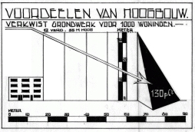
High Rise
Building characteristics
Duiker plea
Deur repeating in the High Rise Workshop
Notes:
A typology of projects where the building characteristics do take a serious part, and understanding is essential for a good result is the large scale high rise or tall buildings.
In his enthusiastic plea for high rise building Jan Duiker (1930) claimed many advantages of high rise compared to ordinary low rise. High rise would reduce 500% on ducts and wiring, 67% on pile foundation, 200% on brickwork, 130% on groundwork (Figure 2), and so on. In line with this history an architect suggested in a high rise workshop in 2000 a reduction on facade costs of tall buildings due to the repetition of elements. This seemed besides the truth and was one of the provocations to start the research on ‘High Rise Ability’.

Slide 6
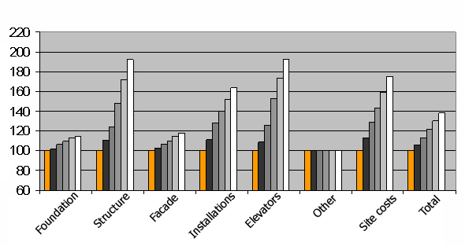
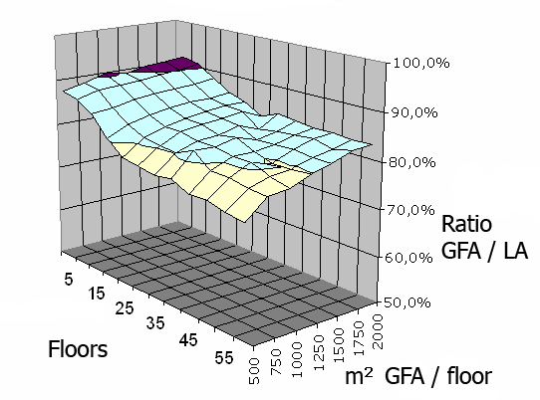
High Rise
At the expenditure site tall buildings are more expensive then other projects.
At the revenue site these buildings are less efficient, especially where regulations impose slender buildings.
Double trouble for the initial yield, since the increased costs have to be balanced with (higher) rents on decreased lettable floor area.
Notes:
The definition of a height charge for tall buildings, defining the additional total building costs for every extra metre of height, was already formulated by Gossow (2000). The arguments for these additional costs, especially for the UK market, are elaborated by e.g. (Watts, 2002a; 2002b; Collins, 2008). Basically heavy loads, vertical transportation requirements, the larger capacities of systems, effects of scale and complexity and risks contribute to these additional costs. Our research (de Jong, 2007b) is going into the fact that such a height factor and the building performance is very depending on local regulations. In the Dutch situation the increase of total building costs for high rise is around 0.8% per floor: if a low-rise office will cost 1100 €/m2 gross floor area (gfa), a tower with a similar quality level but with 50 floors will do 1550 €/m2 gfa. The main problem however is the decrease in efficiency. The building efficiency, the ratio between gross floor area and leasable floor area, is dropping 20%, especially with the slender type of buildings, resulting from Dutch building legislation.
Both effects, the height factor and the efficiency, have a serious impact on the possible gross initial yield of high rise buildings. It was remarkable this information was hardly known at the ERES conference in 2007, where the first results of the High Rise Ability research were presented. The assumptions were more in line with the ideas of Jan Duiker, which could be the explanation for the long list of never built designs for tall buildings, see Figure 3. Compared to other buildings high rise should be addressed more like a vertical transportation system. With height as one of the main characteristics, building and using tall buildings is like making a ship in a bottle; every piece of material and user has to pass the bottleneck.

Slide 7
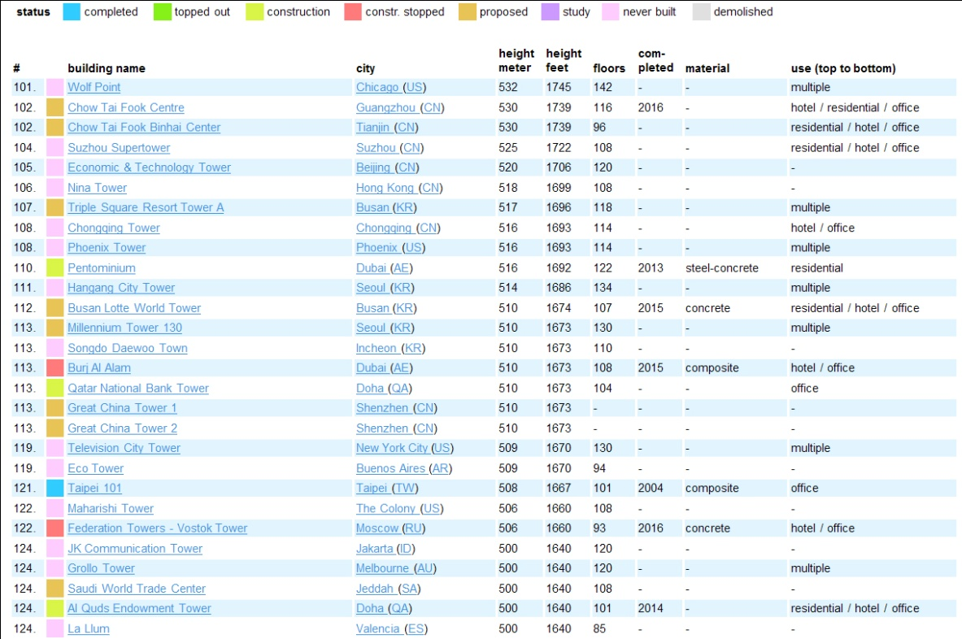
High Rise
Notes:
Looking at the building process from a limited discipline based view is not reserved to investors. A part of the High Rise Ability research was focussed on the client perspective. Tim den Dekker (den Dekker, 2009a; 2009b) gave evidence to the fact, that while tenants of high rise dwellings are triggered by the view inside out, and want the windows and floor plans to be arranged around this phenomena, architects are much more designing outside in, giving more value to a compelling rhythm of the facade, then the clients’ appreciation.
High Rise is just exemplary for the need to understand the objects of the trade. Other ‘interesting’ project like area development, city-in-a-building concepts or mixed-use buildings have a similar scale of complexity and a similar need for intrinsic knowledge of the object.
But also in the more standard office building the building characteristics are underestimated. The research of Philip Koppels adds another dimension to the suggestion the rent is dictated by the location and nothing else but the location (Koppels, 2010; 2010 (forthcoming)). Especially in fine-meshed observations the quality approach, related to these characteristics, do make the difference.

Slide 8
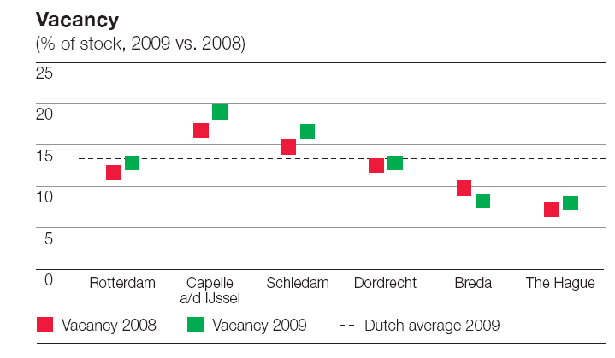
Vacancy
Development of buildings in Rotterdam of 50.000-150.000 m2
Take-up 115.000 m2
Replacement market
Building your own problem
Don’t develop
Develop with quality (think solid)
Develop with flexibility
Notes:
However the development of tall buildings is not only tensed by the building characteristics in itself. It is by definition large scale development with higher risk. The success factor is highly depending on the compliance of the tenants. These office users, preferably the larger companies are seldom new players on the market. The office market can be described almost entirely as a replacement market.
In Rotterdam some projects are in preparation or under construction with 50.000 - 150.000 m² floor area. With a take-up of only 115.000 m² in 2009 (DTZ Zadelhoff, 2010), this kind of projects are extremely depending of the willingness of tenants to pay. These users will leave other office buildings, probably also in Rotterdam and most likely being part of the same stock owned by the same investors - in particular if the investment is dealt with through less transparent funds instead of real buildings. So the success of the new building at one hand will contribute to the vacancy on the other hand. Every participant of the building process is conscious of the importance of getting users into the new building and at the same time unaware of the fact they are contributing to this vacancy rate.
Next to the quantitative mismatch, Hilde Remøy (2010a) explains the cause of vacancy in the qualitative mismatch of demand and supply in the market, the increased odds of structural vacancy by monofunctional locations and inflexible floor plans on building level. Coping with the unbalanced market is hampered by inadequate value assessment. In customer directed publications real estate agents are suggesting the worst part of the crisis is gone, but the same organisations conclude in more indepth articles the total amount of vacant space will almost be doubled in the next decade if nothing is changing (Snijders, 2010).
See www.dtz.nl or www.joneslanglasalle.nl
Recent research of a real estate agents institute suggests that not acting on vacancy seems the best solution at the moment, completely skipping investors’ interests.
Coping with vacancy is also depending on buildings characteristics. The structure and the facade deceive for the office buildings transformation potential (Mackay, 2009). Prevention of vacancy has next to the market (Knowledge of user preferences) and location (mixed-use), also a building component, namely adaptability, in order to limit structural vacancy.
The best way to prevent vacancy is to reach a level of quality for which a building is beloved. Not just enough to fit its purpose, but so precious a quality with future value is created, creating a need to preserve buildings. Frank Bijdendijk (2007), amongst others inspired by the squatter’s movement, as an external group striving for preservation, came to the concept of solids with such a quality definition. As an entrepreneur he is looking these kind of long term investments, and as the CEO of an large housing association he has the ability and the organisation to control long term investments. Looking into the details of this concept, a flexible shell with high exterior quality and the organisation to maintain it, in-depth knowledge of the building process and the building characteristics is conditional.
See http://www.solids.nl/en/#/home for an English description or Bijdendijk (2007) for the Dutch background information on solids.

Slide 9
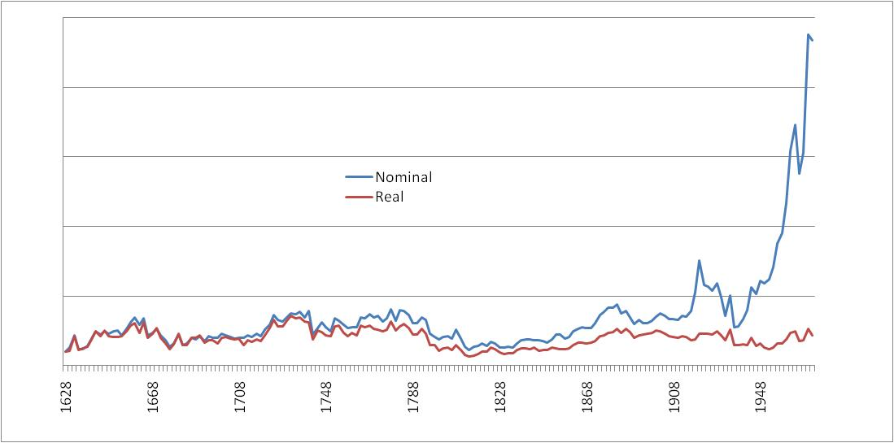
Adaptability
adaptability at almost no cost
exit value/whole life costs
You cannot predict or control adaptability. All you can do is make room for it (Brand, 1994)
Notes:
Adaptability does not have a high influence on the building costs (Schenk 2009). In his research he investigated the marginal costs for keeping an open mind to functional freedom while designing single corridor and central core buildings. Basically this is about rethinking the facade, making it not load bearing if it should be replaceable, which is often the case in adaptations. Not designing at minimal levels for fire protection, related to the initial function, but going to the next level, which also works as an additional value if the client appreciates safety. Rethinking the structure and sometimes applying some additional space. Developing adaptable buildings only makes sense if located in a location where functional adaptation is possible, thus in dynamic mixed-use locations. Making adaptable buildings in such a way does at to the buildings costs, but not on a impressive scale (< 5%). Looking strictly at the investment costs this probably is the first item to cut out. However, if at the end of the first functional period, when the object is sold by the institutional investor to another party, the adaptability may proof to be one of the best parts of the exit value. The object will even be more valuable if the options for adjustments are clearly documented, which still is lacking many times.
Wiechert Schenk was originally triggered by the adaptability of the canalside houses in Amsterdam. The same location being subject of the well-known study of Piet Eichholtz (Geltner et al., 2001; 2007; Eichholtz et al., 2002), illuminating a 346-year Herengracht Location Value Index, see Figure 5. This study offers solid evidence that, in the long run, prices stay, more or less, in-line with general price and wage inflation. Due to location conditions the Herengracht represents an upper bound, nevertheless, a revaluation of exit values is suggested.

Slide 10
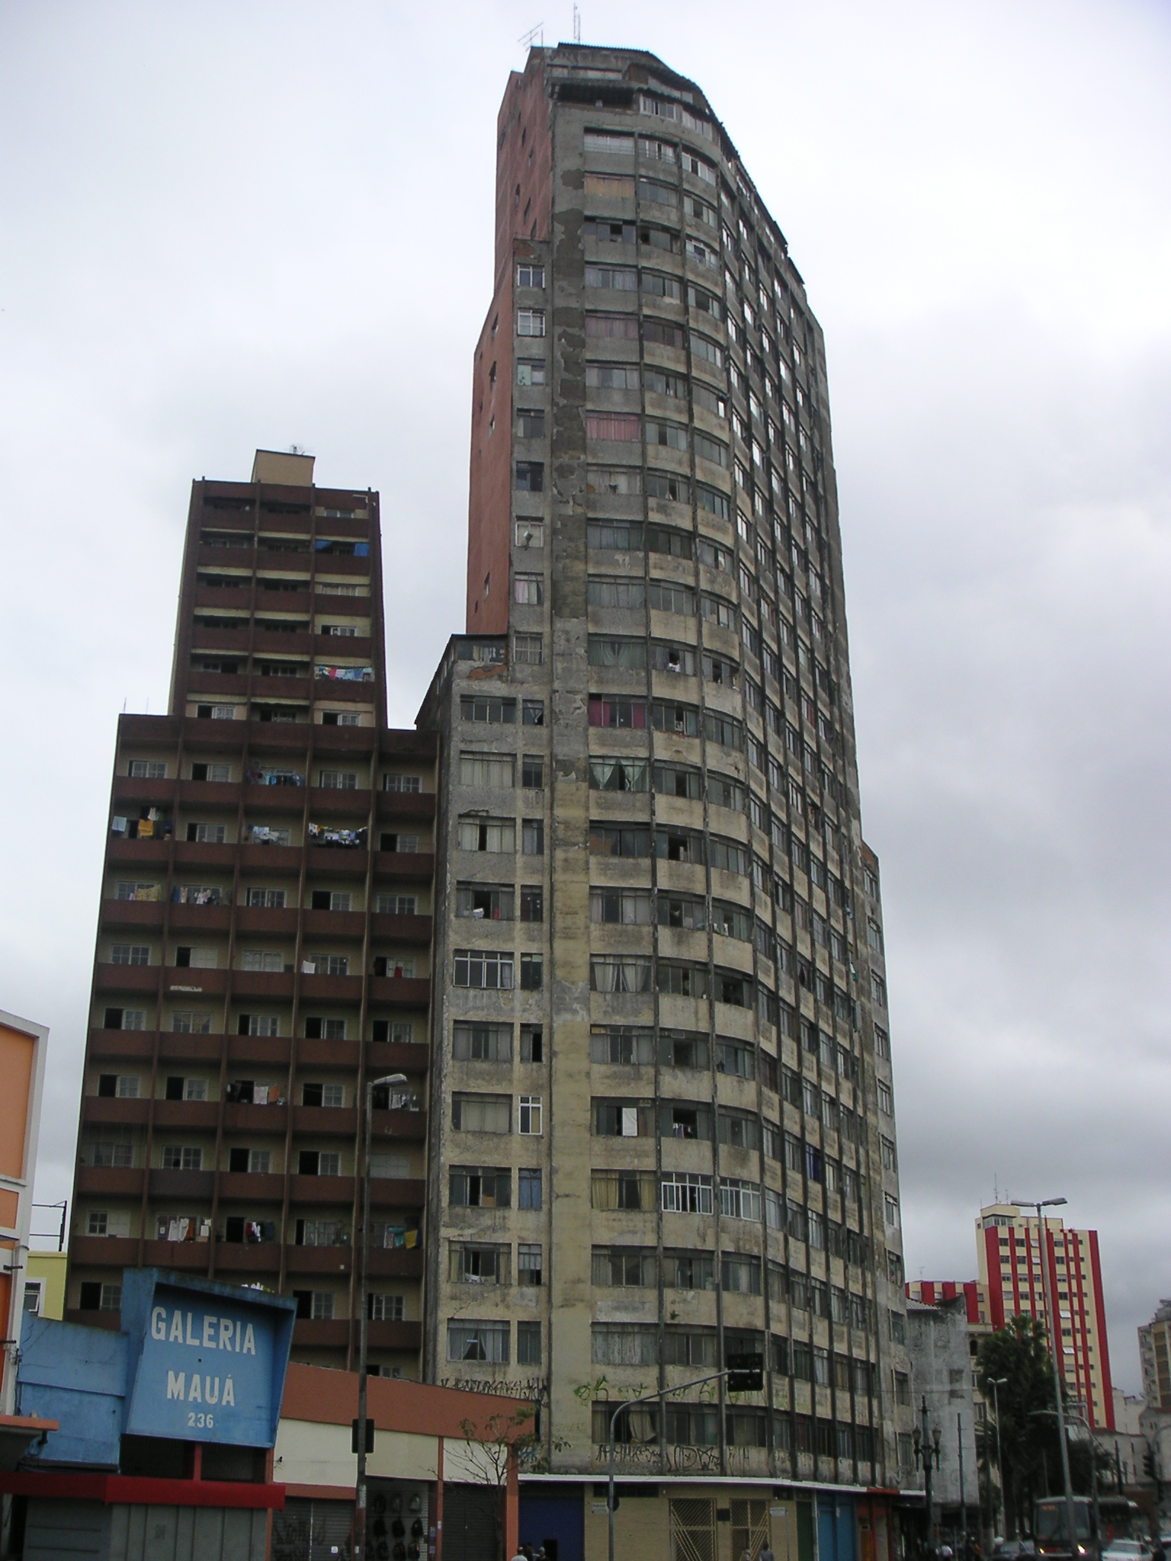
Sustainability
Chris Ryan
LEED, BREEAM, BREEAM.NL
EPC, GreenCalc, EVR
scalability and modular
Notes:
Is the Environmental aspect fulfilled by a high LEED or BREEAM ranking, and if so, which scheme to choose? Basically it is a good starting point. Thomas Saunders (2008) produced a comparison on both schemes as well as Green Star and CASBEE. He concludes that none of the schemes travel well if used in countries other than those which the scheme was designed for; the schemes should be localised and tailored to take account of the local context. Since the easiest points are scored by using a certified assessor (a self-supporting feature used in all these schemes), the best suggestion is to use LEED in the US, BREEAM in the UK and some local version anywhere else. This has been also to approach of the Dutch Green Building Council.
Leadership in Energy and Environmental Design (LEED). LEED v3 is launched on April, 2009, by the U.S. Green Building Council. See http://www.usgbc.org/DisplayPage.aspx?CMSPageID=1988.
BREEAM: BRE (Building Research Establishment) Environmental Assessment Method. Revision 08 is launched in August 2008. See http://www.breeam.org for the latest version
BREEAM.NL, the Dutch localised version of BREEAM, hosted by the Dutch Green Building Council, see http://www.dgbc.nl/
However the suggestion sustainability is reached by a nice label, using sound bits like Excellent or Platinum, is hardly convincing, although commercially doing rather well. Previously more sophisticated systems have been developed giving more detail to the environmental performance. E.g. in the Netherlands the Energy Performance Coefficient is used as a part of the Dutch Building Regulation. In Germany similar developments took place. The detailed information and accountable forecasting of energy consumption is well-organised in the EPC. The disadvantage is the need of a much further elaborated design, up to complete materialisation and installation design, in order to even start with the assessment. After completing this exercise, the previously mentioned difference in appreciation by tenants for LEED and Energy Star (Kok, 2010) is addressed.
The use of the term sustainability refers and is giving credits to the original definition of the World Commission on Environment and Development (Bundtland, 1987). The oft-quoted definition of sustainable development is defined as: "development that meets the needs of the present without compromising the ability of future generations to meet their own needs."
The hosting organisations of the schemes are aware of this need for further detail on performance. A second generation of assessment tools is under construction, introducing scalability between ranking schemes at the start of project development and the assessment and the more detailed calculation tools to be used in the following phases, hopefully reaching a level which can be used for bench­marking the actual performance in use.
A shift in focus from (pre)-design into design and use is already a huge improvement. The next level is to take full life cycle into account. Even the best buildings have to be demolished on a certain moment. Methods like the Eco-costs/Value Ratio (Vogtländer, 2001; de Jonge, 2005; Hoffman, 2008) are defining eco-costs as ‘virtual’ costs related to measures, which have to be taken to make (and recycle) a product ‘in line with earth’s carrying capacity’. Eco-costs are the costs of technical measures to prevent pollution and resource depletion to a level, which is sufficient to make society sustainable. More specifically, the model is based on the virtual eco-costs ’99 being the sum of the marginal prevention costs of the depletion of materials, energy consumption, toxic emissions, labour and depreciation.
Sustainable design opens up a broader context, in which indeed al the questions like the right HVAC-systems, building and construction systems, materialisation and so on has to be determined. Sustainable management is for a great deal to find the right experts fitting in the scope of those commissioning the green project. For sustainable development the scalable ranking tools are setting the right targets.

Slide 11
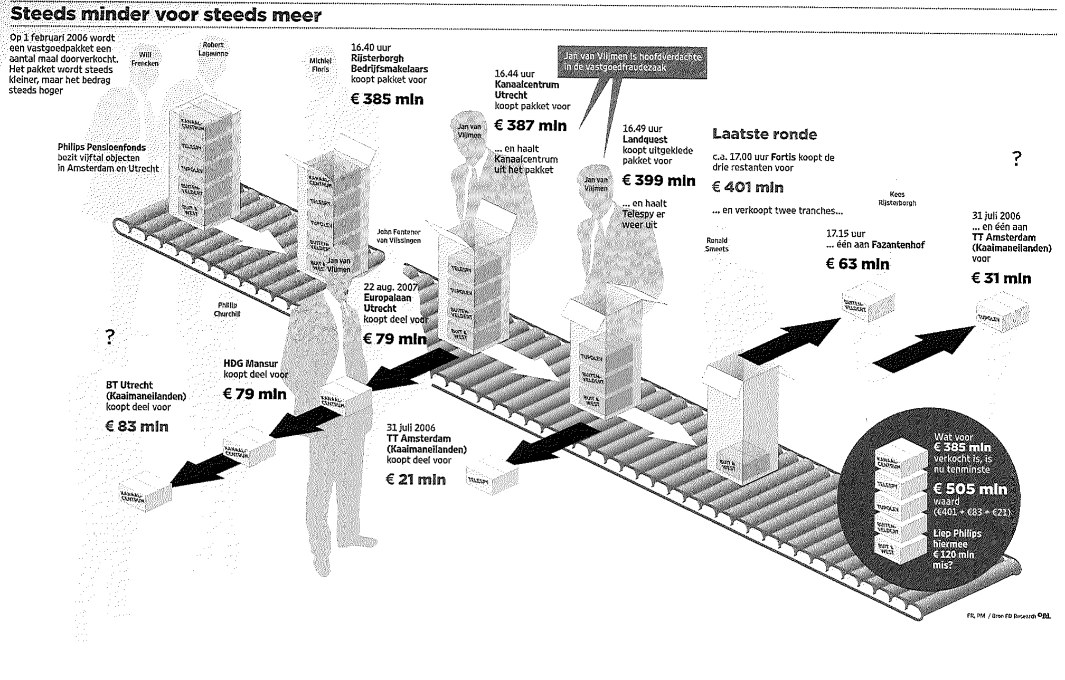
Transparency
prevent fraud
Governance = anti-corruption (10)
learn from housing corporations
Notes:
The previous parts may suggest that all the answers to renewed approach of the Environmental, Social & Governance aspects are to be found in sustainability. This is only through if the concept of green development is stretched into such a direction, which seems the case where the ranking tools are also introducing points for sustainable management. However the thread in this paper is to have an intrinsic vision on the object next to, or combined with a financial one. The Governance aspect is not fulfilled by talking about sustainability but needs more transparency, in line with the anti-corruption statement of the Global Compact.
See http://www.wiki.dgbc.nl/index.php?title=Management (Dutch) or http://www.breeam.org/page.jsp?id=13#management (English)
Probably the most important asset is real estate is trust. The Dutch real estate society will be confronted this year with some legal proceedings with a huge impact. Part of this scandal is the sell of a large package of real estate by a pension fund, Philips Real Estate Investment Management (PREIM), for € 385 million in a so-called ABC-operation (van der Boon, 2009). The package was worth over € 520 million at the end of the same day, by which every pensioner of this fund lost € 1100. It is hard to believe that with proper valuation one can oversee 40% of the value in which one is dealing. Even worse for the complete Dutch real estate is the fact, such scandals will have an impact on the appreciation by international investors on the whole country.
This example goes beyond policy on governance aspects, it becomes a criminal matter, but real knowledge of the assets could prevent such misery. The first step in a transparent business is to work with controllable and accessible data. In this line of thinking it is logical the expert witness in the previous example is a professor in taxation and valuation, working uniformity and consistency for a long time (Hordijk, 2005). The recent British Bribery Act 2010 requires sufficient measurements for prevention, probably including a similar setting – the first jurisprudence will appear soon enough.
As already indicated before, housing associations are in this view an interesting subgroup of investors, with their own but informative view on investment and building. Dutch housing associations are forced to formulate a policy on integrity before 2011, according to a given format of the Ministry of Housing. PricewaterhouseCoopers investigated the state of the art of their preparation to fulfil these requirements (PWC, 2010). As a result the more employee related items have been regulated in a way the ministerial objective is manageable, but there where the essentials of checks and balances are met, results are still poor. Only 45% of the real estate projects, based upon 10% of the total number of associations, are checked at the Kadaster, for the historical value development.
In the Netherlands the Kadaster, or the Dutch Land Registry Office, collects information about registered properties, records them in public registers and in cadastral maps and makes this information available to members of the public, companies and other interested parties in society: http://www.kadaster.nl/english/.
Due to the legal position of the housing association, the Minister of Housing is able to set the regulations for the associations on social performance, financial continuity, stake of own resources, efficiency, justification and integrity and governance. Such an obligation will be totally different for investors, but the lessons learned in this perspective could be very useful. Key issues are the integrity of the management and upgrading of supervision. Although not supervised by a Minister, investors could learn from policy development of associations, especially for being close to the client and the bricks. Comparable with the investors, there are housing associations talking the talk and others walking the walk.

Slide 12
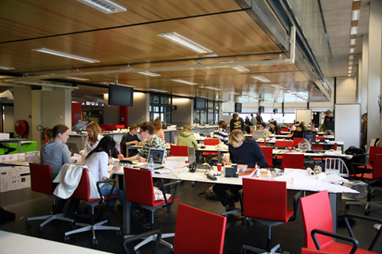
Education
existence
return to the bricks
the perfect student
Notes:
As illuminated by the example comparising the investment approach versus the life cycle approach, and the time implicated, return to the bricks is not an overnight transition. It will take a few more years, by which education becomes involved.
There is an interesting similarity between the call for a different approach of investing and the way we run our education. The fact that our department Real Estate and Housing is based in the faculty of Architecture of Delft University of Technology will not be obvious on forehand. The reason for this existence can be found in the request of the Royal Institute of Dutch Architects (BNA) observing a need for such a department. In those days numerous building project were running out of time and out of costs. The logical response of the clients was to appoint external project managers, mainly originating of economics or business administration. These project managers did steer on ‘cheaper’ and ‘quicker’; in itself positive but in many cases but at the expense of quality as well as in the process as in the product. The underlying idea behind this request was that managers with knowledge of the design and building process would be better equipped to control the process with maintaining the quality. The notable role our graduates are fulfilling since can be seen as evidence of the correctness of the BNA’s assumption.
The approach described ‘returning to the bricks’ should also reflect on the curriculum of schools educating the future investors. Within the field of management schools one can distinguish at one hand the general type focussed on the management techniques, in which it doesn’t matter if a graduate will end up in a tin can factory or a human resource recruitment agency, and at the other hand the discipline dedicated schools. Given the history above, the latter is obviously our preference, in which being close to the bricks is the natural attitude.
Sustainability is an upcoming field of interest for many years already, for universities research and education should be balanced and fed by scientific development. However, in the scientific development most time in the early days is spent on the more technical side – tools and tricks, gadgets and materials. Our research and objectives are evolving into land use, juridical and financial aspects, policy and strategy development, actor significance and process design, implementing energy programs for housing associations, marketing and branding (client approach) and so on.

Slide 13
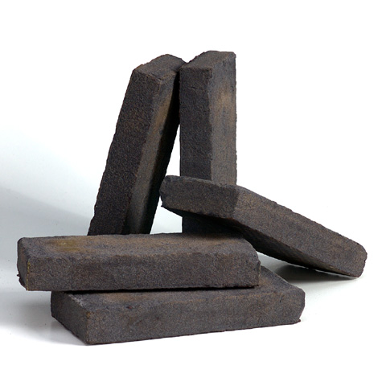
Conclusions
Exit value
Scalable forecasting of sustainability
Portfolio management
Return to the bricks
Notes:
Most investors probably will already look into the total return of investment instead of solely the direct return, and by doing so, calculate with an exit value of the building project. Fulfilling the Environmental, Social & Governance aspects in an object orientated and sustainable manner will have a good impact on this exit value due to good valuation, higher expectations on life time of the building, reliable (energy) performance figures, predictable options for adaptability and flexibility and so on. A higher exit value brings us back to the core business, making money with money.
Sustainable development has to to be brought to the next level for which today’s ranking schemes should be extended with more sophisticated tools in order to enable scalable forecasting of performance during the buildings’ life time. Such enhanced tools could also be intergrated with the necessary financial models.
In order to establish good result with large scale projects like tall buildings knowledge of specific additional costs is essential. As can be learned from research of Davis Langdon (Watts, 2002a; 2002b), this is all about building characteristics: increased wind loadings and heavier frames, vertical transportation requirements, particularly elevator capacities, speed, zoning etc., larger capacities of plant and distribution systems together with the increased pressures/hydraulic breaks that are required to deal with the increased vertical distances, effects of scale and complexity on the movement of materials and labour, risks associated with uniqueness and the fact that these risks are exacerbated by scale and the need to access a limited pool of skills and expertise, and potential interest in including elective security and safety enhancements in response to possible risks.
Some natural vacancy is needed on an active market. However, most vacancy is not a fact of life but a result of interventions of developers and investors. The mismatch of demand and supply should be dealt with in better portfolio management of the combined investors. Improving the market must be done by more realistic value assessment. New buildings should be built in a way they can be adapted and transformed in order to keep this portfolio up to date.
It is never suggested to exchange financial investing in green investing. A sustainable approach is reaching out to all stakeholders in the process. There is probably room for other parties filling the gaps in active asset management, taking risks on exploitation in order to supply a predictable cash-flow for investors. As the title suggests a good return is possible in real estate, but most of all if the financial scope is stretched. The final call is, if you want to do real estate, return to the bricks.

Slide 14
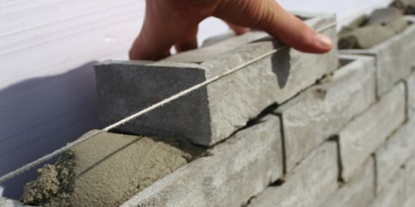
Questions/Discussion

