Slide 1
Urban Redevelopment Concept (URC) for Existing Neighbourhoods
ERES Conference 2010 in Milano
26.6.2010
Authors:
Jukka Luoma-Halkola, B.Sc
Seppo Junnila, Professor, D.Sc
Wisa Majamaa, D.Sc
Matti Kuronen, M.Sc

Slide 2
Introduction
Renovating the old, energy hungry concrete suburbs is a huge challenge in Europe
Suburban construction boom in the 1960’s and 70’s
  First extensive renovations are inevitable
Changes also in the social environment
Arising questions about the sustainablility issues
  Suburban Redevelopment
Many studies are omitting the economical and financial point of view
  Financing sets the limits for redevelopment
  New approaches are needed
  In Finland: infill development as one solution for financing
Urban Redevelopment Concept (URC) for Existing Neighbourhoods

Slide 3
Purpose of the research
Rethink the ”suburban challenge” and innovate a value creation strategy for the existing neighbourhoods
Test financing approach based on the logics of investment markets rather than solely on the traditional debt markets
  Redevelopment as an investment opportunity
  Equity financing for the occupants, profit for the outside investor, public benefit in the form of low-energy construction
  Maximize the value of redevelopment for all the parties
Urban Redevelopment Concept (URC) for Existing Neighbourhoods
Notes:
Maximize the value of redevelopment to the various stakeholders: Users, owners and public stakeholders of an existing neighbourhood
Redevelopment as an inv
Consider external investors’ point of view
Within what framework is it feasible to join the redevelopment investment process? Business incentives
estment opportunity that brings potential value for both internal and external stakeholders

Slide 4
Structure of the paper
Literature review
-Theoretical framework
New data
-Workshops
-Thematic interviews
-Financial analysis (model)
Case study
-Apply the concept to the suburb of Siltamäki
Conclusions
-Case study findings
-Further development themes
Urban Redevelopment Concept (URC) for Existing Neighbourhoods

Slide 5
Case presentation
Siltamäki
  Typical suburb built in the 1970’s
  Located in the very north of Helsinki, 15km from the CBD
  44 buildings, 1000 apartments
  Renovation cost for the whole area approx. 60 million euros
One management company for the whole area
Commercial center with 14 tenants
Urban Redevelopment Concept (URC) for Existing Neighbourhoods
Notes:
Incentives for low-energy construction?
Commercial center has 14 tenants
separate unit owned by the tenants

Slide 6
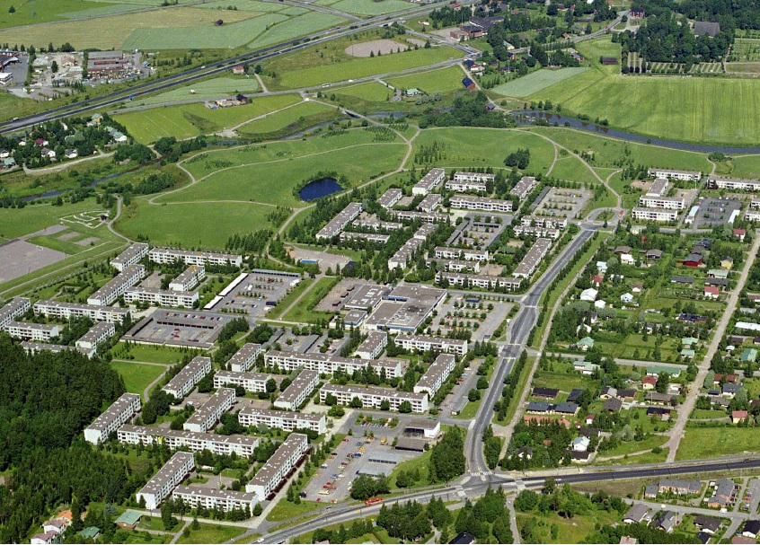
Siltamäki case area
Urban Redevelopment Concept (URC) for Existing Neighbourhoods

Slide 7
Results and case experiences
Thematic interviews
  Rigid decision making process is a problem
  Role of the municipality
  Economics of scale
  New ideas: reverse housing trade & the plot concept
Financial analysis model
  Unite the interests of the most important stakeholders
  Sound basis for assessing the investment opportunity from different perspectives
  An example based on the case study
Urban Redevelopment Concept (URC) for Existing Neighbourhoods

Slide 8
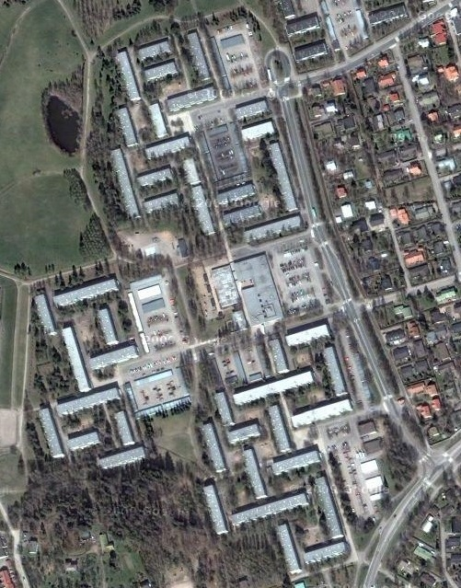
Financial analysis model
Base Case, a sale of one parking lot for infill development
  realistic scenario
Scenario 1, a sale of four parking lots for infill development
  opportunistic scenario
Scenario 2, sale and leaseback of all the land (excluding the parking lots and the commercial center)
  new concept
Urban Redevelopment Concept (URC) for Existing Neighbourhoods

Slide 9
Financial analysis model

Slide 10
Urban Redevelopment Concept (URC) for Existing Neighbourhoods

Slide 11
Discussion and conclusions
Wide range of possibilities for financing
Challenges for the Urban Redevelopment Concept
  Complicated overall process
  Many stakeholders with different incentives
    Rigid decision making process
    Moderate infill development has only little significance from the financing point of view
New discussion openers are needed
  Further research
More detailed analysis in the conference paper!
Urban Redevelopment Concept (URC) for Existing Neighbourhoods

Slide 12
Grazie!
Any questions?
Jukka Luoma-Halkola
jukka.luoma-halkola@tkk.fi
+358407000550

