Slide 1
Housing the urban poor: A case study of institutional and governance issues in a developing economy
European Real Estate Society Conference 2010 PhD Session
PhD Candidate:
Hasniyati Hamzah Department of Property University of Auckland Business School Supervisors: Professor Laurence Murphy (University of Auckland) Associate Professor Deborah Levy (University of Auckland)

Slide 2
Structure of presentation
Background
Context of study
Objectives & Methodology
Main findings &Conclusion
Q&A
Notes:
Background: This paper is only component of a larger research into impact of regulations on LCH provision.
Literature review: 4 slides.
Context: 4 slides
Methodology: 2 slides
Findings: 5 slides

Slide 3
Low cost housing in Malaysia
Far reaching socio-economic implications.
Role of state in Malaysia as provider and policy maker.
Malaysian ‘housing policies’ in 5-yearly Malaysia Plans.
10th MP (2011-2015): focus on quality of life of bottom 40% of household income.
Comparing public sector & private sector performance:
8th MP (2000-2005): 200,513 units, 51.5% by public sector but private sector surpassed planned supply by 243.2%.
9th MP (2006-2010): 165, 290 units, 51.4% public sector 48.6% private sector.
Different economic development levels in Malaysia.
Notes:
Provide context early, grab the audience’s attention.
Stress on:
need to study housing for the urban poor – use the new 10th Malaysia plan.
Different SoP for LCH in different states.
Terengganu developing region, vs other parts.

Slide 4
Impact of regulations on housing
Neo-classical economic approach – regulations said to:
Restrict land supply.
Reduce elasticity of housing supply.
Raise housing costs.
US: Glaeser & Gyourko, 2002; Glaeser et al, 2005; Glaeser et al, 2006, Mayer & Somerville, 2000, Quigley & Raphael, 2004, 2005; Quigley & Rosenthal, 2005.
UK: Bramley and Leishman, 2005
Inevitably recommends deregulation.
One of World Bank enabling strategies.
However state interference still relevant in developing economies:
Limited effective demand
Market failure
Notes:
To show tradition of neo-classical economic approach.
Use of econometric models by studying how variables affect price and quantity.

Slide 5
Research approach
Traditionally neo-classical economic models ‘black-boxes’ social relations of agents involved in housing provision: This study adopts an institutional approach.
GDP
Demographic changes
Employment
Income
Mortgage interest
Land
Housing developers
Financial
institutions
Prices
Volume
Local authorities
State authorities
House
buyers
Building
contractors
Planners
Landowners
Federal government
Source: Adapted from Ball,1986
Notes:
Econometric models simplify institutional factors, overlook processual issues.
I want to study what’s in the black box!!!

Slide 6
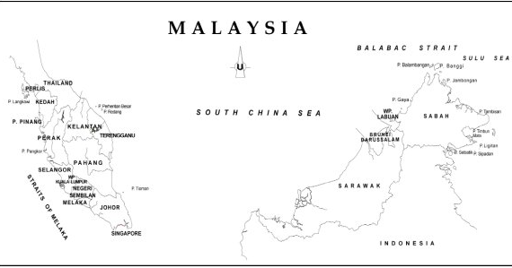
Study area
“The strategy for housing provision will give more focus on affordable housing for the low and medium income groups.”
(Terengganu State Authority, 2006)
Notes:
This slide and 2 slides onwards will provide the context of this study.
Above slide shows location of Malaysia & study area.

Slide 7
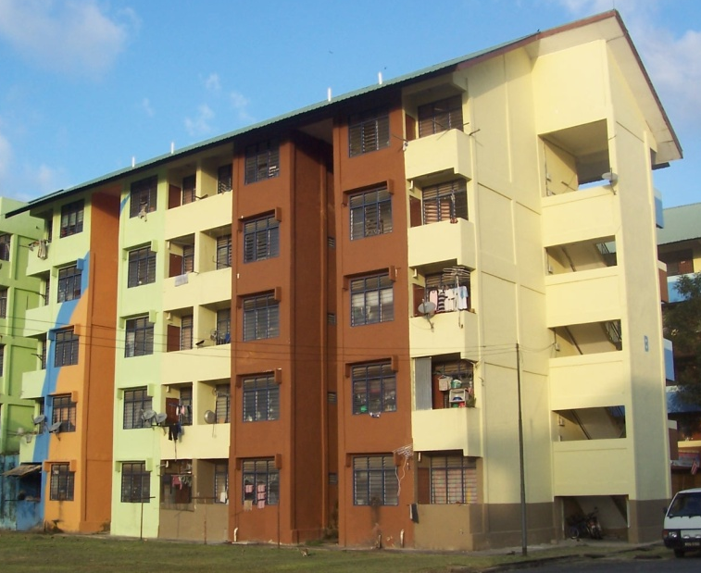
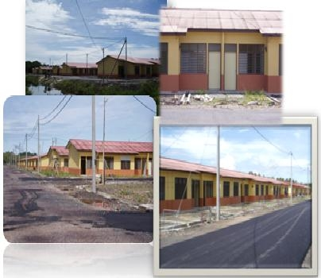
Low cost housing definition
Selling price RM25,000 to RM42,000 (USD 7,800 to USD 13,100)
Household income below RM1500 (RM2,500 in large cities)
Notes:
The definition of low cost housing in Malaysia:
Price
Income
Some authors argue land & building specifications incl. size of land & building, no. of rooms, construction material.

Slide 8
Objectives of study
Examine institutional structure of provision of low cost housing in study area.
Examine the inter-agency dynamics under the present regulatory environment.
Notes:
To clarify what my research aims to achieve.
To clarify the focus of this paper i.e. Objective 2.

Slide 9
Research Methodology
Research Methodology and design
Interview transcription
Coding
Research background
Literature review
Data collection
Data analysis
Result and Conclusion
Phase 1: Semi-structured Interviews with key informants& secondary data collection
Research questions
Phase 2: Four case studies , housing regulations database & secondary data collection
Notes:
This diagram shows the focus of this paper in relation to the bigger PhD research.

Slide 10
Malaysian legal system
Federal Constitution
Acts passed by Parliament
Regulations and other subsidiary legislation passed by the executive (Ministerial Regulations)
State Laws and Regulations
Guidelines/Guidebooks
and Government Circulars
Federal
Government
State Authority
Local Authority
Notes:
The Malaysian legal system (relevant because the paper discusses effects of government structure on implementation of housing regulations).
Federation of 13 individual states & 3 federal territories.
3 tier government system: Federal Government, State Authority and Local Authority.
Complicated relationships of agents in low cost housing → next slide.

Slide 11
Interaction of Regulatory and Institutional Structures in the provision of Low Cost Housing in Terengganu
1. Local Authority
2. State Authority
Enforcement & Management
Land Administration system
End users
Low income groups
Project Finance
Federal budget
State budget
Commercial banks
State Authority via Open Registration System
Land office, Reg. of Lands and Mines & State Authority
Producers:
State Authority
Federal Government
Private developers
Distribution
Finance
Local authorities & MHLG
State Housing Fund
Commercial Banks
Housing Development control
Building control
Local authorities
Land ownership control
Land office, Registry of Lands and Mines
& State Authority
Notes:
This is my contribution.
I show the complexity of agents’ interactions with the regulatory structure.

Slide 12
Authority over Low Cost Housing
Division of power in Ninth Schedule, Federal Constitution: State, Federal and Concurrent Lists.
Land and housing under State Authority Item 2, State List.
Local Authorities under State Authority Item 4, State List.
Town Planning under both State Authority and Federal Government Item 5, Concurrent List.
Conclusion: Constitutionally, most authority over low cost housing lies with State Authority.
Notes:
Shows the complicated institutional structure of low cost housing provision in Malaysia.
This institutional structure not emphasised before in literature.

Slide 13
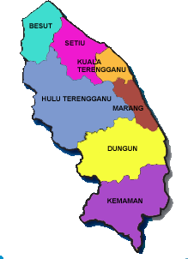
Housing in the Study Area
1991-2000: Housing construction by private sector 70%, public sector 30%.
However, public sector main producer for housing for low and low-medium income groups.
(Terengganu State Authority, 2006)
Notes:
The demand and supply situation of LCH in study area.
The above shows market cannot be relied to supply low cost housing in study area.

Slide 14
Phase 1: Semi-structured Interviews with key informants& secondary data collection (October – November 2009)
No. | Code | Role of Organisation
1 | State Official 1 (S1) | Producer and policy maker of low cost housing (State)
2 | State Official 2 (S2) | Producer and implementing agency (State)
3 | State Official 3 (S3) | Producer and implementing agency (State)
4 | State Official 4 (S4) | Town planning (State)
5 | Federal Official 1 (F1) | Economic planning of study area (Federal)
6 | Federal Official 2 (F2) | Property information centre (Federal)
7 | Federal Official 3 (F3) | Property information centre (Federal)
8 | Federal Official 4 (F4) | Technical supervision of low cost housing projects (Federal)
9 | Federal Official 5 (F5) | Policy maker of low cost housing (Federal)
10 | Federal Official 6 (F6) | Town planning (Federal)
11 | Federal Official 7 (F7) | Town planning (Federal)
12 | Local Authority Official 1 (L1) | Secretariat for approval of development proposals (Local)
13 | Developer 1 (D1) | Government-linked Private Developer
14 | Developer 2 (D2) | Private Developer
Notes:
14 interviews with key actors representing different interests across the spectrum (both public and private sectors):
4 state officials, 7 federal officials, 1 local authority official, 2 developers.
Interviews in local Malay dialect, standard Malay and English.
Translated & transcribed.
Analysed & coding.

Slide 15
FINDINGS
Structure of government has a major role to play in implementation of housing regulations.
Roles of agents:
State Authority.
Producer & policy maker.
Development, distribution, finance, management and enforcement.
Federal Government.
General policy guidance
Funding
Private housing developers.
Small scale.
Avoid legal requirement (30% low cost component in development above 10 acres).
Notes:
Structure of government as per Federal Constitution has a significant impact on how regulations are implemented.
Federal Government provides general housing objectives BUT State Authority has full power in refining and implementing them.

Slide 16
FINDINGS: Interviewees' Perception of Key Institutional and Governance Issues in the Implementation of Housing Regulations
Interviewee | Selective Implementation | Local Capture | Political input | Local culture input | Clientelism | Power play
S1 | ✔ | ✔ | ✔ |  | ✔
S2 | ✔ | ✔ | ✔ | ✔
S3 | ✔ | ✔ | ✔ | ✔ |  | ✔
S4 | ✔ | ✔ | ✔
F1 |  |  | ✔
F2 |  |  | ✔
F3 | ✔ | ✔ |  | ✔ |  | ✔
F4 |  |  | ✔ | ✔ | ✔ | ✔
F5 | ✔ | ✔ | ✔ | ✔ | ✔
F6 | ✔ | ✔ |  | ✔ |  | ✔
F7 | ✔ | ✔ |  |  | ✔ | ✔
L1 | ✔ | ✔ | ✔ | ✔ | ✔
D1 | ✔ | ✔ | ✔ |  | ✔
D2 | ✔ | ✔ | ✔ |  |  | ✔
Notes:
Do not dwell on this slide.

Slide 17
Some selected key issues: Selective implementation
Generic provisions and standards from federal government.
Lack of top-down implementation system.
Non-mandatory Federal inputs.
Flexibility is a potential source of tensions and benefits.
“...(T)he guidelines also contain non-numerical items, descriptive... such as requirement to be near to a community hall. So the word ‘near’ is itself subjective. Is 1 kilometre near? Is 100 metres near?” (State Official 4).
“The guideline just gives the direction, it’s up to you to make a layout that is more creative or contains something new. We have to think far, take into consideration various factors” (State Official 4).
Notes:
Selected issues

Slide 18
Some selected key issues: Local capture
Federal/State division.
Although central housing policy (Malaysia Plan) is provided by Federal Government, State Authority holds absolute power over land and low cost housing.
Terengganu low cost housing recipients enjoy better housing quality than other regions.
At what long term effects?
“When I asked you (the Ministry of Housing and Local Government) to solve a problem you said it it’s a State matter... It’s a very difficult. The Ministry is sometimes a toothless tiger” (Developer 2).
“Our low cost terraced houses are comparable with other people’s medium cost terraced... The ceiling height is now raised (State Authority 3).

Slide 19
Some selected key issues: Political input
Highly politicised.
State Authority under ruling party UMNO, but ruled by opposition party PAS in 1998. Political interference under both parties.
Most noticeable in distribution process even with Open Registration System.
Also evident in location choice, enforcement and development rate.
“To say there is no political interference would be lying. Especially at distribution level (State Official 4).

Slide 20
Conclusion
Findings highlight:
Importance of studying how regulations are implemented i.e. regulations have no uniform impact.
Structure of government potential source of tensions/benefits.
Selective implementation.
Local capture.
Political input.
Clientelism.
Power play.
The State provides better outcome than market in provision of low cost housing in study area despite Malaysia Plan.
Next stage: examine perception of developers and planners.

Slide 21
Thank you.
Question & Answer
h.hamzah@auckland.ac.nz

Slide 22
Other key issues: Local culture input
Cultural approach in property studies (Guy & Henneberry, 2000; 2002).
Study area comprises indigenous Malay, west coast of Malaysia more ethnically mixed.
Tensions between Federal and State agencies.
Islamic and Malay cultural laws are additional sources of law Kiah v Som [1953] 19 MLJ 82.
Federal housing regulations may be influenced by local cultural factors.
“Sometimes the Local Authority does not want to give the information or entertain us... the assistance from Local Authorities is lacking. There is lack of cooperation” (Federal Official 3).

Slide 23
Other key issues: Clientelism
The act of politicians providing tangible or intangible benefits to his supporters in exchange of votes that would enable him to gain or stay in power.
Low cost housing as a political tool to ensure continuous support from the low income population.
Tenure as expandable: long term implications under the National Land Code especially upon redevelopment.
“Where the money comes from is secondary, but rakyat diutamakan (“the people come first” – a popular political slogan)... They want to pull back the voters.” (Federal Official 5).
“A house for a vote, yes. In order to keep the (political) interest, whoever’s interest” (Local Authority Official 1).

Slide 24
Other key issues: Power Play
Perceived superiority of Federal/State and State/State agencies.
Power of Federal agencies in terms of manpower and funding sometimes used as bargaining chips.
Hindrance to effective implementation of housing policy as the perceived superior agency may pull rank on a ‘lesser’ agency.
Example of power play: Terengganu lost its position as the main East Coast petrochemical port to a neighbour state.
“(T)hey should have worked collectively. Unfortunately, maybe because out of habit certain department feel that their word or say are much more prominent than others... Power play...” (Federal Official 4).
There is infighting” (State Official 4).

