Slide 1
Determinants of The Capital Structure OF Residential PROPERTY COMPANIES
Björn-Martin Kurzrock
Frieder Mokinski
Felix Schindler
Peter Westerheide

Slide 2
Motivation of the Research
Concept of financial leverage is a paradigm in real estate investment
Debt offers a variety of benefits and downsides that affect financial performance in multiple ways
Do German Residential Property Companies (RPCs) systematically adjust their capital structure?

Slide 3
Aim of the Research
Identify considerations that drive the capital structure choice of German RPCs
Identify differences among the major legal forms (eG, GmbH, GmbH & Co. KG, AG)

Slide 4
Potential Considerations I: Overview
Pecking Order Theory:
Firms prefer internal to external funding ↔ asymmetric information costs
Trade Off Theory:
Firms choose capital structure as a compromise between costs and benefits of debt and equity funding
Market Timing Theory:
Firms adjust capital structure to market prices of debt and equity

Slide 5
Potential Considerations II: POT
Pecking Order Theory (Myers/Majluf 1984) I:
Management: superior information, acts in owners’ interest
Outside investors: inferior information; reasoning: management raises equity capital if & only if company is overvalued by market
→ Asymmetric information ↔ raising equity capital harms owners

Slide 6
Potential Considerations III: POT
Pecking Order Theory (Myers/Majluf 1984) II:
Debt: lower exposure to information asymmetry ↔ fixed payment…
Hierarchy of financing sources: 1. retained profits, 2. debt, 3. equity
Empirical implication: Unless leverage is extreme, financing deficits are covered through debt:
“Change in Debt” = “Financing Deficit”

Slide 7
Potential Considerations IV: TOT
Trade Off Theory (inter alia Kraus/Litzenberger 1973) I:
Capital structure choice balances benefits and costs of financing sources/additional leverage
Benefits of Debt:
tax shield, mitigation of agency conflicts between owner and manager, monitoring/control etc.
Costs of Debt:
growing bankruptcy risk, rising costs of financial distress, agency conflicts between manager and bank (e.g. incentive for asset substitution) etc.

Slide 8
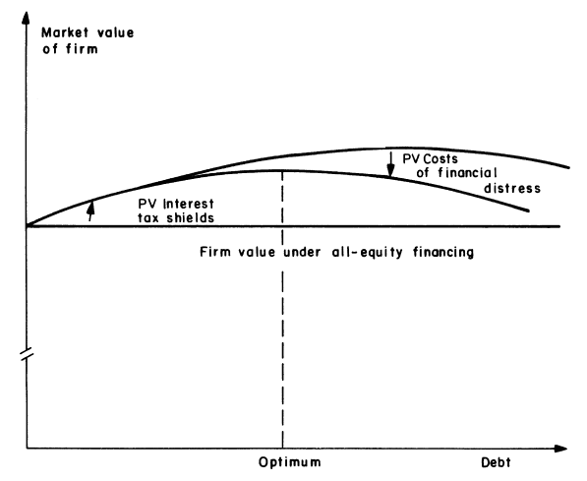
Potential Considerations V: TOT
Target Debt Ratio
From: Shyam-Sunder/ Myers (1999), p. 220.

Slide 9
Potential Considerations VI: TOT
Trade Off Theory (inter alia Kraus/Litzenberger 1973) II:
Empirical Implication:
Firms adjust their leverage towards a target debt ratio:
“Change in Debt” = “a” x (“Actual Debt”–“Target Debt”)
“a” є [-1,0] – share of the deviation of actual debt from target debt that is closed during a period

Slide 10
Potential Considerations VII: MTT
Market Timing Theory (Baker/Wurgler 2002):
Firms:
issue equity when equity prices are high and costs of equity are low compared to interest on debt
Potentially long lasting effects on the capital structure
Influence of structural characteristics of the firm can be blurred
Not tested here

Slide 11
Data I: Overview
Panel of German RPCs (Dafne Database/ Bureau van Dijk)
Sample period: 1996 – 2009
(Unsystematic) missing values reduce regression samples
>1,300 companies

Slide 12
Data II: Summary Statistics
Leverage Ratios, Financing Deficits, Target Debt Ratio:

Slide 13
Empirical Strategy I: POT
Tests according to Shyam-Sunder/ Myers (1999) (and others)
Stylized POT test regression: ΔD_{it} = a + b_{POT}DEF_{it} + e_{it}
where
ΔD_{it} = Net change in debt of firm i in period t, and
DEF_{it} = Financing deficit of firm i in period t, and
a & b_{tot} are coefficients, and
e_{it} = random disturbance.
Modification: DEF_{it} interacted with legal form dummies
Prediction of the POT: a = 0, b_{POT} = 1

Slide 14
Empirical Strategy II: POT
Construction of involved variables:
ΔD_{it} = D_{it} – D_{it-1}
where
D_{it} = overall Debt of firm i in period t
Financing deficit:
DEF_{it} = DIV_{it} + X_{it}+ ΔW_{it} – C_{it}
where
DIV = dividend payments
X = capital expenditure ( = change in tangible assets)
ΔW = net increase in working capital
C = operating cash flow after interest and taxes
Note: No equity issues/ repurchases in DEF! Equity issues at high debt levels will improve the fit of TOT model and degrade the fit of this POT model (Shyam-Sunder/ Myers (1999), p. 225)

Slide 15
Empirical Strategy III: TOT
Stylized TOT test regression:
ΔD_{it} = a + b_{TOT}(D_{it-1} - D*_{it-1}) + e_{it}
where D*_{it} = target debt level
Modification: DEF_{it} interacted with legal form dummies
Prediction of the TOT: b_{TOT} є [-1,0]
(implying adjustment towards target ratio and positive adjustment costs)
Construction of D*: [simple/ moving] average of firm leverage over preceding years (cf. Shyam-Sunder/ Myers 1999)

Slide 16
Empirical Results: POT

Slide 17
Empirical Results: POT
POT:
  Coefficients fairly stable across specifications
  GmbH (base cat.): cover 23% of DEF through debt
  eG coefficent closest to 1 (0.63)
  AG and GmbH & Co. KG coefficient not significantly different from 0
  POT prediction fails for AGs – i.e. where we would expect it to hold ≠ Shyam-Sunder/ Myers (1999)

Slide 18
Empirical Results: TOT

Slide 19
Empirical Results: TOT
TOT:
  Again: fairly stable across specifications
  Coefficient significantly different from zero only for GmbHs and eGs; however, small coefficients, low R²
  → Minor adjustment towards a target ratio

Slide 20
Empirical Results: Interpretation
Except for GmbHs and eGs: No indication of systematic adjustments to capital structure! – WHY?:
Firms exploit cheapest sources of funding available when they need to cover a financing deficit? (Market timing theory?)
Failure to maximize company value?
Considerations such as information asymmetries fail for RPCs: rare growth opportunities, largest part of firm assets are tangible?

Slide 21
Limitations & Further Research
Simple models to test POT and TOT
No test of MTT (yet)
Impact of financial leverage on the performance of property companies (requires long-term analysis)
Relationship with stock performance for publicly-traded companies

Slide 22
Contact
  Dr. Björn-Martin Kurzrock*
  Frieder Mokinski**
  Dr. Felix Schindler**
  Dr. Peter Westerheide**
* University of Kaiserslautern
Dept. A/ RU /BI
Paul-Ehrlich-Straße 14, D-67663 Kaiserslautern
kurzrock@rhrk.uni-kl.de
** Center for European Economic Research
Dept. Int. Finance and Financial Management
P.O.-Box 10 34 43 D-68034 Mannheim
mokinski@zew.de; schindler@zew.de; westerheide@zew.de

