Slide 1
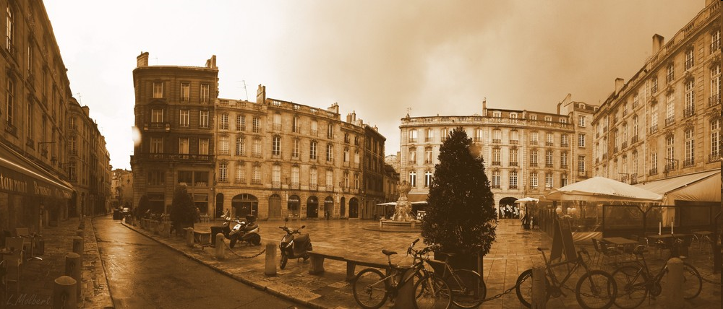
PLACE, PLAZZA, PIAZZA
Reading of an effect of centrality on price structure of housing
Empirical evidence on a french city
Benoit FAYE and Eric LE FUR
INSEEC Business Schools

Slide 2
From public space to urban plaza:
research of definition
Plaza is a hinge of the urban structure (LAVEDAN, 1959) ie the central location of a structure or a link between two structures. Yet it‘s in the literature on public spaces and not in that of centrality we found the description of the dimensions of plaza.

Slide 3
Economic Dimension
Degree of commodification
(Sorokin, 1992 ; Boyer, 1994 ; Zukin, 1995 ; Loukaitou-Sideris, 1996 ; Mordue, 2007 Carmona et De Magalhaes, 2006)
Social Dimension
from community to discrimination
(Mandanipour (1999)
Lehrer (1998) Atkinson, 2003 ; Dixon et al., 2006)
Fyfe et Bannister 1996)
Korosec-Serfaty and Kauffmann, (1974) Racine (1999)
Rappa (2002)
Characteristics of the plaza
(Cα)
architectural dimension
Control (or not) of the design of the place by the residents
(Lavedan, 1959)
Symbolic dimension
or tourism dimension if authenticity of the place
(Meethan, 1997 ; (Walzer, 1986)) , Fraisse (1987) et Augé (1992)

Slide 4
2. Asumptions and methods
The hedonic model
C^{ij}_{α} = (C^{ij}₁…, C^{ij}_{m}, C^{ij}_{m+1}, …, C^{ij}_{m+n})
H1: each resident (i) has the same perception of the characteristics of the plaza (j)
H2: the environment of the housing (i) is only defined by characteristics of the plaza (j)
H3: we suppose derivability (twice) and continuity of functions
U^{i} = U^{i} (C^{ij}_{α}, a^{i}, Z)
R^{i} = Pij(C^{ij}_{α}) + p_{z}Z
MAX U^{i} (C^{ij}_{α}, a^{i}, Z) / R^{i} - P_{ij}(C^{ij}_{α}) – p_{z}Z = 0
C^{ij}_{α} = ζ (P^{ij}, R^{i}, a^{i})

Slide 5
Introduction of the neighbourhood
We suppose (j) belonging to neighbourhood V(j), (Galster et al.2000), in which the socioeconomic conditions of the households (i) and their income are homogeneous (H3). We can write
P_{ij} = ζ-1 (C^{ij}_{α})
As fluently used in the literature, we suppose that this function is a Cobb – Douglas.
_{m+n}
P_{ij} = ζ⁻¹ (C^{ij}₁…, C^{ij}_{m}, C^{ij}_{m+1}, …, C^{ij}_{m+n}) = Π (C^{ij}_{α} )^{aα}
^{α=m+1}

Slide 6
Are the internal characteristics of the housing always necessary?
We suppose that the livable surface is the main explanatory factor of the price (40% according to Cavailhes (2005), 80% on the top of the cycle according to Faye and Le Fur, 2008) and the architectural homogeneity of the plaza. So, we can admit that
P^{ij} = ζ⁻¹ (C^{ij}_{s}, C^{ij}_{m+1}, …, C^{ij}_{m+n} )
Or by dividing each term by the surface
(P^{ij}/ C^{ij}_{s}) = p^{ij} = ζ⁻¹ (C^{ij}_{m+1}, …, C^{ij}_{m+n} ) = Π (C^{ij}_{α} )^{aα} (A)
Here, we are able to obtain implicit prices of each characteristic by a partial derivation.

Slide 7
Introduction of time to increase the representativeness
p_{t}^{ij} = Π (C^{ij}_{αt} )^{aα}
p_{rt} ^{ij}= p_{t}^{ij}/P V_{(j)t} = Π (C^{ij}_{αt})^{a’α}
Ω_{j} = (1/ τ) ∑ ln(p^{ij}_{rt}) =(1/ τ) ∑ {Π (C^{ij}_{αt})^{a’α}} = Π (C^{ij}_{αt})^{a’α}
LnΩ_{j} = ∑ a’_{α} (C^{ij}_{αt}) = a’_{m+1}lnC^{ij}_{m+1}+ …+ a’_{m+n} lnC^{ij}_{m+n}
a’_{α} represents the characteristic elasticity of the average of the relative prices on the period.
if the variables are quantitative, the coefficients are estimated by multiple regression and their significance is provided by the Student test.

Slide 8
Typical forms of the spatial structure of elasticity depending on the distance of the plaza.
lnΩ_{j}
0
distance
d₀

Slide 9
3. Different databases in France
Indices | Company | Source | Price | Number of trasactions per year | Cover rate
Notaires-INSEE Index | CINP, Perval INSEE | Internal | Selling price | About 500 000 | About 2/3 of national transactions
FNAIM Index | FNAIM (National federation of estate agents) | Internal | Selling price | 150 000 | Between 20 to 25% of national transactions
DIA | Notaries | Internal | Price reported by sellers | From 749 to 12418 per year on the studied period | All property subject to preemption
City: Bordeaux (France)
Data: DIA (1985-2008)
Sample: 54 plazas

Slide 10
Characteristics | Description of the variable
Nature tourism (TOURISM) | Number of sightseeing tours through the plaza
Level of deviance (DEV) | Article number of facts about the place in the local press
Public transport (TRANSIT) | Bus / tram present on the plaza
Disruption of public transport (STOP) | Bus / tramway stations
Supermarket (SUPMK) | Supermarket
Retail (RETAIL) | Retail shop
Bars and restaurants (BARESTO) | Bars (night), night club and restaurants.
Community facilities (ADMBUILD) | Prefecture, city hall, chamber of commerce, embassy
Culture (CULTUR) | cinema, theater, opera, art galerie, museum
Religious building (CHURCH) | Church, basilica, cathedral, mosque
Number of angles (FORM) | 0: round ; 2: open square ; 3: triangle ; 4: rectangle ; 5: more than 4 sides
Weight (SP) | 1: small ; 2: medium ; 3: great ; 4: very great
Vegetation (COVER) | null (0), weak (1), medium (2) dense (3)
Number of decorative monuments (ORN) | statue, fountain, tower, covered market
Number of lanes (WAY) | Pedestrian (0 lane), limited access (1 lane), normal trafic (2 lanes), dense trafic (3 lanes) very dense (4 lanes)
Carpark (SIDEPK) | Parking autobilateral (2), lateral (1), no parking (0)
Proximity of centre (CENTR) | Centre (1), pericentre (2), distant (3)

Slide 11
4. Model estimation, results and discussion
On the whole sample
Variables (ln) | Regression with all variables | Variables (ln) | Best model
 | a’_{α} |  | a’_{α}
Constante | 0,237 | STOP | -0,149*
STOP | -0,357 | BARREST | -0,169**
BARREST | -0,101 | ADMBUILD | 0,447**
ADMBUILD | 0,333* | COUVER | -0,180**
COVER | -0,178* | TOURISM | 0,232**
CENTR | -0,109 | SIDEPK | -0,182*
TOURISM | 0,155
DEV | -0,040
TRANSIT | 0,119
SUPMK | -0,287
FORM | -0,097
RETAIL | 0,016
CULT | -0,303
CHURCH | 0,027
SP | 0,044
ORN | 0,006
WAYS | 0,015
SIDEPK | -0,127

Slide 12
Typology of urban places in the literature
Functional typology (Lavedan, 1959) | Plaza of monuments
 | Plaza of gathering
 | Plaza of traffic
 | Plaza of junction
Typology of representation (Levy, 2008) | Plaza very known (hyper-centre)
 | Plaza of neighborhood (centre)

Slide 13
By level of centrality
 | Optimized model hyper-centre (probability of FISHER = 0.003 R² = 0,735 ; R²aj = 0.594) |  |  |  | Optimized model centre (probability of FISHER = 0.018 R² = 0,446)
VARIABLES | Tolerance | Value | Pr > |t| | VARIABLES | Tolerance | Value | Pr > |t|
Constant | - | 0,918 | 0,001 | Constant | - | 0,000
STOP | 0,527 | -0,165 | 0,201 | STOP | 0,712 | -0,215 | 0,114
COVER | 0,804 | -0,168 | 0,104 | ADMBUILD | 0,786 | 0,665 | 0,003
TOURISM | 0,813 | 0,121 | 0,080 | COVER | 0,922 | -0,217 | 0,036
SUPMK | 0,548 | -0,503 | 0,082 | TOURISM | 0,716 | 0,196 | 0,100
FORM | 0,602 | -0,569 | 0,000 | DEV | 0,670 | -0,099 | 0,039
RETAIL | 0,717 | -0,090 | 0,070 | SIDEPK | 0,817 | -0,335 | 0,055
CHURCH | 0,757 | 0,344 | 0,022
WAYS | 0,721 | 0,205 | 0,065

Slide 14
By type of plaza: research of a typology
Principal factor extraction and rotation VARIMAX:
- correlation between factors below 0.33 in the oblimin procedure (Iacobbuchi, 2001)
- shows a structure quite similar to the functional typology of Lavedan.
The total variability returned (38,7%):
- selection of factors by the method KAISER-GUTTMAN
- alpha of CRONBACH: 0.792 for D1, 0.737 for D2 and 0,578 for D3
VARIABLES | D1 (merchant) | D2 (traffic) | D3 (touristic)
STOP | 0,217 | 0,637 | 0,128
BARREST | 0,965 | -0,067 | 0,141
ADMBUILD | 0,081 | 0,554 | 0,118
CENTR | -0,099 | 0,007 | -0,842
TOURISM | 0,309 | 0,110 | 0,704
DEV | 0,626 | 0,338 | 0,078
RETAIL | 0,589 | 0,388 | 0,232
CHURCH | 0,019 | -0,078 | 0,395
SP | 0,245 | 0,696 | 0,009
ORN | 0,519 | 0,142 | -0,040
WAYS | -0,184 | 0,668 | -0,096
SIDEPK | -0,189 | 0,514 | -0,009

Slide 15
Variables | Tourist dimension (R² = 0.657 ; R²aj = 0,588 ; probability of Fisher < 0,0001) |  | Traffic dimension (R² = 0.364 ; probability of Fisher = 0.084) |  | Merchant dimension (R² = 0.482 ; Probability of Fisher = 0.000)
Parameters | Value | Pr > |t| | Value | Pr > |t| | Value | Pr > |t|
Constant | 1,004 | < 0,0001 | 0,000 |  | 0,000
CENTR | -0,247 | 0,003 |  |  | -0,144 | 0,060
TOURISM |  |  | 0,173 | 0,055
SUPMK | -0,449 | 0,082
SIDEPK |  |  | -0,282 | 0,075
ADMBUILD |  |  | 0,376 | 0,042 | 0,405 | < 0,0001
STOP | -0,262 | 0,005 |  |  | -0,374 | 0,001
FORM | -0,454 | 0,000 | -0,183 | 0,053
CULT | -0,879 | 0,005 |  |  | -0,748 | 0,027

Slide 16
5. Permanence of residential valuations in the space and time
Are the effects of characteristics of public squares remain in space? Or, how the effects of characteristics on residential values are altered according to the distance to places?
Are the effects of characteristics of places are maintained over time? or how urban regeneration alter the residential values?

Slide 17
The spatial structure of prices around places
 | BIR HAKEIM | SARRAIL | PALAIS | CHARTRONS | d1 PALAIS | d1 Bir Hakeim | d1 SARRAIL | d1 CHARTRONS
No. of obs | 14 | 12 | 103 | 59 | 594 | 330 | 256 | 141
1st Quartile | -0,369 | -0,012 | -0,149 | -0,049 | -0,589 | -0,268 | 0,877 | -1,098
Median | -0,330 | 0,125 | 0,077 | 0,000 | -0,145 | -0,064 | 1,274 | -0,387
3rd Quartile | -0,326 | 0,511 | 0,189 | 0,216 | 0,119 | 0,155 | 1,643 | 0,129
Mean | -0,254 | 0,098 | 0,002 | 0,050 | -0,228 | -0,094 | 1,318 | -0,460
Standard deviation (n) | 0,257 | 0,583 | 0,307 | 0,291 | 0,478 | 0,428 | 0,582 | 0,695
Skewness (Fisher) | 1,709 | -1,003 | -1,529 | -0,333 | -0,266 | -1,138 | 0,503 | -0,362
Kurtosis (Fisher) | 2,183 | 1,272 | 3,476 | 0,821 | 2,249 | 7,009 | 0,153 | -0,905

Slide 18
Impact of urban regeneration programs on residential values
Places type | No. of obs | 1st Quart | Med | 3rd Quart | Mean | sd (n) | Skewness (Fisher) | Kurtosis (Fisher)
BIRHAKEIM A | 22 | -0,612 | -0,245 | 0,271 | -0,156 | 0,501 | 0,454 | -0,931
BIRHAKEIM B | 12 | -0,334 | -0,326 | -0,326 | -0,221 | 0,305 | 1,326 | 0,447
Camille JULIAN A | 8 | -1,070 | -0,932 | -0,698 | -0,891 | 0,523 | -0,337 | 1,236
Camille JULIAN B | 6 | -0,248 | 0,015 | 0,279 | 0,094 | 0,382 | 0,772 | -0,621
JEAN JAURES A | 19 | -0,382 | -0,035 | 0,000 | -0,119 | 0,371 | 1,715 | 5,878
JEAN JAURES B | 26 | -0,082 | 0,230 | 0,302 | 0,112 | 0,319 | -1,016 | 0,562
PEY BERLAND A | 97 | 0,013 | 0,192 | 0,470 | 0,203 | 0,440 | -1,210 | 4,138
PEY BERLAND B | 21 | -0,250 | 0,078 | 0,179 | -0,039 | 0,391 | -1,728 | 5,133
Note: A before renovation ; B after renovation.

Slide 19
Conclusion
If the new urban economy requires that residential values increase with proximity to a center containing a transport hub, jobs, shops, cultural activities and urban qualities, a micro-localized study shows that proximity to these features generates externalities very negative.
For places of hyper-centre, proximity to commercial activities, traffic flow and openness have a significant adverse effect. The visitor and the presence of administrative jobs have positive impacts.
For places of hyper-centre, the presence of trade-related transport, trade, cultural activities have a negative impact on tourist places and even on market places, while tourism and community facilities have a positive impact on the development of places of traffic.
The negative effects of commercial and of transportation routes are decreasing when we move away plazas.
The outskirts of tourist places suffer from the presence of a traffic, but values become again normal beyond.
In short, the characteristics which attract towards the centre are also them which repel when we are to the centre. There is a conflict of interest between residents and non residents of the centrality.

Slide 20
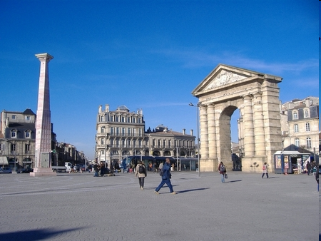
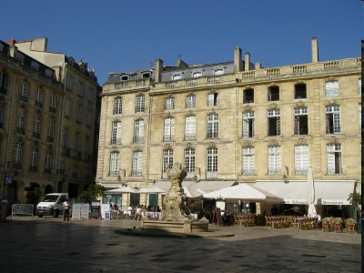
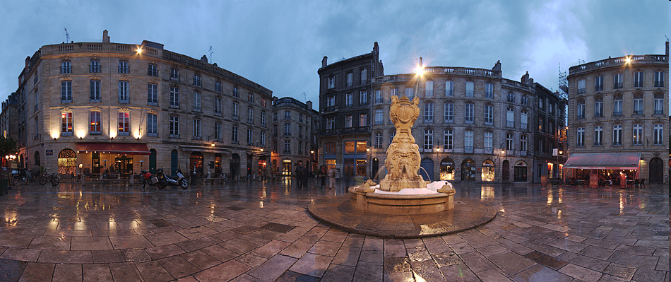

Slide 21
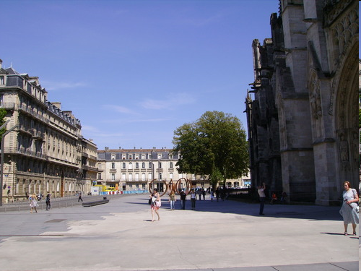
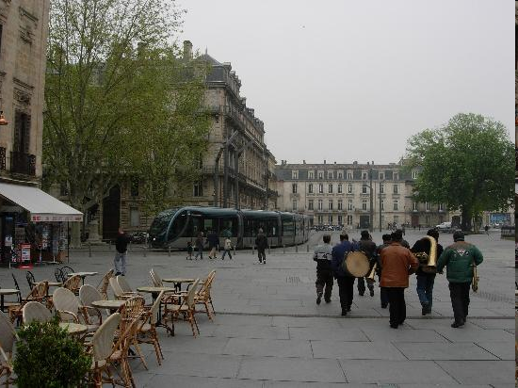
Place Pey Berland

Slide 22
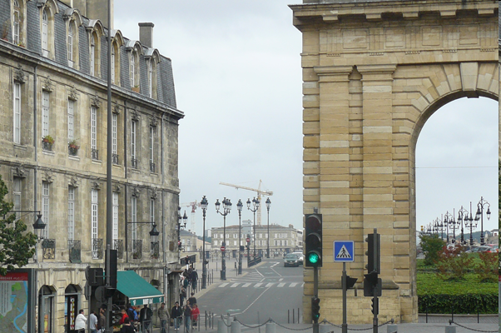

Place du Palais

Slide 23
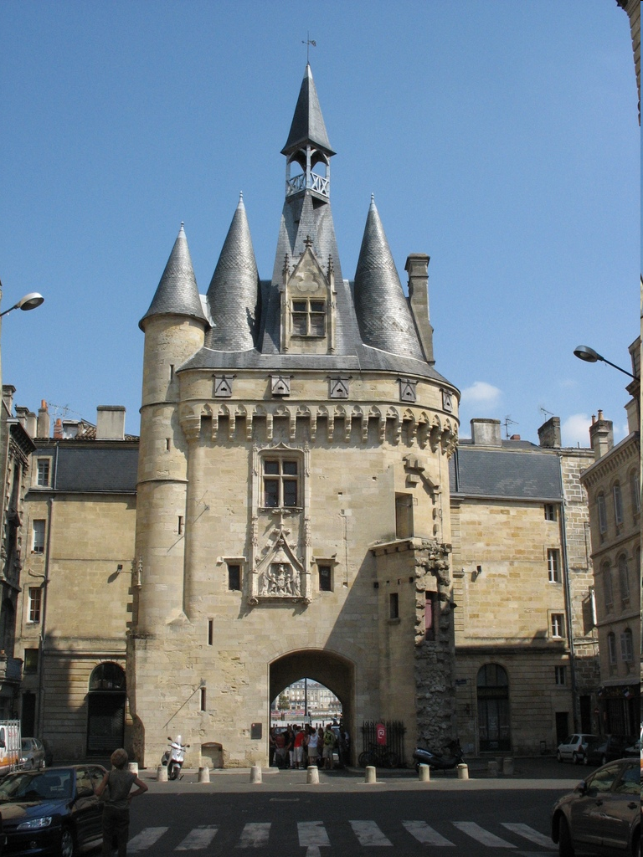
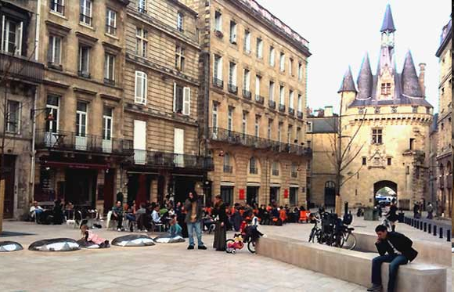
Place du Palais

Slide 24
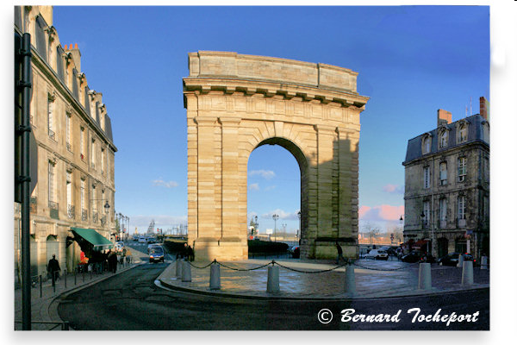
Place Bir Hakeim

Slide 25
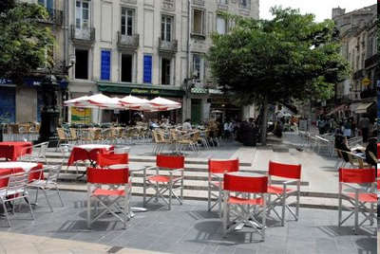
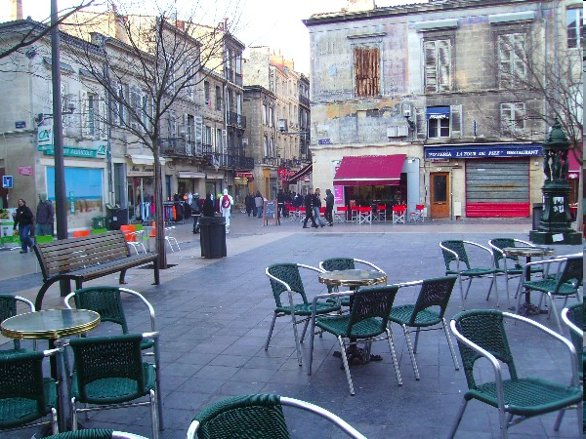
Place du général SARRAIL

Slide 26
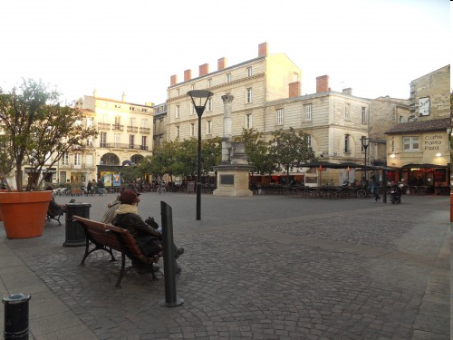
Place Camille Julian

Slide 27
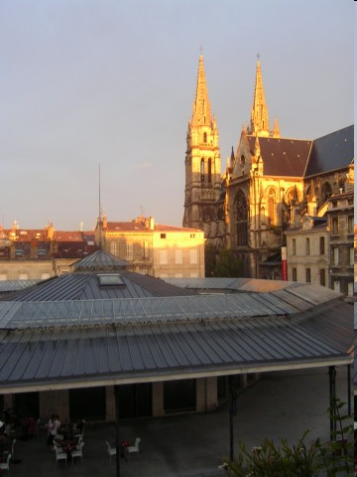

Place du marché des chartrons

