Slide 1
The Contribution of Solar Energy to Green Buildings
Meeting Environmental and Economic Objectives
Andrea Bodenhagen
Solar Integrated Technologies GmbH
www.solarintegrated.com
16th European Real Estate Society Conference 2009, Stockholm

Slide 2
Advantages and benefits of photovoltaic installations
Solar technology
Solar Integrated’s approach
Case study

Slide 3
Ecologic advantages and benefits
Stable climate
Achieving Kyoto protocol objectives of max. 2°C rise of global temperatures compared to pre-industrial conditions
Reduce threat of increasing natural catastrophes, inherent costs for relief and rebuilding and political instability
Energy security
Reduce dependence on fossil fuels, access cost and overall energy costs
Developing a sustainable, unlimitedly available energy resource with decreasing cost levels for energy generation
Health and well-being
Reduce health impairing emissions
Improve overall health and well-being

Slide 4
Balancing CO₂ emission is not an option
Space required for a 200 kWp PV system
262 MWh / year of electricity
Life time 30 years
7000 ts CO₂ emission saving
Space required for a forest to balance the CO₂ emissions from generating the same amount of electricity with fossil fuels:
⇨ 7.000.000m² or 980 soccer fields

Slide 5
Monetary economic benefits
Additional revenue
Lower costs at peak times
Decreasing energy costs
Stable return on investment
Feed-in tariffs
Incentive schemes
Feed-in tarffs offer a guaranteed return on investment
Peak times are usually around midday, when PV systems generate the most energy
Unlimited resources
Rising production levels allowing to reach economies of scale

Slide 6
Feed-in Tariffs in Europe
 | Small Up to 30 kWp | Middle 30 kWp – 100kWp | Large 100 kWp – 1MW | Extra – Large > 1MW
Austria | €ct 28 - 44 / kWh | €ct 28 / kWh | €ct 28 / kWh | €ct 28 / kWh
Bulgaria | €ct 36,7 - 40 / kWh | €ct 36,7 / kWh | €ct 36,7 / kWh | €ct 36,7 / kWh
Czech Republic | €ct 45,8 / kWh | €ct 45,4 / kWh | €ct 45,4 / kWh | €ct 45,4 / kWh
France BIPV | €ct 60,176 / kWh | €ct 60,176 / kWh | €ct 60,176 / kWh | €ct 60,176 / kWh
Germany | €ct 43,01 / kWh | €ct 40,91 / kWh | €ct 39,58 / kWh | €ct 33 / kWh
Greece Greece Islands | €ct 45 / kWh €ct 50 / kWh | €ct 45 / kWh €ct 50 / kWh | €ct 40 / kWh €ct 45 / kWh | €ct 40 / kWh €ct 45 / kWh
Italy BIPV BAPV | €ct 43,12-48,02/ kWh €ct 39,2- 43,12/kWh | €ct 43,12 / kWh €ct 39,2 / kWh | €ct 43,12 / kWh €ct 39,2 / kWh | €ct 43,12 / kWh €ct 39,2 / kWh
Luxembourg | €ct 42 / kWh | €ct 37 / kWh | €ct 37 / kWh
Netherlands | €ct 40 / kWh | €ct 40 / kWh
Portugal | €ct 40 - 55 / kWh | €ct 40 / kWh | €ct 40 / kWh | €ct 40 / kWh
Slovakia | €ct 45 / kWh | €ct 45 / kWh | €ct 45 / kWh | €ct 45 / kWh
Spain | €ct 34 / kWh | €ct 34 / kWh | €ct 32 / kWh | €ct 32 / kWh
Source: DENA, own research

Slide 7
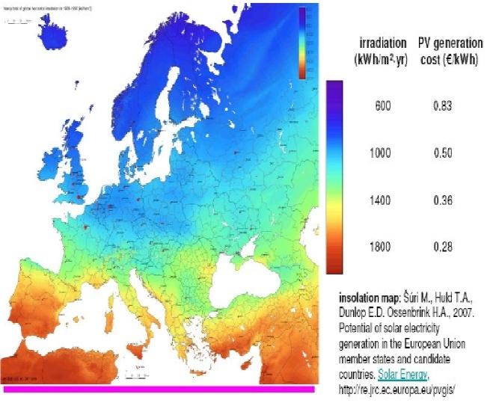
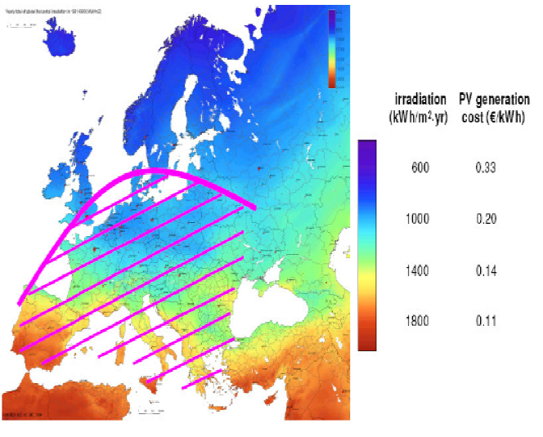
European solar energy reaching grid parity
2007
2010
2015
2020
Source: EPIA – PV Technology Platform

Slide 8
Competitive advantages
Trend towards sustainable products
Customer interest in environmentally friendly products and practices increases
Growing sense for conserving the planet
Strengthening brand reputation
Increased credibility with external stakeholders
Being green increase identification and motivation of employees
Higher shareholder value
Analysts consider environmental concern beyond financial risk to be an indicator for good risk management
Converting to green is considered a catalyst for innovation

Slide 9
Advantages and benefits of photovoltaic installations
Solar technology
Solar Integrated’s approach
Case study

Slide 10
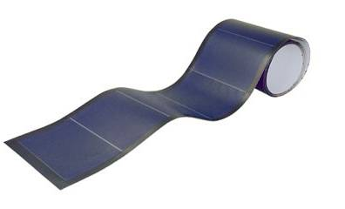
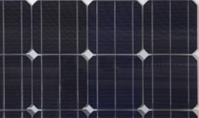
Crystalline versus thin-film
Crystalline silicon cells
Thin-film cells
Mono-crystalline cells made from a solid mono-crystal without grain boundaries
Poly-crystalline cells made from a material composed of various crystallites with visible grains
Cells are extremely fragile and sensitive towards humidity
Encapsulated in glass
Installation tilted (30°) on a substructure with a south orientation
Thin layer of active material coated to a substrate (0,2-5µm)
Main materials used
Amorphous silicon
Copper-indium-diselenide
Cadmium-telluride
Amorphous silicon can deposited on flexible substrates
Amorphous silicon can be encapsulation in flexible materials
Possibility to build flexible modules with amorphous silicon thin-film cells

Slide 11
Efficiency versus energy rating
Efficiency: measures the energy generated per m² under standard test conditions (1000 W/m², AM 1.5, 25°C cell temperature)
Energy rating: measures the energy generated under realistic outdoor conditions, taking brightness, latitude, season, time of the day, air mass, cloud cover, pollution etc. into consideration
⇨ Main indicator of the suitability of a PV system at a certain location
Module Type | Module Efficiency | Energy Rating (measured at the test side of the University of Urbino in Italy, tilt angle 30°) [8]
Thin-film amorphous silicon (triple-junction technology by UNI-SOLAR®) | Approx. 6,5% | 1064 kWh/kWp
Mono-crystalline silicon modules | Approx. 14 % on average | 962 kWh/kWp (average of all mono-c-Si modules at the Urbino facility)
Poly-crystalline silicon modules | Approx. 12 % on average | 936 kWh/kWp (average of all poly-c-Si modules at the Urbino facility)
Source: University of Urbino, Italy

Slide 12
Advantages and benefits of photovoltaic installations
Solar technology
Solar Integrated’s approach
Case study

Slide 13
Philosophy
To reach the objectives of the Kyoto protocol Solar Integrated believes that it is important to:
Create a network of people and companies worldwide, dedicated to reducing their impact on climate change and dependency on fossil fuels
Increase the usage of renewable energy by making low-load bearing roofs and other so far unused space available for photovoltaic systems
Landfills
Large, low-slope roofs
Car-parks

Slide 14
Approach – the SolarRoof Membrane
Lightweight: 4,9 kg / m²
For low load bearing roofs
Light materials and no windloads
Easy to install: hot air welding
Fixation to the roof membrane layer with the same tools
Modules are delivered coiled up and roll right onto the roof
Durable: Tested materials
Membrane with a 40-60 years lifetime
PV technology installed since >10 years and under severe conditions
25 years performance guarantee
High energy yield: more kWhs
Triple junction PV technology
Low temperature coefficient

Slide 15
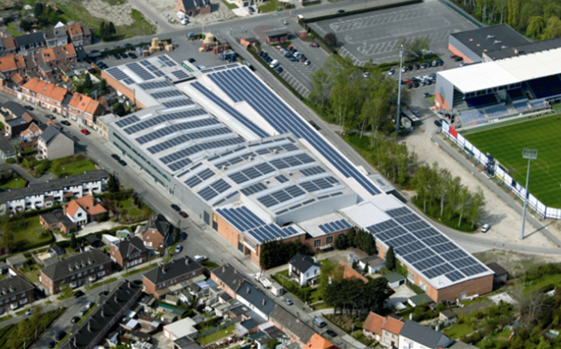
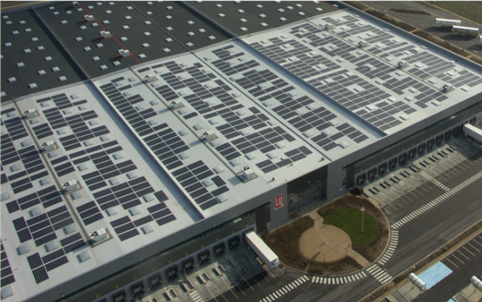
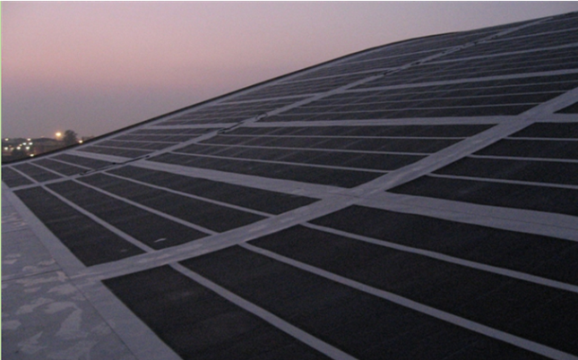
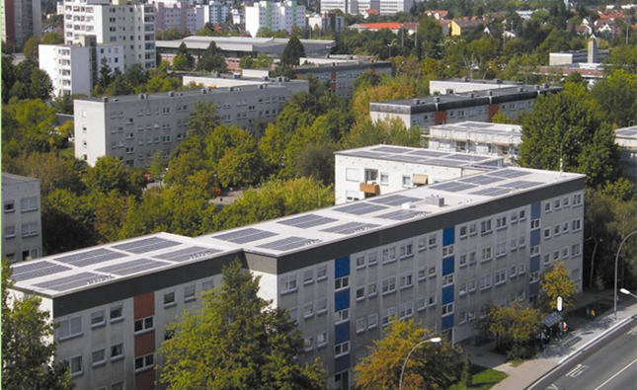
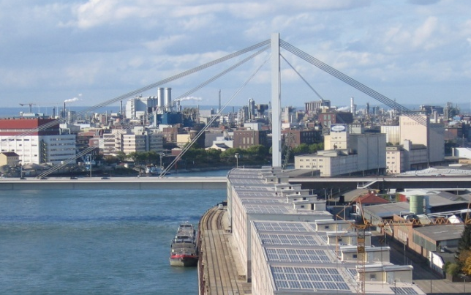
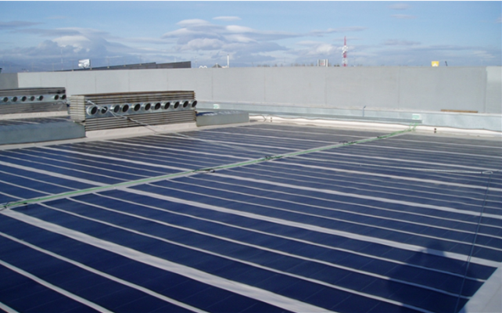
Application examples
Factory, Lokeren, Belgium Logistic center, Paris, France Sports hall, Voghera, Italy
Apartment block, Rüsselsheim, and Warehouse, Mannheim, Germany Shopping Mall, Sta. Olivia, Spain

Slide 16
Advantages and benefits of photovoltaic installations
Solar technology
Solar Integrated’s approach
Case study

Slide 17
Gleisbergschule Mainz, Germany
Installation of the SolarRoof Membrane in the course of a necessary re-roofing.
Technical Data:
Type: SI-T2
Size: 76 kWp
Start of operations: 09/2006
Energy output: 66 MWh / a
Equivalent to the demand of 16,5
four-people households
Specific yield: 872 kWh/kWp
CO₂ emission saved: 58 ts / a
Equivalent to 24 average cars travelling
15.000 km per year

Slide 18
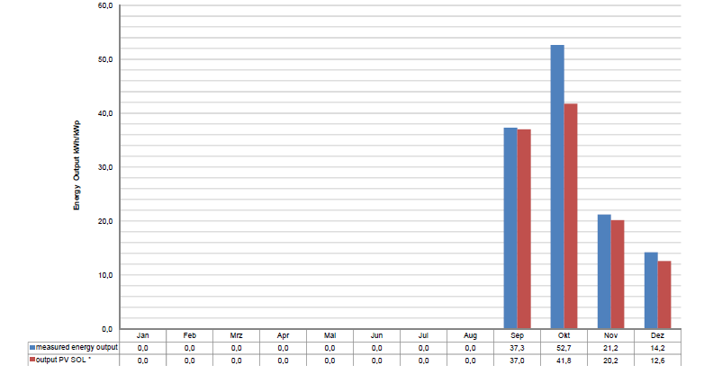
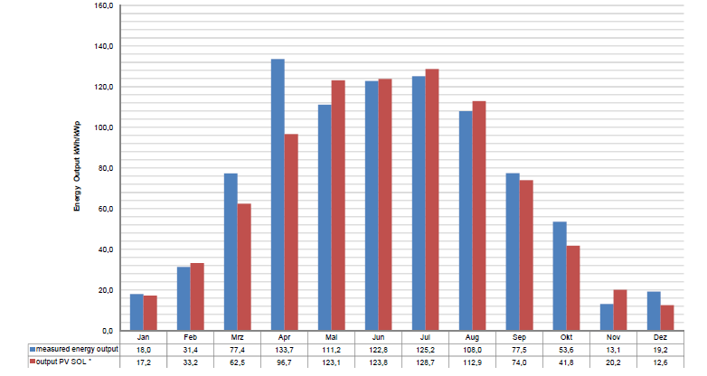
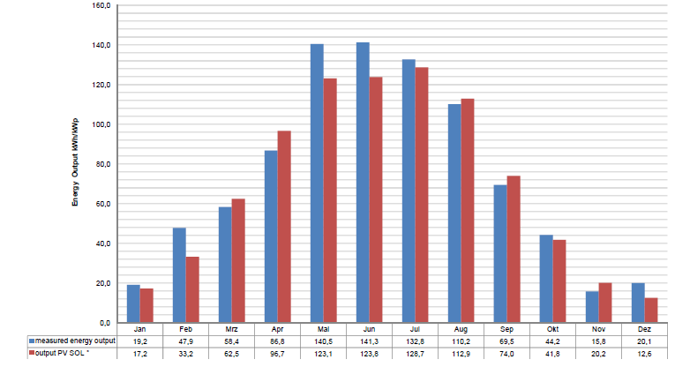
Forecasts versus actual measurements
The investment decision was based on the forecasted energy. The actual measurements continually exceed the forecast.
2006
Forecasted: 112 kWh/kWp
Achieved: 126 kWh/kWp
2007
Forecasted: 872 kWh/kWp
Achieved: 891 kWh/kWp
2008
Forecasted: 872 kWh/kWp
Achieved:
887 kWh/kWp
2006
2007
2008

Slide 19
Conclusion
Kyoto Protocol
Buildings need to play a major part
PV systems generate clean renewable energy
Increase available space for PV
Requires lightweight, easy to install, durable products
SolarRoof Membrane
Turning unused space into an energy generating asset
PV on low-load bearing roofs, such as industrial, commercial, institutional roofs

Slide 20
Thanks for your kind attention
“We may end up with an aggregated grid that uses buildings as primary generators of energy in cities.”
Sandra Mendler, Architect, “Women in Green”
www.solarintegrated.com

